Slide 1
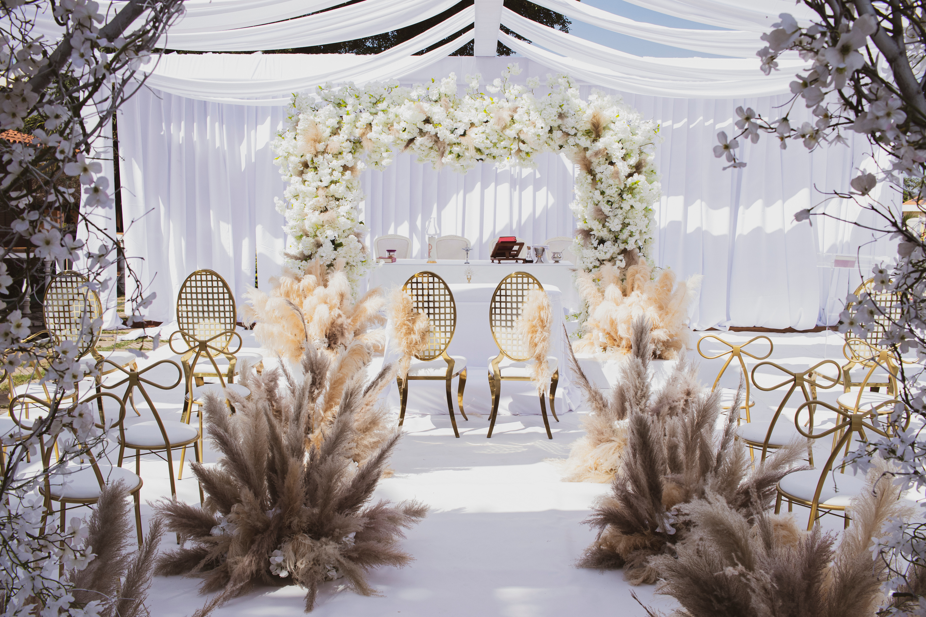


MARINA & FEDERICO
are getting married
3 PM Wednesday 15 November 2023
St. Mary's Church
86 Oak Avenue, Smalltown, Anycity
WEDDING
TIMELINE
WEDDING
PARTY
3:00 P.M
OFFICIANT
Wedding Begins
Rabbi Sarah Cohen
4:00 P.M
PARENTS OF
THE BRIDE
Opening Remarks
John & Mary Johnson
PARENTS OF
THE GROOM
4:15 P.M
David & Susan Smith
Exchange of Vows
MAIDS OF HONOR
4:30 P.M
Emily Wilson
Ring Exchange
BEST MEN
5:00 P.M
A LOVE STORY
WORTH CELEBRATING
James Roberts
Cocktail Hour
As we embark on this joyous journey together, we invite you to be a part of our love story.
Join us in celebrating the union of Marina and Federico, as we exchange vows and pledge our love in the presence of cherished friends and family. Your presence will add to the magic of this day, making it a celebration to remember and a testament to the enduring power of love. Let's create lasting memories and mark the beginning of our new chapter.
FLOWER GIRL
Lily Martinez
6:00 P.M
RING BEARER
Dinner Service
Ethan Wilson
7:30 P.M
WEDDING PLANNER
Wedding Party
Marina & Federico
Samantha Reynolds
Marina & Federico
2024

