Slide 1

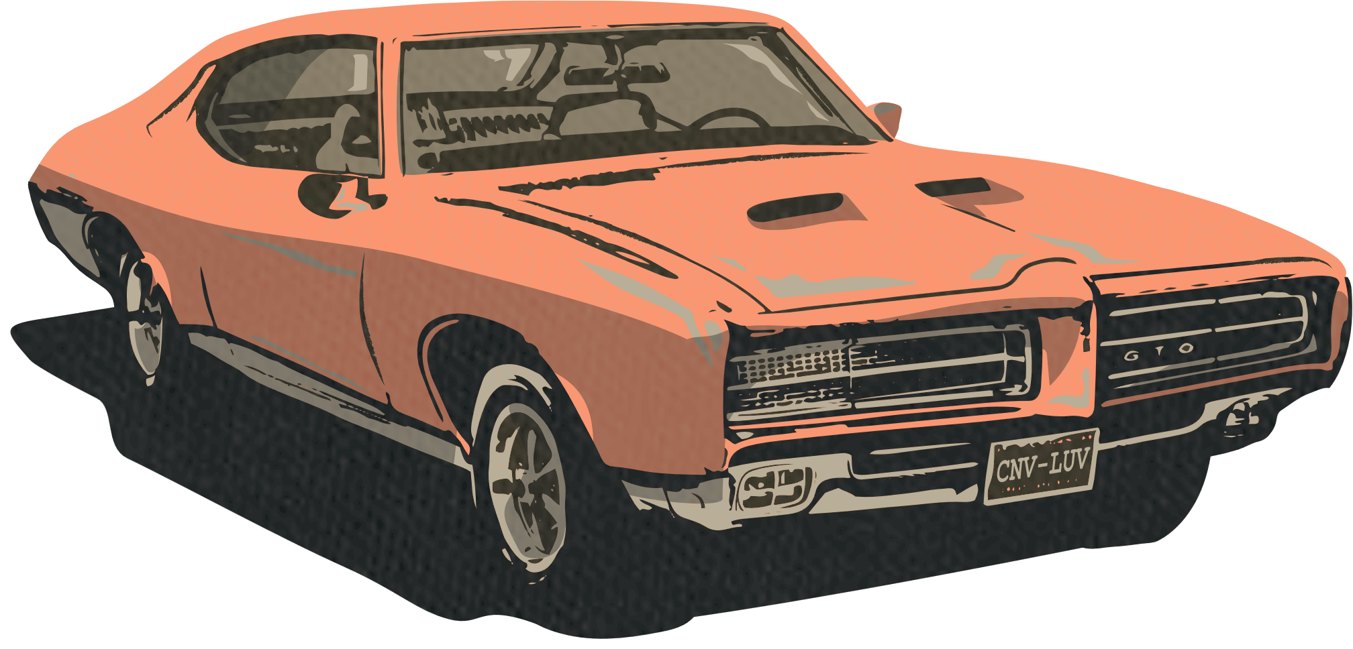






FRADEL AND SPIES CO.
HOT ROD
CAR SHOW
TICKET
$20
SPEEDWAY ARENA
312 Main Street 456 Oak Avenue, Yourtown
SATURDAY
Drag Racing Showdown - Hot rods battle for speed supremacy on track
JUNE 15TH
Hot Rod Showcase - Rare classics display timeless automotive craftsmanship
Rock 'n' Roll Concert - Groove to live bands amidst roaring engines
START FROM 10 AM
Food Truck Fiesta - Indulge in delicious eats amidst hot rod spectacles
CONTACT INFORMATION
hello@hotwheelssociety.com
+123-456-7890
hotwheelssociety.com

