Slide 1





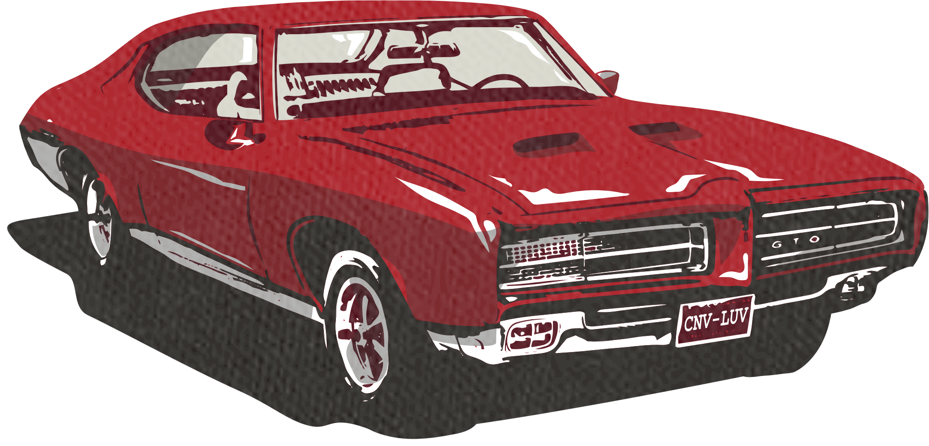




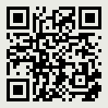

Proudly sponsored by
Retro Auto Restoration
Vintage Parts Emporium
Classic Car revival
July 20th, 2024 | 9AM - 5PM
Experience the glory days of automotive history at our Classic Car Revival! Join us for a showcase of beautifully restored vintage automobiles, live music, and family-friendly activities
Retro Park Pavilion
123 Vintage Avenue, Nostalgia Town, USA
1957 Chevrolet Bel Air
1969 Ford Mustang Mach 1
1955 Cadillac Eldorado
Entry Fee
Activities
Contact
10
$
Live music performances throughout the day
Sarah Davis
Food vendors serving classic American cuisine
(555) 789-1234
per person
info@ccrevive.com
Vintage car memorabilia for purchase
Scan this QR code
to get more detailed information about
the event
Free entry for children under 12
Parking available onsite

