Slide 1




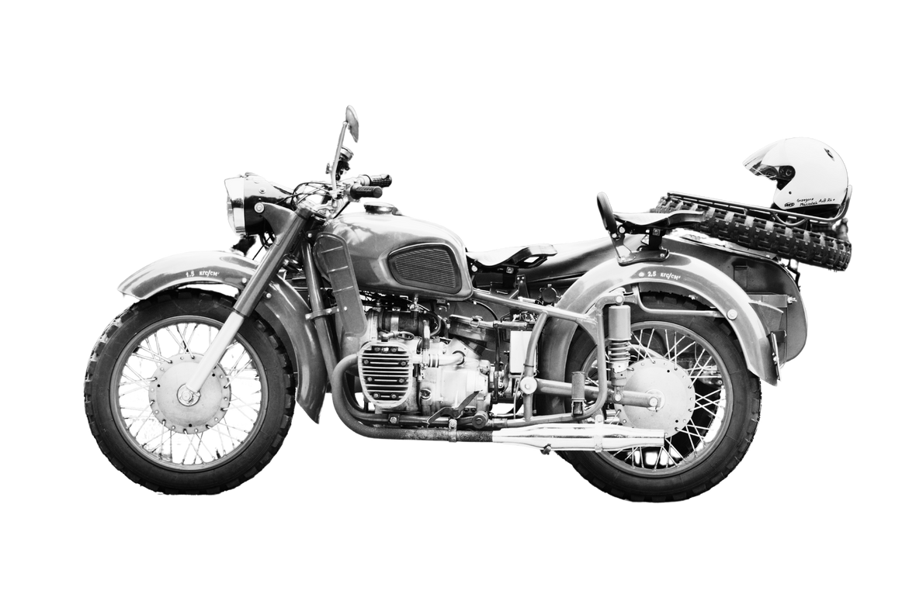
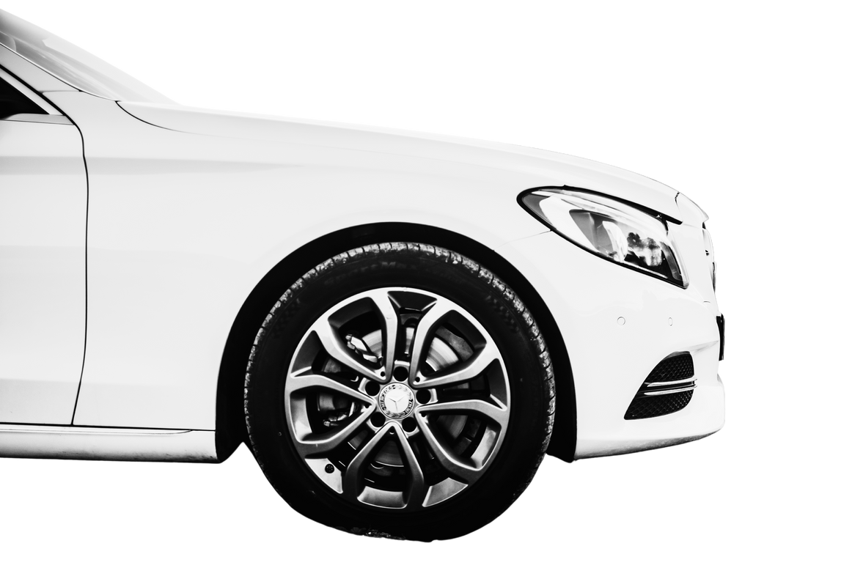

Modern Auto Group
Car and bike show
$10
per person
TIME
DATE
10:00 AM - 5:00 PM
SATURDAY, MAY 18TH
LOCATION
ADDRESS
CITY CONVENTION CENTER
123 MAIN STREET, CENTRAL CITY
MAIN ACTIVITIES
LIVE MUSIC
SHINE BAND
EXHIBITION
SHOWCASE
FORTUNATE DRAW
THIS EVENT IS PROUDLY supported by
TIMMERMAN INDUSTRIES
Paucek and Lage
Wardiere Inc.
Salford & Co.
  Aldenaire & Partners
KEITHSTON AND PARTNERS
CONTACT INFORMATION
Organizer - John Smith
Phone - (555) 123-4567
Email - johnsmith@example.com

