Slide 1

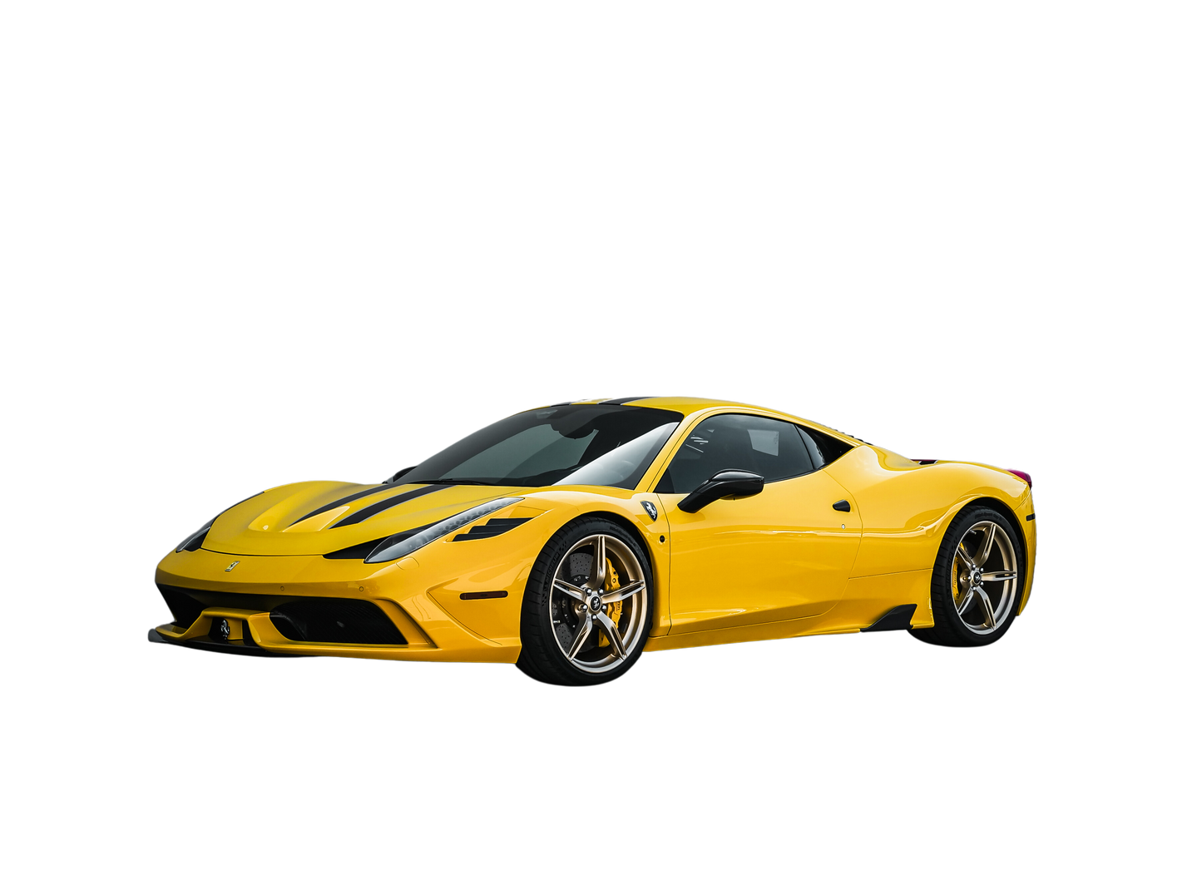


Presented By - Modern Auto Group
Co-sponsored by - RevTech Motors
ANNUAL MODERN SHOWCASE
MAY 15TH, 2024
URBAN SUMMIT CONVENTION CENTER
10:00 AM - 4:00 PM
789 Innovation Boulevard, Techopolis
ENTRY FEE
VIP PACKAGE
ACTIVITIES
10
30
Custom Creations
$
per person
$
per person
FutureTech Zone
Includes priority access to attractions
Live Demonstrations
Free entry for children under 12
VIP lounge access with free refreshments
Interactive Exhibits
VIP parking close to the entrance
Prizes and Giveaways
CONTACT INFORMATION
Organizer - John Smith
Phone - (555) 123-4567
Email - johnsmith@example.com

