Slide 1

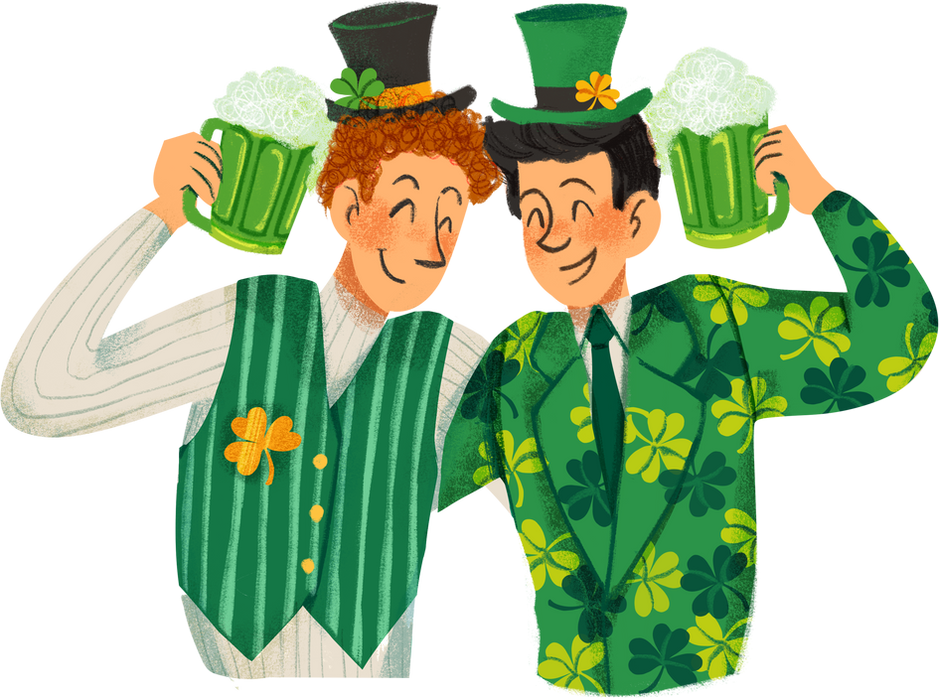





St. patty's
day potluck
Sunday, October 20, 2030
2pm - 4pm
123 Anywhere St., Any City
NAME
ITEM/DISH
QUANTITY
CONTACT
MAIN DISHES
SIDE DISHES
DESSERTS
DRINKS

