Slide 1


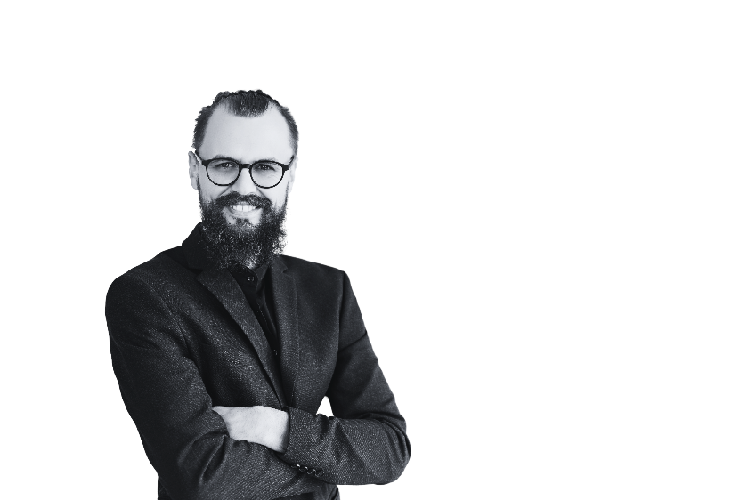




Voting ballot
CITIZENS' VOTING COMMITTEE
INSTRUCTIONS FOR VOTERS
1
Read Carefully: Take your time to read through the ballot and understand the positions and candidates
3
Verify Your Choices: Before submitting your ballot, review it to ensure you have marked your selections accurately
2
Marking Your Choices: Use a pen or pencil to mark an "X" or fill in the box next to your chosen candidate for each position
4
Confidentiality: Your vote is confidential. Fold your ballot to conceal your choices before depositing it in the ballot box
MAYOR
Geraldine Smith
Emily Brown
Robert Williams
Age: 58 years old
Hometown: Oak Ridge
Age: 34 years old
Hometown: Bay City
Age: 29 years old
Hometown: Win Valley
I will prioritize community engagement, fiscal responsibility, and sustainable development for a prosperous future
I will champion education, public safety, job creation, and community engagement to build
a vibrant and inclusive city
I will advocate for equity, transparency, and environmental stewardship to ensure a thriving and resilient community
CITY COUNCIL MEMBER
Rachel Banker
Michael Chen
Emma White
Age: 58 years old
Hometown: Oak Ridge
Age: 34 years old
Hometown: Bay City
Age: 29 years old
Hometown: Win Valley
I will advocate for transparency, equity, and sustainability to build a stronger, more resilient community for all
  I will advocate for transparency, sustainability, and equity to ensure a thriving, resilient, and connected community
  I will work to enhance public services, support local businesses, and strengthen neighborhoods for a vibrant city

