Slide 1
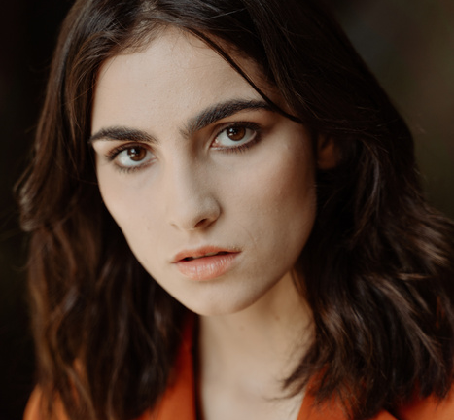
OSCAR BALLOT
Best Picture
Best Actor
Film Title A
Film Title B
Film Title C
Actor P
Actor Q
Actor R
Directed by John Smith Starring Actor A, Actress B
Directed by Jane Doe Starring Actor X, Actress Y
Directed by James Johnson Starring Actor M, Actress N
Film Title D
Film Title E
Film Title F
A gripping drama set in the heart of a war-torn country, highlighting the resilience of the human spirit
A heartwarming tale of friendship and redemption set against the backdrop of a small town
An epic adventure following the journey of a group of explorers in search of lost treasure
Renowned for his captivating portrayal of a troubled detective in this intense noir thriller
Captivating audiences with his transformative performance as a historical figure in this drama
Bringing both humor and profound depth to his role as a struggling artist in this indie masterpiece
Best Actress
Best Director
Actress S
Actress T
Actress U
Director V
Director W
Director X
Film Title G
Film Title H
Film Title I
Film Title J
Film Title K
Film Title L
She gives a standout performance, balancing strength and vulnerability in this emotional journey
She commands the screen, captivating audiences with her portrayal of a determined activist
Through nuanced performance, she captures the essence of relationships in this drama
With masterful direction, he crafts a visually stunning and emotionally resonant story leaving an impact
Continuously pushing artistic boundaries, she deeply inspires audiences her cinematic creations
Guiding a talented ensemble, he adeptly blends humor, drama, and suspense to craft a film

