Slide 1








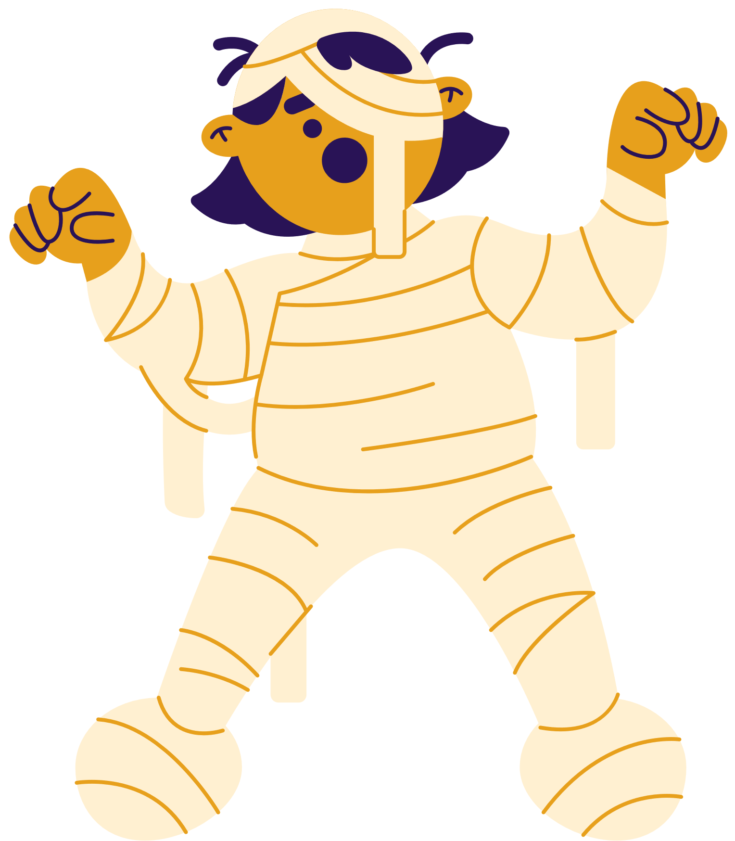






COSTUME CONTEST
Select your preferred outfit by marking its corresponding box for each option
FRANKENSTEIN
VAMPIRE
DAIKON RADISH
Jackson Bennett
Nathan Cooper
Olivia Anderson
PUMPKIN
MUMMY
DEVIL
Isabella Yellow
Sophia Patel
Lucas Ramirez

