Slide 1





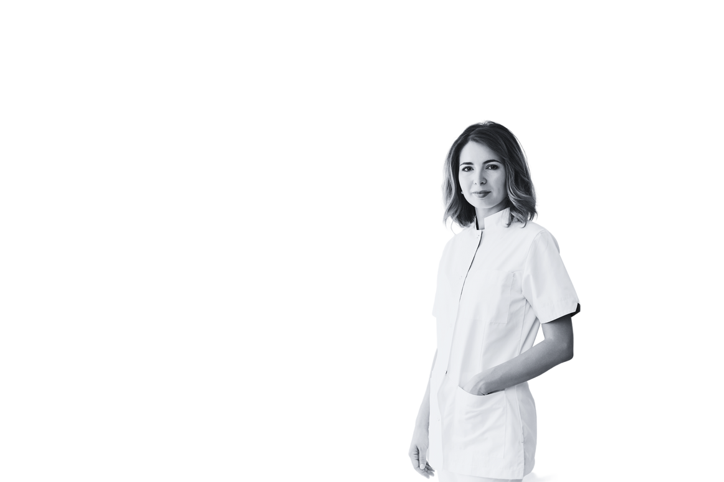

CHURCH NAME
Your information will be shared in the church directory. If you wish to opt-out or restrict any information, please contact the church office
Small church directory
Church Office
Pastor
(555) 999-1234
Rev. John Smith - pastor@email.com
John Doe
Deacon
john.doe@example.com
(555) 123-4567
123 Main Street, Anytown, USA
Relationship status
Engaged
Confirmation Dates
Baptized on May 10, 2008
Special Notes
John prefers to be contacted via email rather than phone calls due to
his work schedule. He's also passionate about organizing community events and welcomes any collaboration opportunities
Mary Smith
Choir Member
marysmith@email.com
(555) 987-6543
46 Oak Avenue, Otherville, USA
Relationship status
Single
Confirmation Dates
Baptized on September 20, 2010
Special Notes
Mary has a severe peanut allergy, so please avoid bringing any peanut-related foods to church events where she may be present. Additionally, she's available to assist with choir-related activities
Jennifer Johnson
Sunday School Teacher
jenniferjohnson@example.com
(555) 555-5555
789 Elm Street, Smalltown, USA
Relationship status
Married
Confirmation Dates
Baptized on December 30, 2020
Special Notes
Jennifer is enthusiastic about Sunday school teaching and welcomes creative ideas to enhance children's learning experiences. She also prefers evening contact after 5:00 PM due to daytime commitments

