Slide 1


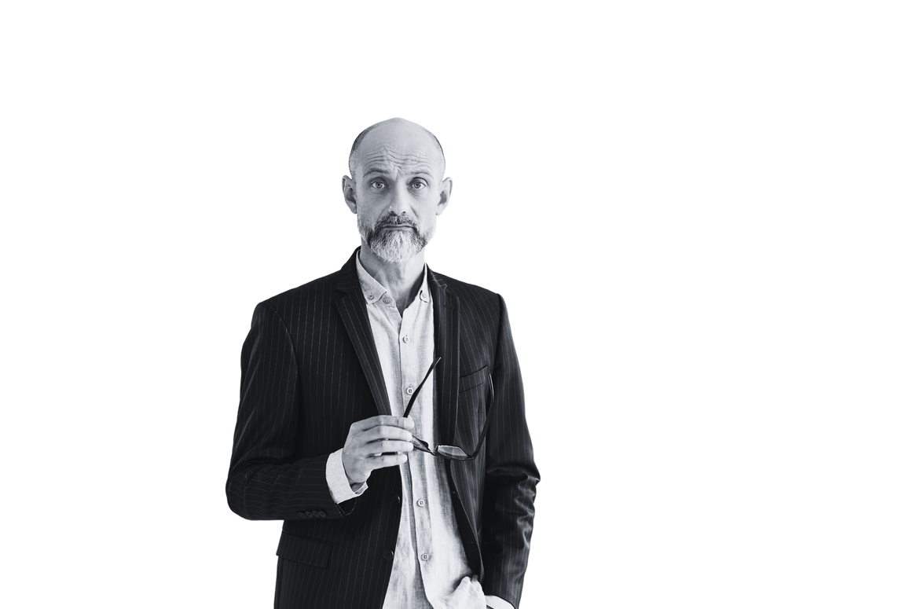




CHURCH NAME
CHURCH MEMBER DIRECTORY
2024
John Doe
Sarah Smith
Justin Brown
Relationship status
Single
Relationship status
Engaged
Relationship status
Married
Membership Status
Active Member
Membership Status
Regular Attendee
Membership Status
Active Member
Date Joined
March 15, 2010
Date Joined
January 5, 2015
Date Joined
March 10, 2018
Emergency Contact
(555) 555-5678
Jane Doe (Spouse)
Emergency Contact
(555) 555-6789
James Smith (Spouse)
Emergency Contact
(555) 555-9012
Daniel Brown (Spouse)
John volunteers for Sunday School every other Sunday. He's also skilled in audiovisual setup for events
  Sarah leads the church choir and also volunteers for organizing community outreach programs
  Rebecca coordinates the church's annual charity fundraiser and leads a weekly prayer group
(555) 555-1234 (Home)
(555) 555-7839 (Phone)
(555) 555-5152 (Home)
(555) 555-4526 (Phone)
(555) 555-6389 (Home)
(555) 555-7309 (Phone)
123 Main Street, Anytown, USA
johndoe@example.com
123 Main Street, Anytown, USA
sarah@example.com
123 Main Street, Anytown, USA
justin@example.com

