Slide 1
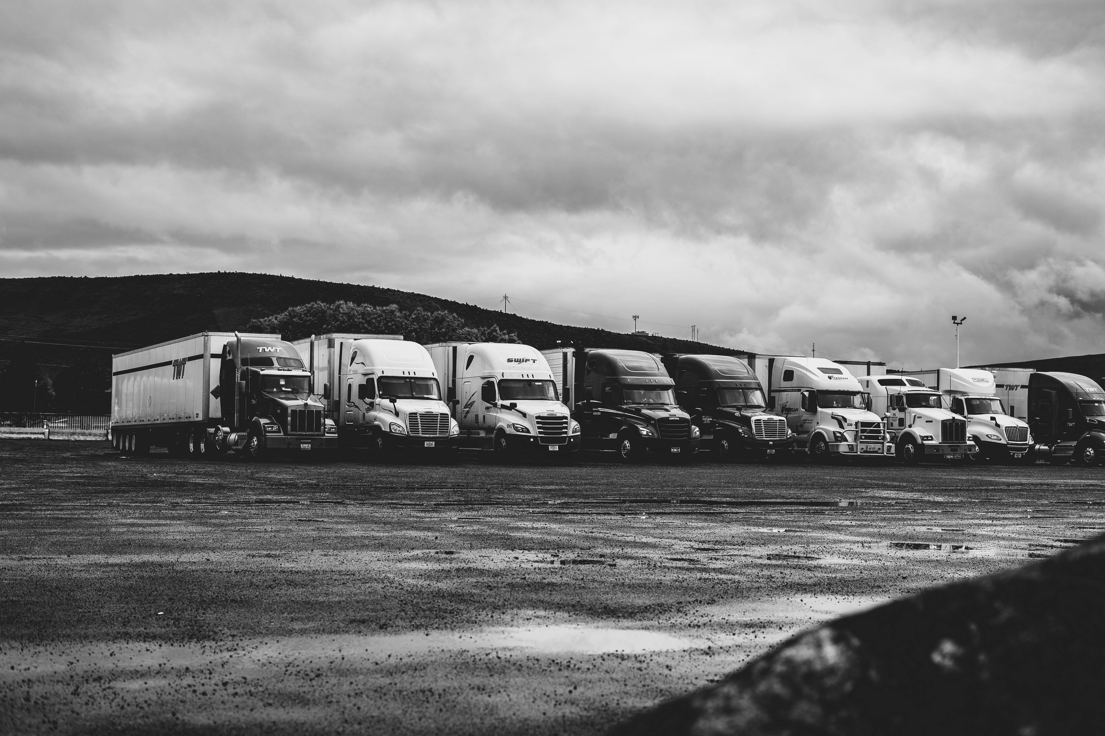











TRUCKING COMPANY PROFILE
XYZ TRUCKING SOLUTIONS
Achievements
Honored with the "Customer Satisfaction Excellence" award for maintaining high service quality
Granted the "Safety Excellence" award for exemplary commitment to safety protocols
Received the "Excellence in Transportation Services" award for commitment and innovation
Company Overview
Founding Year
2008
Mission
Our mission is to provide reliable transportation solutions, prioritizing safety, sustainability, and customer satisfaction. With a dedicated team, we are committed to delivering excellence every mile
Founder/CEO
Emily Johnson
Industry
Transportation and Logistics
Vision
Employees
+150
Our vision is to become a leading force in the transportation industry, recognized for our commitment to innovation, sustainability, and customer-centric solutions, reshaping the future with excellence
Our Services
Why Choose Us
Trusted reputation for consistent on-time deliveries
and performance, ensuring unparalleled reliability
Local and regional delivery
Implementing streamlined supply chain and optimal
route planning for maximum efficiency
Efficient delivery within local and regional areas, ensuring timely arrivals
Upholding industry-leading standards with zero
tolerance, ensuring safety for cargo and personnel
Refrigerated transport for perishable goods
Providing personalized service with responsive 24/7
support, and partnering for mutual success
Ensuring safe and temperature-controlled transport of perishable items
What Our Customer Say
Long-haul trucking
Comprehensive transportation solutions for long-distance freight
XYZ Trucking Solutions consistently delivers on-time and handles our sensitive cargo with the utmost care
Warehousing and distribution solutions
John Smith
Comprehensive storage, logistics services optimize supply chains
Marketing Manager
CONTACT FOR MORE INFORMATION
123 Main Street, Cityville, State, ZIP
info@xyztrucking.com
www.xyztrucking.com

