Slide 1



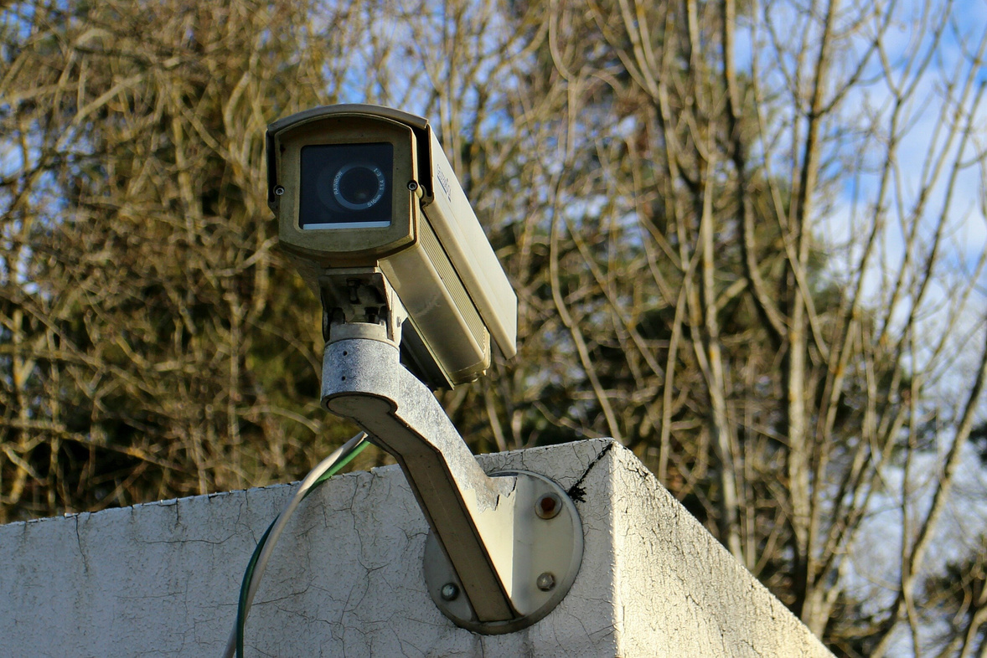










SECUREGUARD SOLUTIONS
SECURITY COMPANY PROFILE
SecureGuard Solutions consistently delivers top-notch security solutions. With an experienced team and unwavering dedication, we are proud to be a dependable partner for all security needs, ensuring the safety and protection of our clients' homes
10 years
+400
2015
2019
Of top-notch security solution provision
Condominiums served with high satisfaction rates
Awarded "Best Security Provider" in the industry
"Security Excellence Award" for outstanding service and innovation
COMPANY OVERVIEW
Founding Year
2010
Founder/CEO
John Smith
Industry
Residential Security Solutions
Employees
+500
OUR SERVICES
Apartment security solutions
Alarm Systems Installation
Security Consultation
Tailored security systems specifically designed for condominiums' unique needs
State-of-the-art alarm systems for comprehensive protection
Customized security plans based on individual client needs
WHY US
CLIENT TESTIMONIAL
Innovation
We've been with SecureGuard Solutions for
5 years. Their outstanding service exceeds expectations with effective, reliable security systems. We're highly satisfied and look
forward to future collaboration
Implementing cutting-edge technologies for robust security solutions
Reliability
Trustworthy partner committed to safeguarding your property
Efficiency
Elena Martinez
Streamlined processes for prompt and effective service delivery
Property Manager
CONTACT FOR MORE INFORMATION
123 Main Street, Cityville, State, ZIP
info@sgsolutions.com
www.sgsolutions.com

