Slide 1




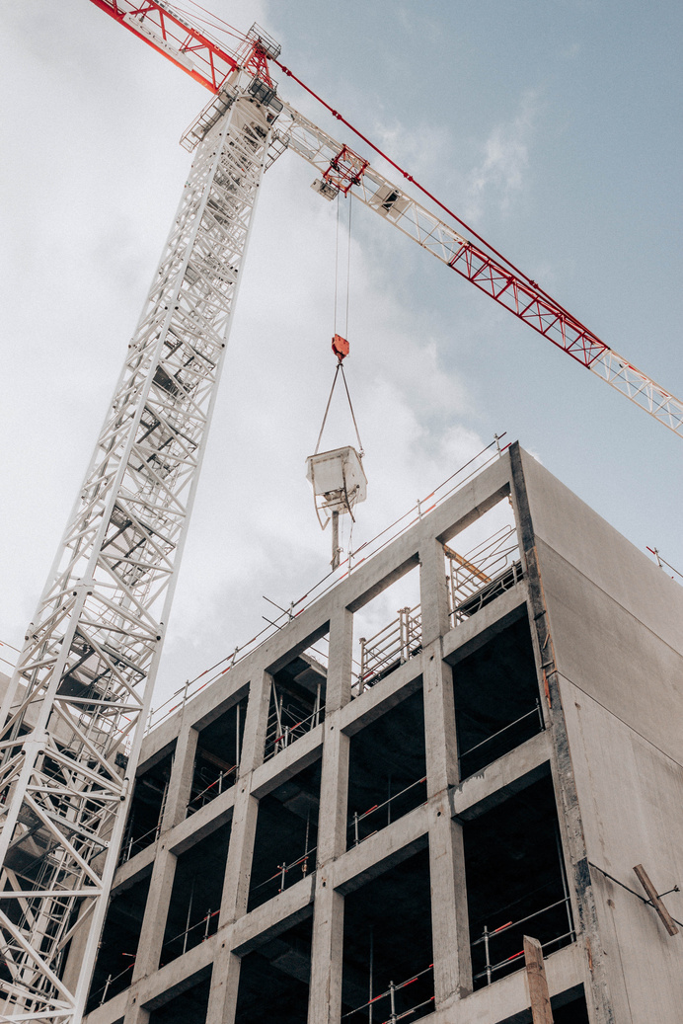






ABC CONSTRUCTION INC.
CONSTRUCTION COMPANY PROFILE
ABC Construction Inc. is a premier construction firm specializing in residential and commercial projects since 2005. Renowned for our commitment to quality, safety, and sustainability, we excel in custom home construction, commercial developments, and green building initiatives. Our strength lies in delivering innovative solutions tailored to clients' unique needs, setting us apart in the industry
KEY INFORMATION
Founding Year: 2005
Founder/CEO: John Smith
Employees: +400
Industry: construction industry, specializing in residential and commercial projects
+ 500
2018
OSHA
Residential and commercial projects are completed
Received "Contractor of
the Year" award
Compliant
OUR SERVICES
01
02
03
Residential Construction
Specialized Services
Commercial Construction
Custom homes, renovations,
and additions exclusively
Green building, LEED certification, and sustainable construction solutions
Office buildings, retail spaces,
and hospitality projects
WHY US?
1
Decades of expertise ensure precision and excellence,
guaranteeing that every project surpasses expectations
with unmatched quality and reliability
2
Our dedicated team is committed to meticulous attention to
detail, ensuring each project is executed flawlessly, meeting
client specifications with precision
3
Rigorous quality control processes ensure adherence to the
highest standards, delivering superior outcomes that exceed
client expectations consistently
4
By prioritizing client satisfaction, we tailor solutions to meet
individual needs, delivering projects on time and within
budget reliably
ABC Construction will surpass expectations with unparalleled attention to detail and unwavering commitment to unmatched quality, setting a new standard in excellence
John Smith - CEO
ABC Construction Inc.
CONTACT FOR MORE INFORMATION
123 Main Street, Cityville, State, ZIP
info@abcconstruction.com
www.abcconstruction.com

