Slide 1
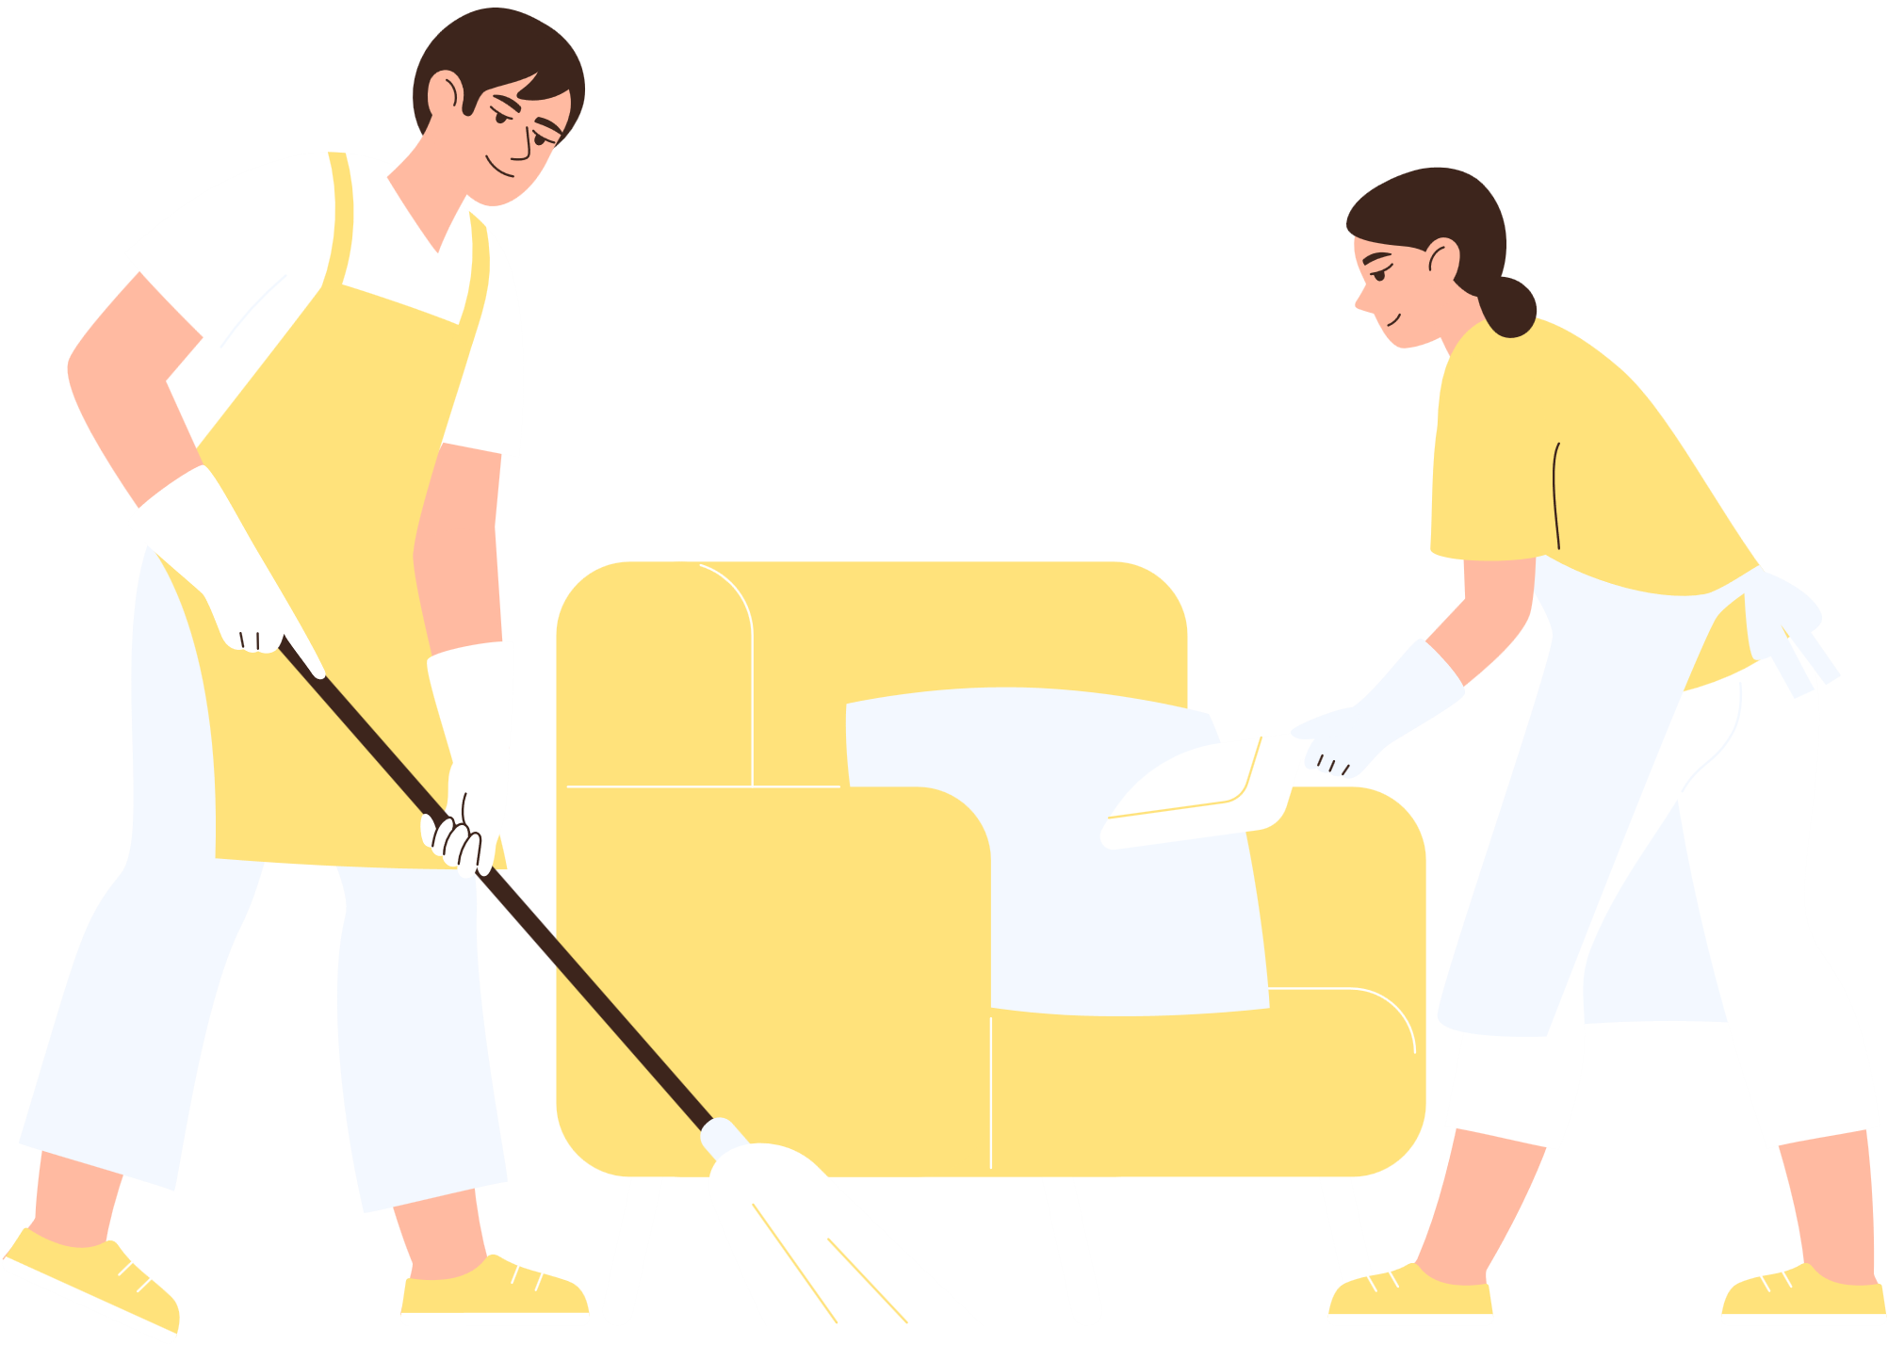







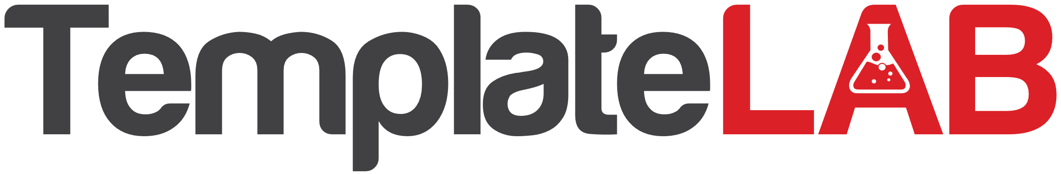
Sparkling Clean Solutions
CLEANING COMPANY PROFILE
  ACHIEVEMENTS
  ABOUT US
2020
Maintained zero workplace safety incidents consistently
Founded in 2004 by Sarah Johnson, Sparkling Clean Solutions has grown from a local cleaning service to a trusted provider of residential and commercial cleaning solutions in the greater metropolitan area
2018
Partnered with leading commercial property developers
2016
Reached 1000+ satisfied residential clientele
  OUR SERVICES
Residential Cleaning
  Carpet Cleaning
2013
Implemented innovative green cleaning technologies
  Commercial Cleaning
  Window Cleaning
  Janitorial Services
  Deep Cleaning
2010
Recipient of 'Best Cleaning Service'
2008
Expanded services to neighboring metropolitan areas
  KEY CUSTOMERS
2004
Company Inception
  CONTACT
  WHY US?
Hotline
  +123-456-7890
  Reliability and Expertise
  Website
Our certified, trained professionals ensure consistent quality assurance and attention to detail, providing client-centric, responsive, and personalized cleaning solutions for utmost customer satisfaction
  www.sparklingcleansolutions.com
  Email
hello@sparklingcleansolutions.com
  Eco-Friendly Practices
Facebook
Our sustainable solutions involve green cleaning, reducing carbon footprints for healthier environments with non-toxic formulations and community commitment to local sustainability
  Sparkling Clean Solutions Official
Location
1234 Sparkling Avenue
Suite 200B
Sunshine City, Cleanstate 56789
  United States
  Innovation and Technology
Employing cutting-edge equipment and digital solutions ensures efficiency and effectiveness with state-of-the-art machinery and continuous improvement through feedback-driven enhancements

