Slide 1
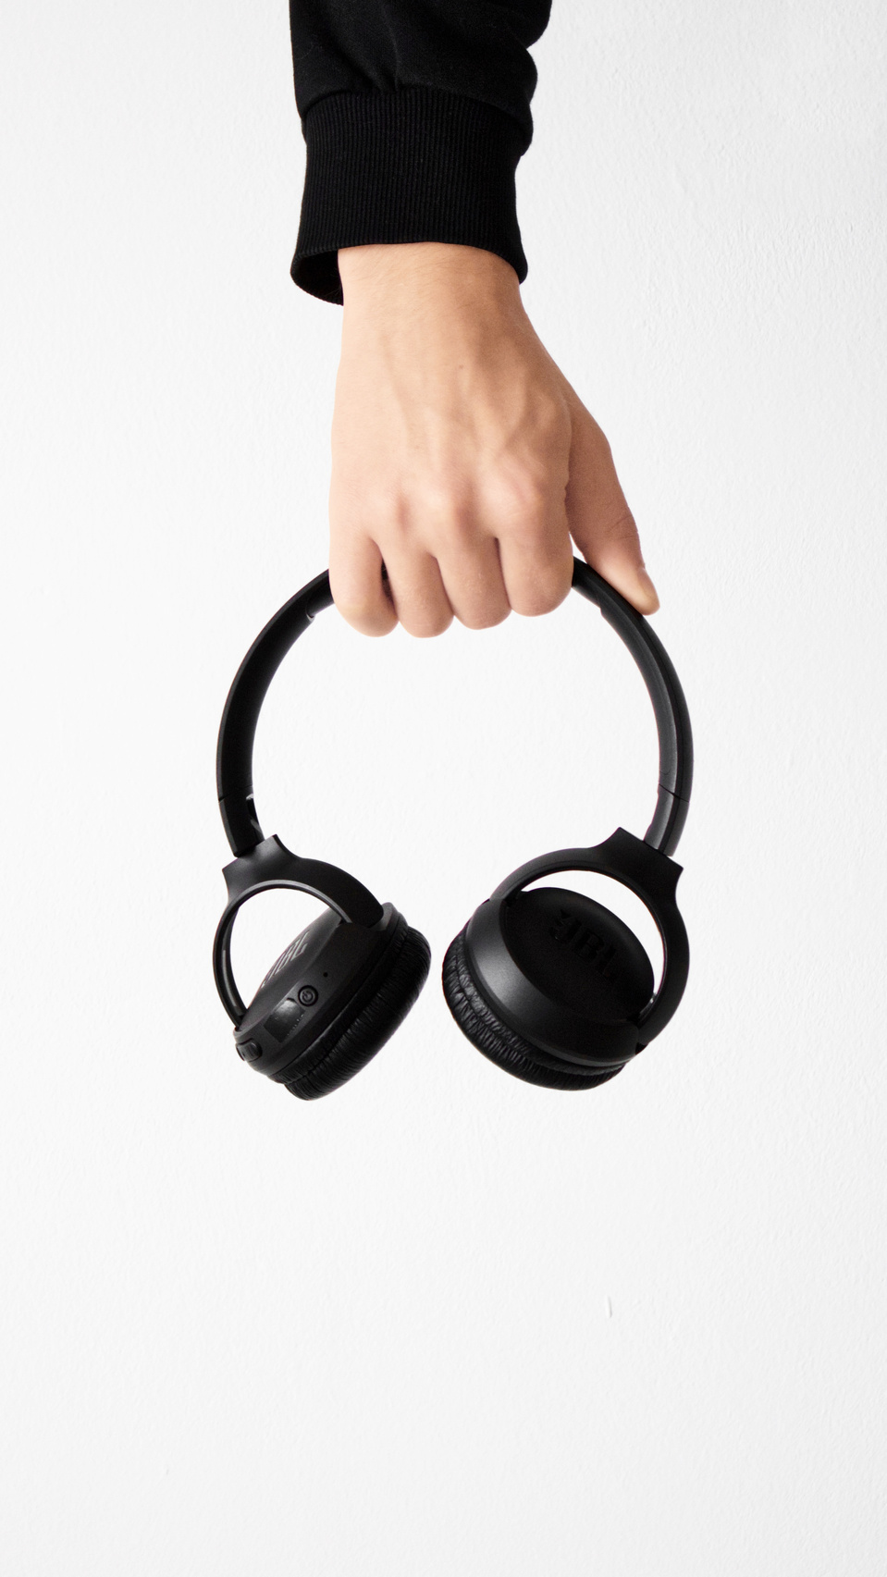





SONICPRO STORE
SONICPRO X500 WIRELESS HEADPHONES
NEW PRODUCT
MAIN KEY FEATURES
NOISE CANCELLATION
BLUETOOTH
5.0
ERGONOMIC DESIGN
WATER RESISTANCE
7.5 INCHES
6.5 INCHES
3 INCHES
0.45 LBS
Length
Width
Height
Weight
BATTERY LIFE
AVAILABLE COLOR
100 HOURS
OF PLAYBACK TIME ON
A SINGLE CHARGE
PERFECT FOR WHO DEMAND HIGH-QUALITY
AUDIO PERFORMANCE AND COMFORT
PRICE
$130.99
BUY NOW
AVAILABLE FOR PURCHASE ONLINE AT SONICPRO.COM

