Slide 1
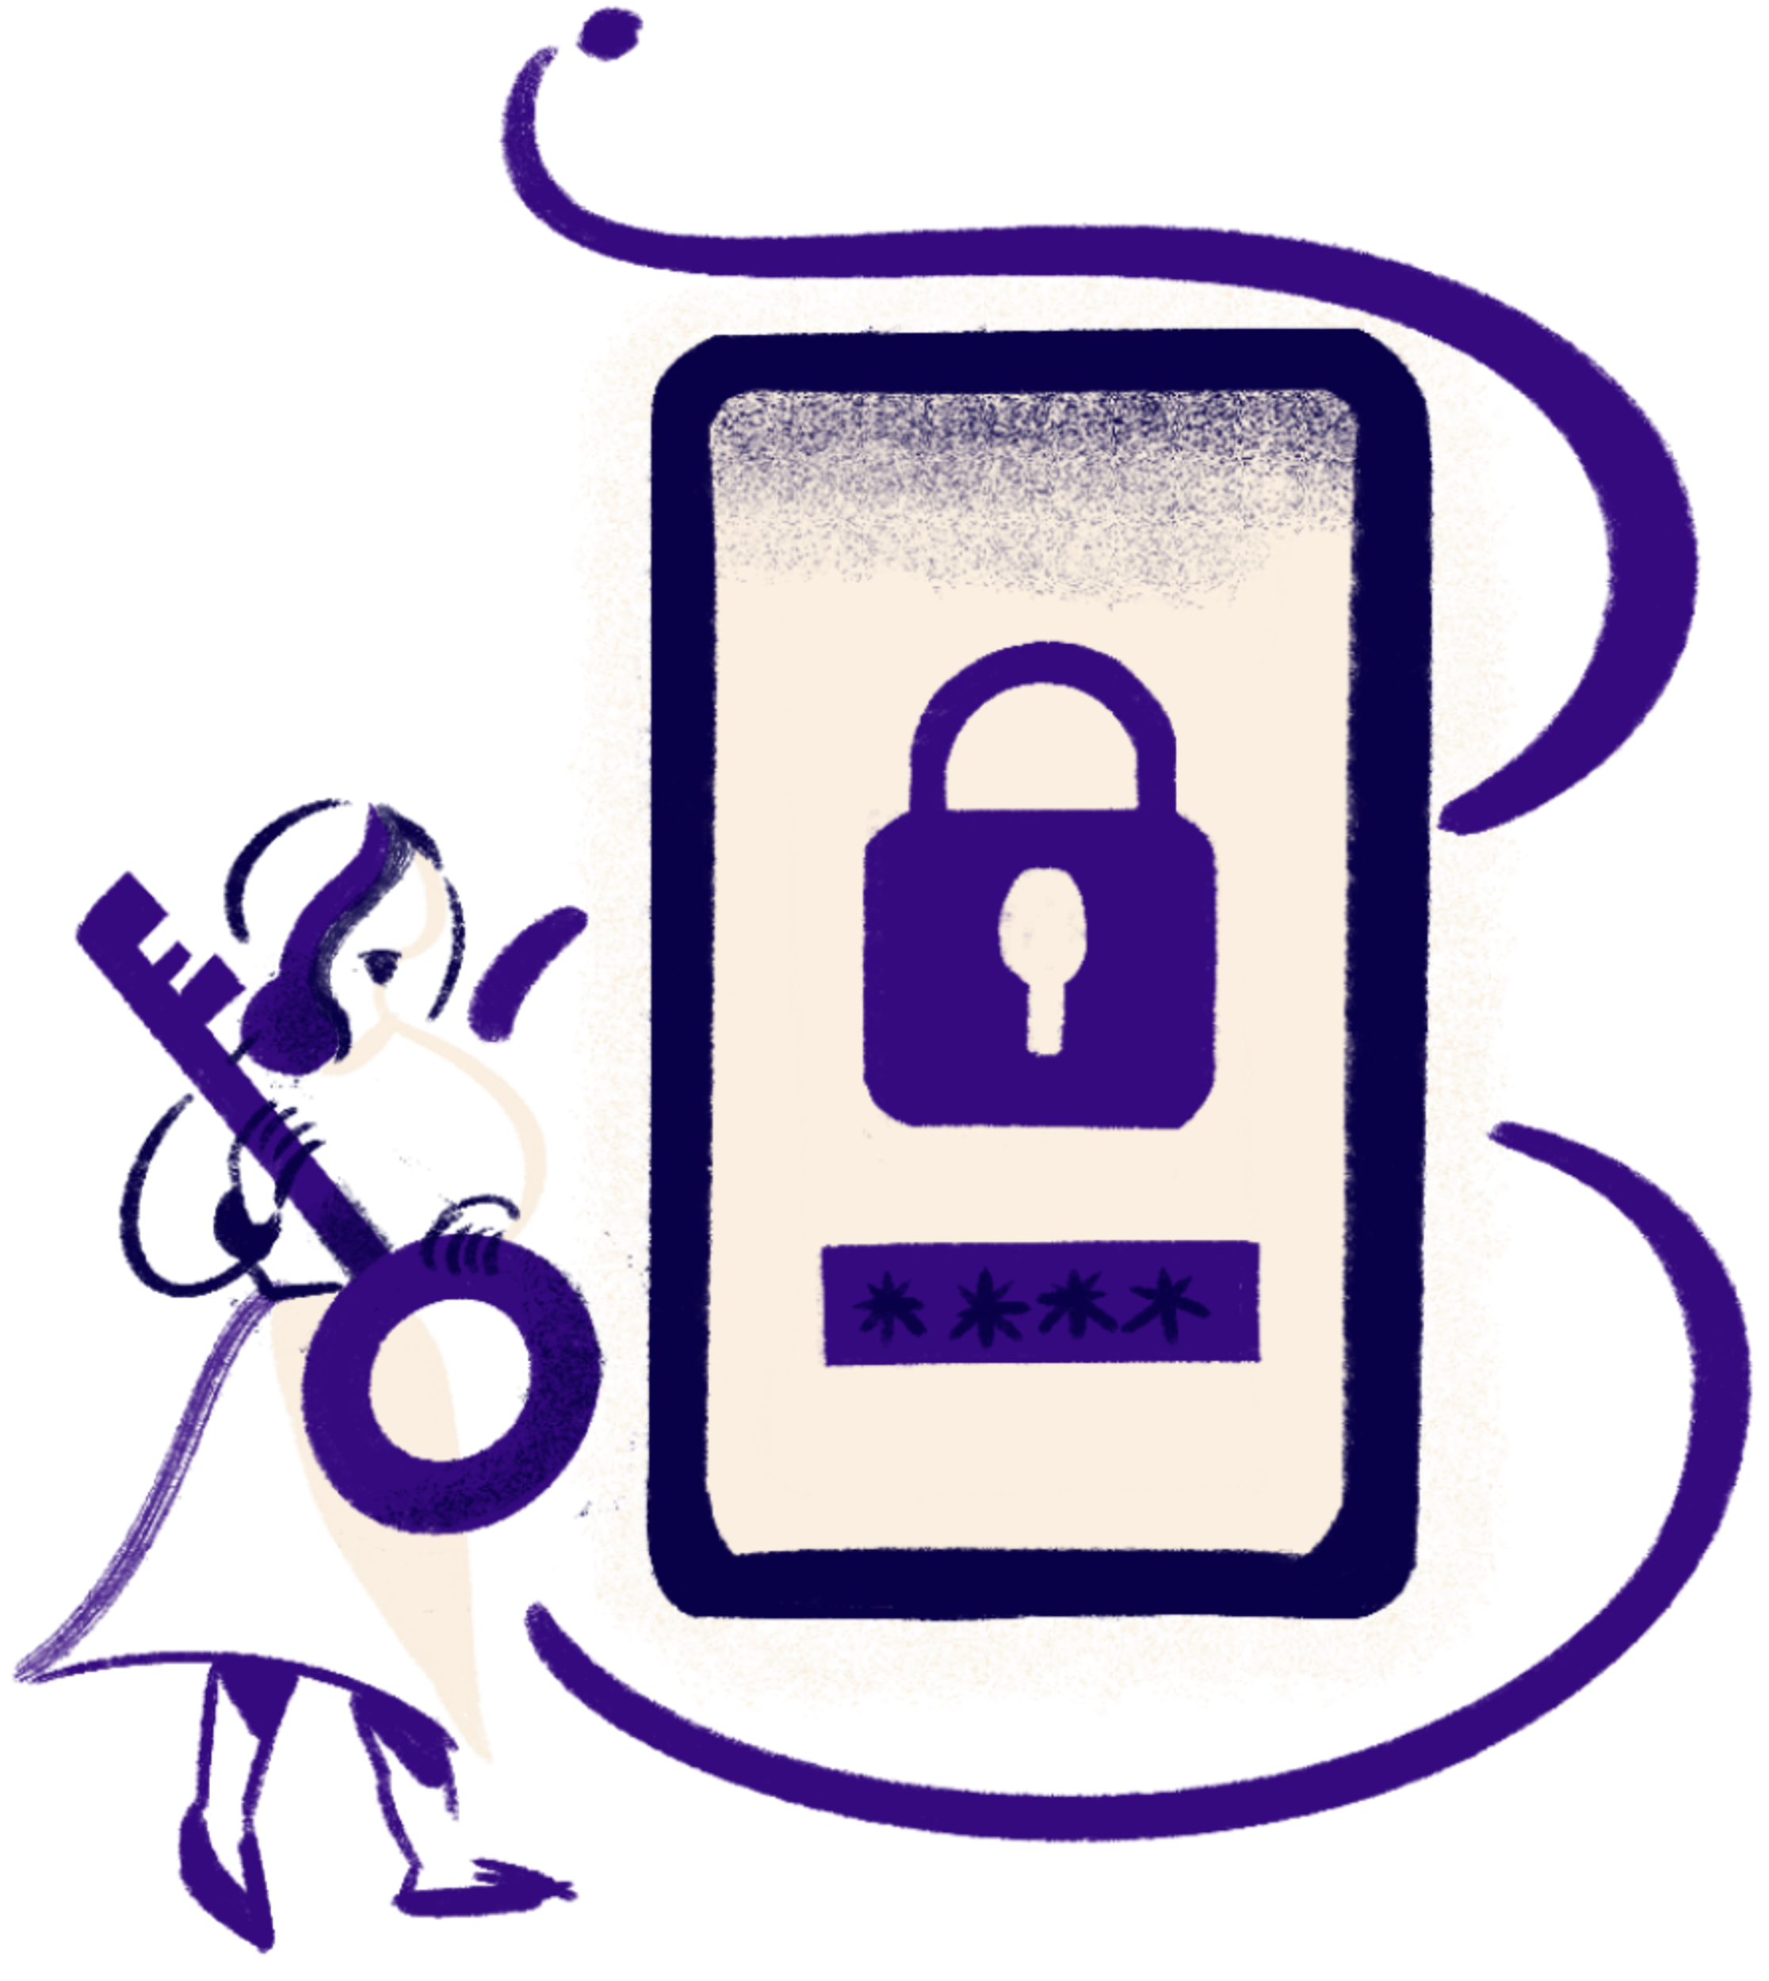

Company Name
Effective from - February 28, 2025
Policy Fact Sheet
Information Security and Privacy Policy
Our Data Privacy and Security Policy ensures the confidentiality, integrity, and responsible handling of sensitive information, adhering to stringent privacy standards and safeguarding against unauthorized access or misuse, fostering a secure and trusted environment for our stakeholders
Key Provisions
1
2
3
Data Classification
Access Controls
Data Breach Response
Clearly defines categories of data
and their handling requirements
Specifies who has access to what types of data and under what circumstances
Outlines procedures for detecting, reporting, and mitigating data breaches
Targeted individuals
Employees
Contractors
Third-party vendors with access to organizational data
Ensuring all stakeholders handling sensitive information adhere to the Data Privacy and Security Policy's guidelines
Compliance Requirements
Resources and Support
Employees must complete mandatory
data privacy training annually
1
Data Privacy Training Modules are available on [Company Name’s Intranet] for comprehensive employee education
Immediate reporting of any suspected
data breaches to the IT Security team
2
For prompt technical assistance, please contact the IT Help Desk at [Help Desk Email] or [Help Desk Phone]

