Slide 1
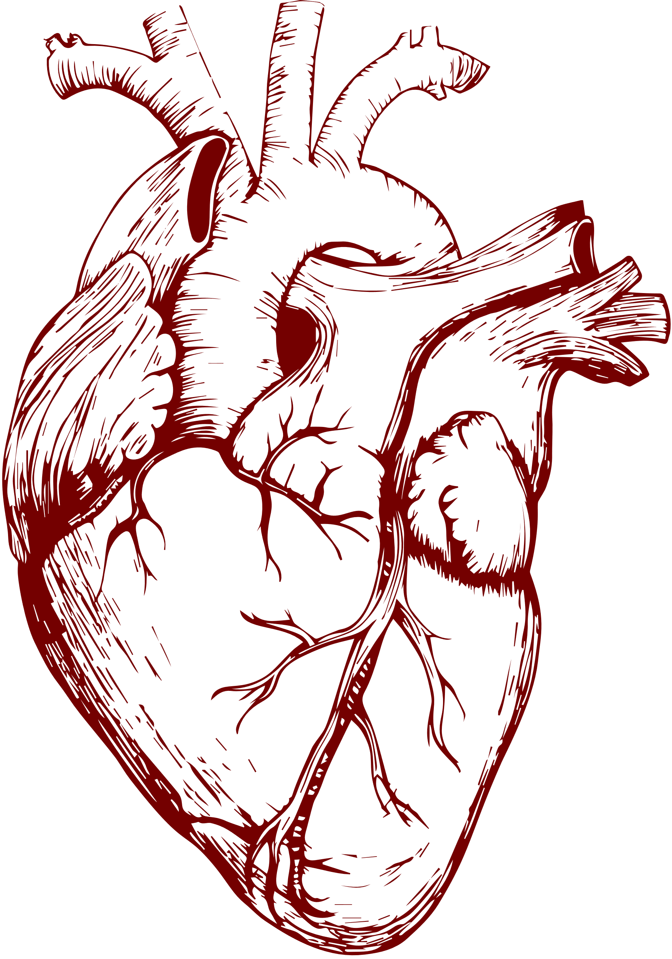









HEART DISEASE
Heart disease refers to a range of conditions that affect the
heart. It is the leading cause of death worldwide and encompasses various conditions, including coronary artery disease, heart failure, arrhythmias, and congenital heart defects
FACT SHEET
~17.9
deaths worldwide each year
M
because of Heart Disease
According to the World Health Organization (WHO)
CAUSES
Typical causes
SYMPTOMS
Typical symptoms
01
High blood pressure (hypertension)
01
Chest pain or discomfort (angina)
02
High cholesterol levels
02
Shortness of breath
03
Smoking
03
Fatigue
04
Diabetes
04
Swelling in the legs, ankles, or feet
05
Sedentary lifestyle
05
Irregular heartbeat
06
Family history of heart disease
06
Dizziness or lightheadedness
PREVENTION
Prioritize heart health with exercise, healthy eating, and regular check-ups for longevity
Follow a balanced diet
Avoid smoking and limit alcohol consumption
Engage in regular physical activity
Regularly monitor and maintain a healthy weight

