Slide 1
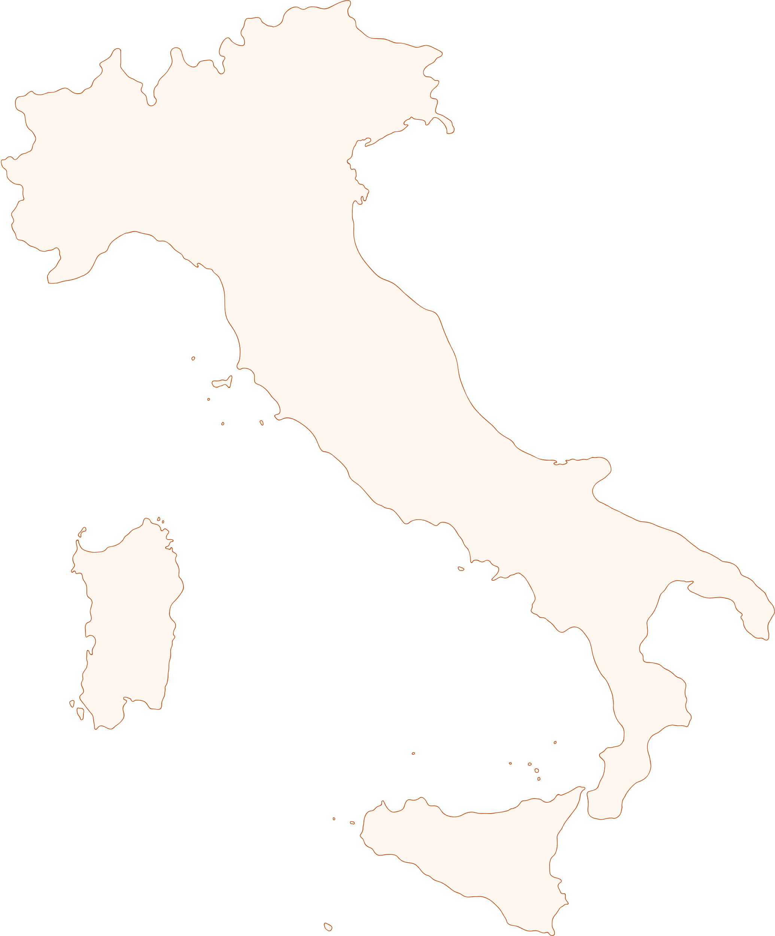






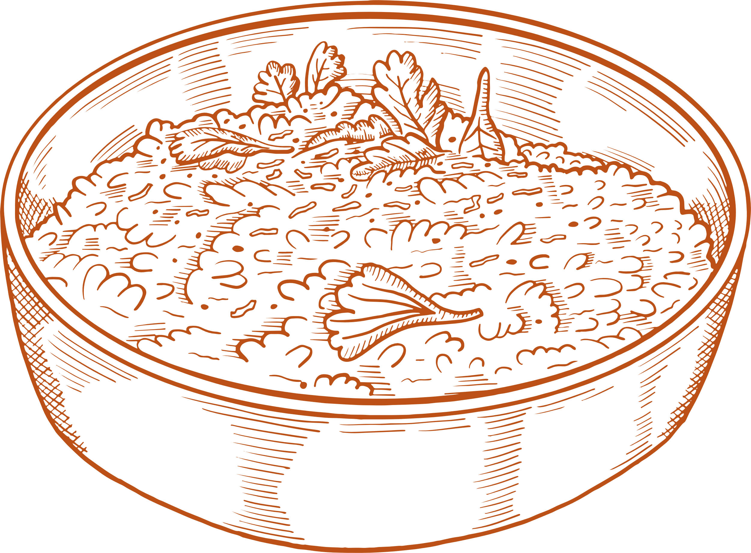
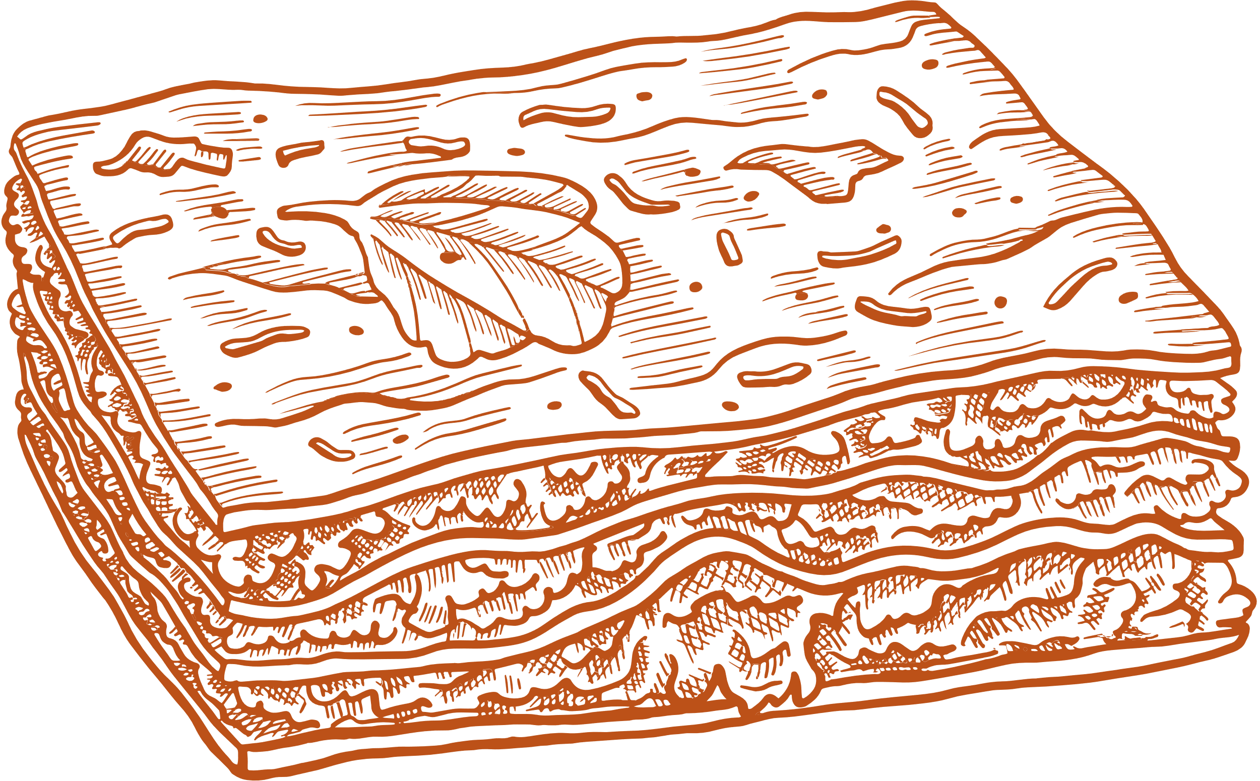
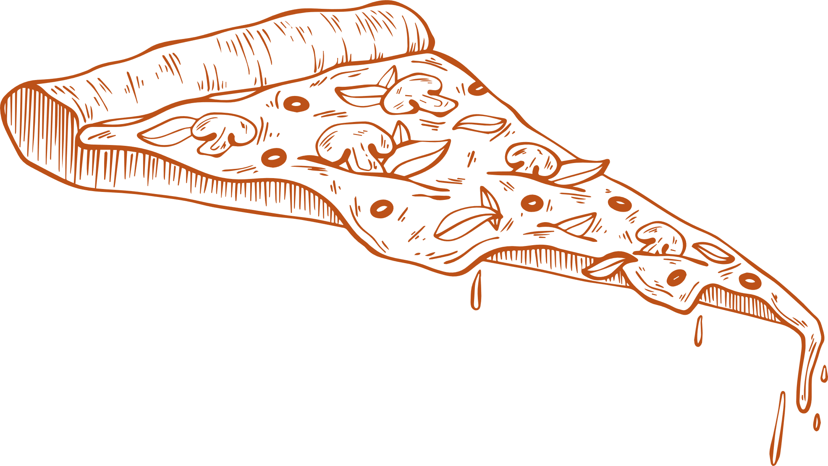
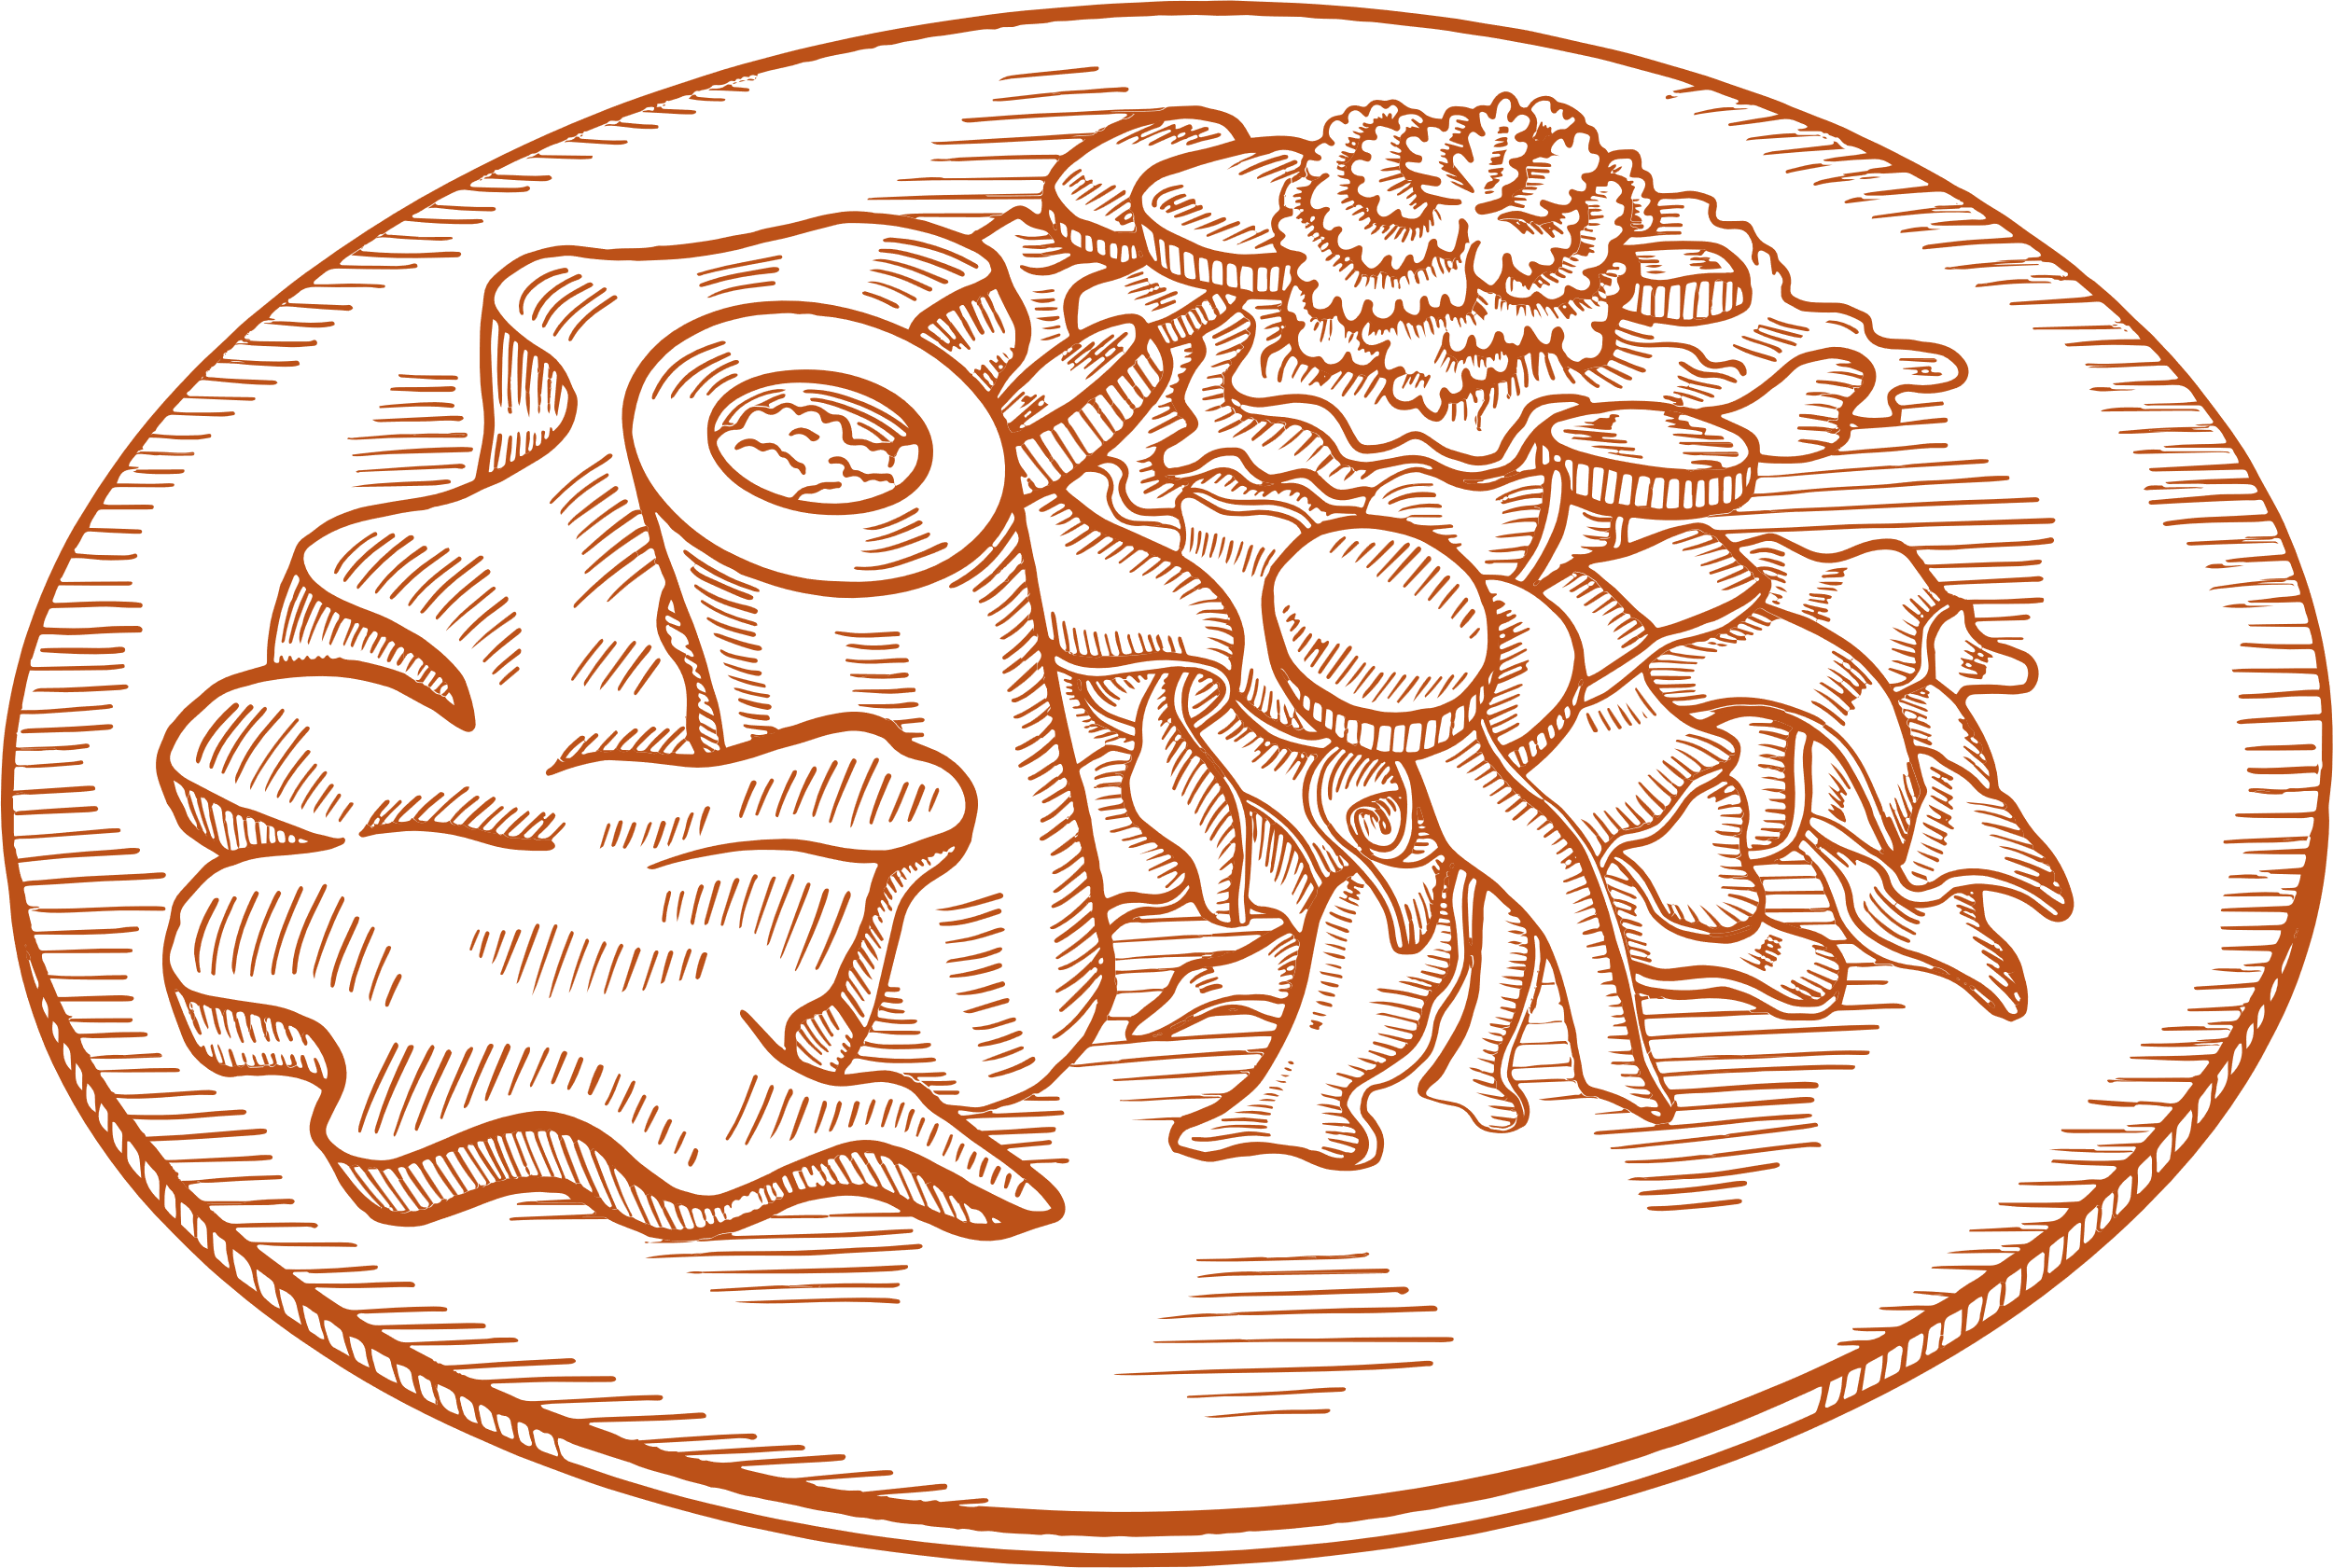

Country fact sheet
Italy - a land of artistic marvels and culinary delights, beckons with its timeless charm and breathtaking landscapes. From the ancient ruins of Rome to the picturesque canals of Venice, Italy's beauty and history enchant visitors from around the globe
Ciao Italy
Capital City
OVERVIEW
Rome
Population
~60
million
Total Area
301,340
sq. km
Bordering Countries
$2.2
France, Switzerland,
Austria, Slovenia
GDP
trillion USD
Official Language
Italian
Currency
Euro (EUR)
Time Zone
Central European Time (CET)
AVERAGE LOW
AVERAGE
AVERAGE HIGH
10-14°C
TEMPERATURE
25-32°C
42.8 - 57.2°F
77 - 89.6°F
MAJOR INDUSTRIES
Tourism
Manufacturing
Agriculture
Automotive
Fashion
RICH CUISINE
Risotto
Lasagna
Pizza
Ossobuco
Creamy rice dish with saffron, mushrooms, and Parmesan cheese
Layered pasta,
Bolognese sauce, ricotta, and melted cheese
Thin crust, tomato
sauce, mozzarella, and assorted toppings
Braised veal shanks
in wine, broth, with aromatic vegetables

