Slide 1

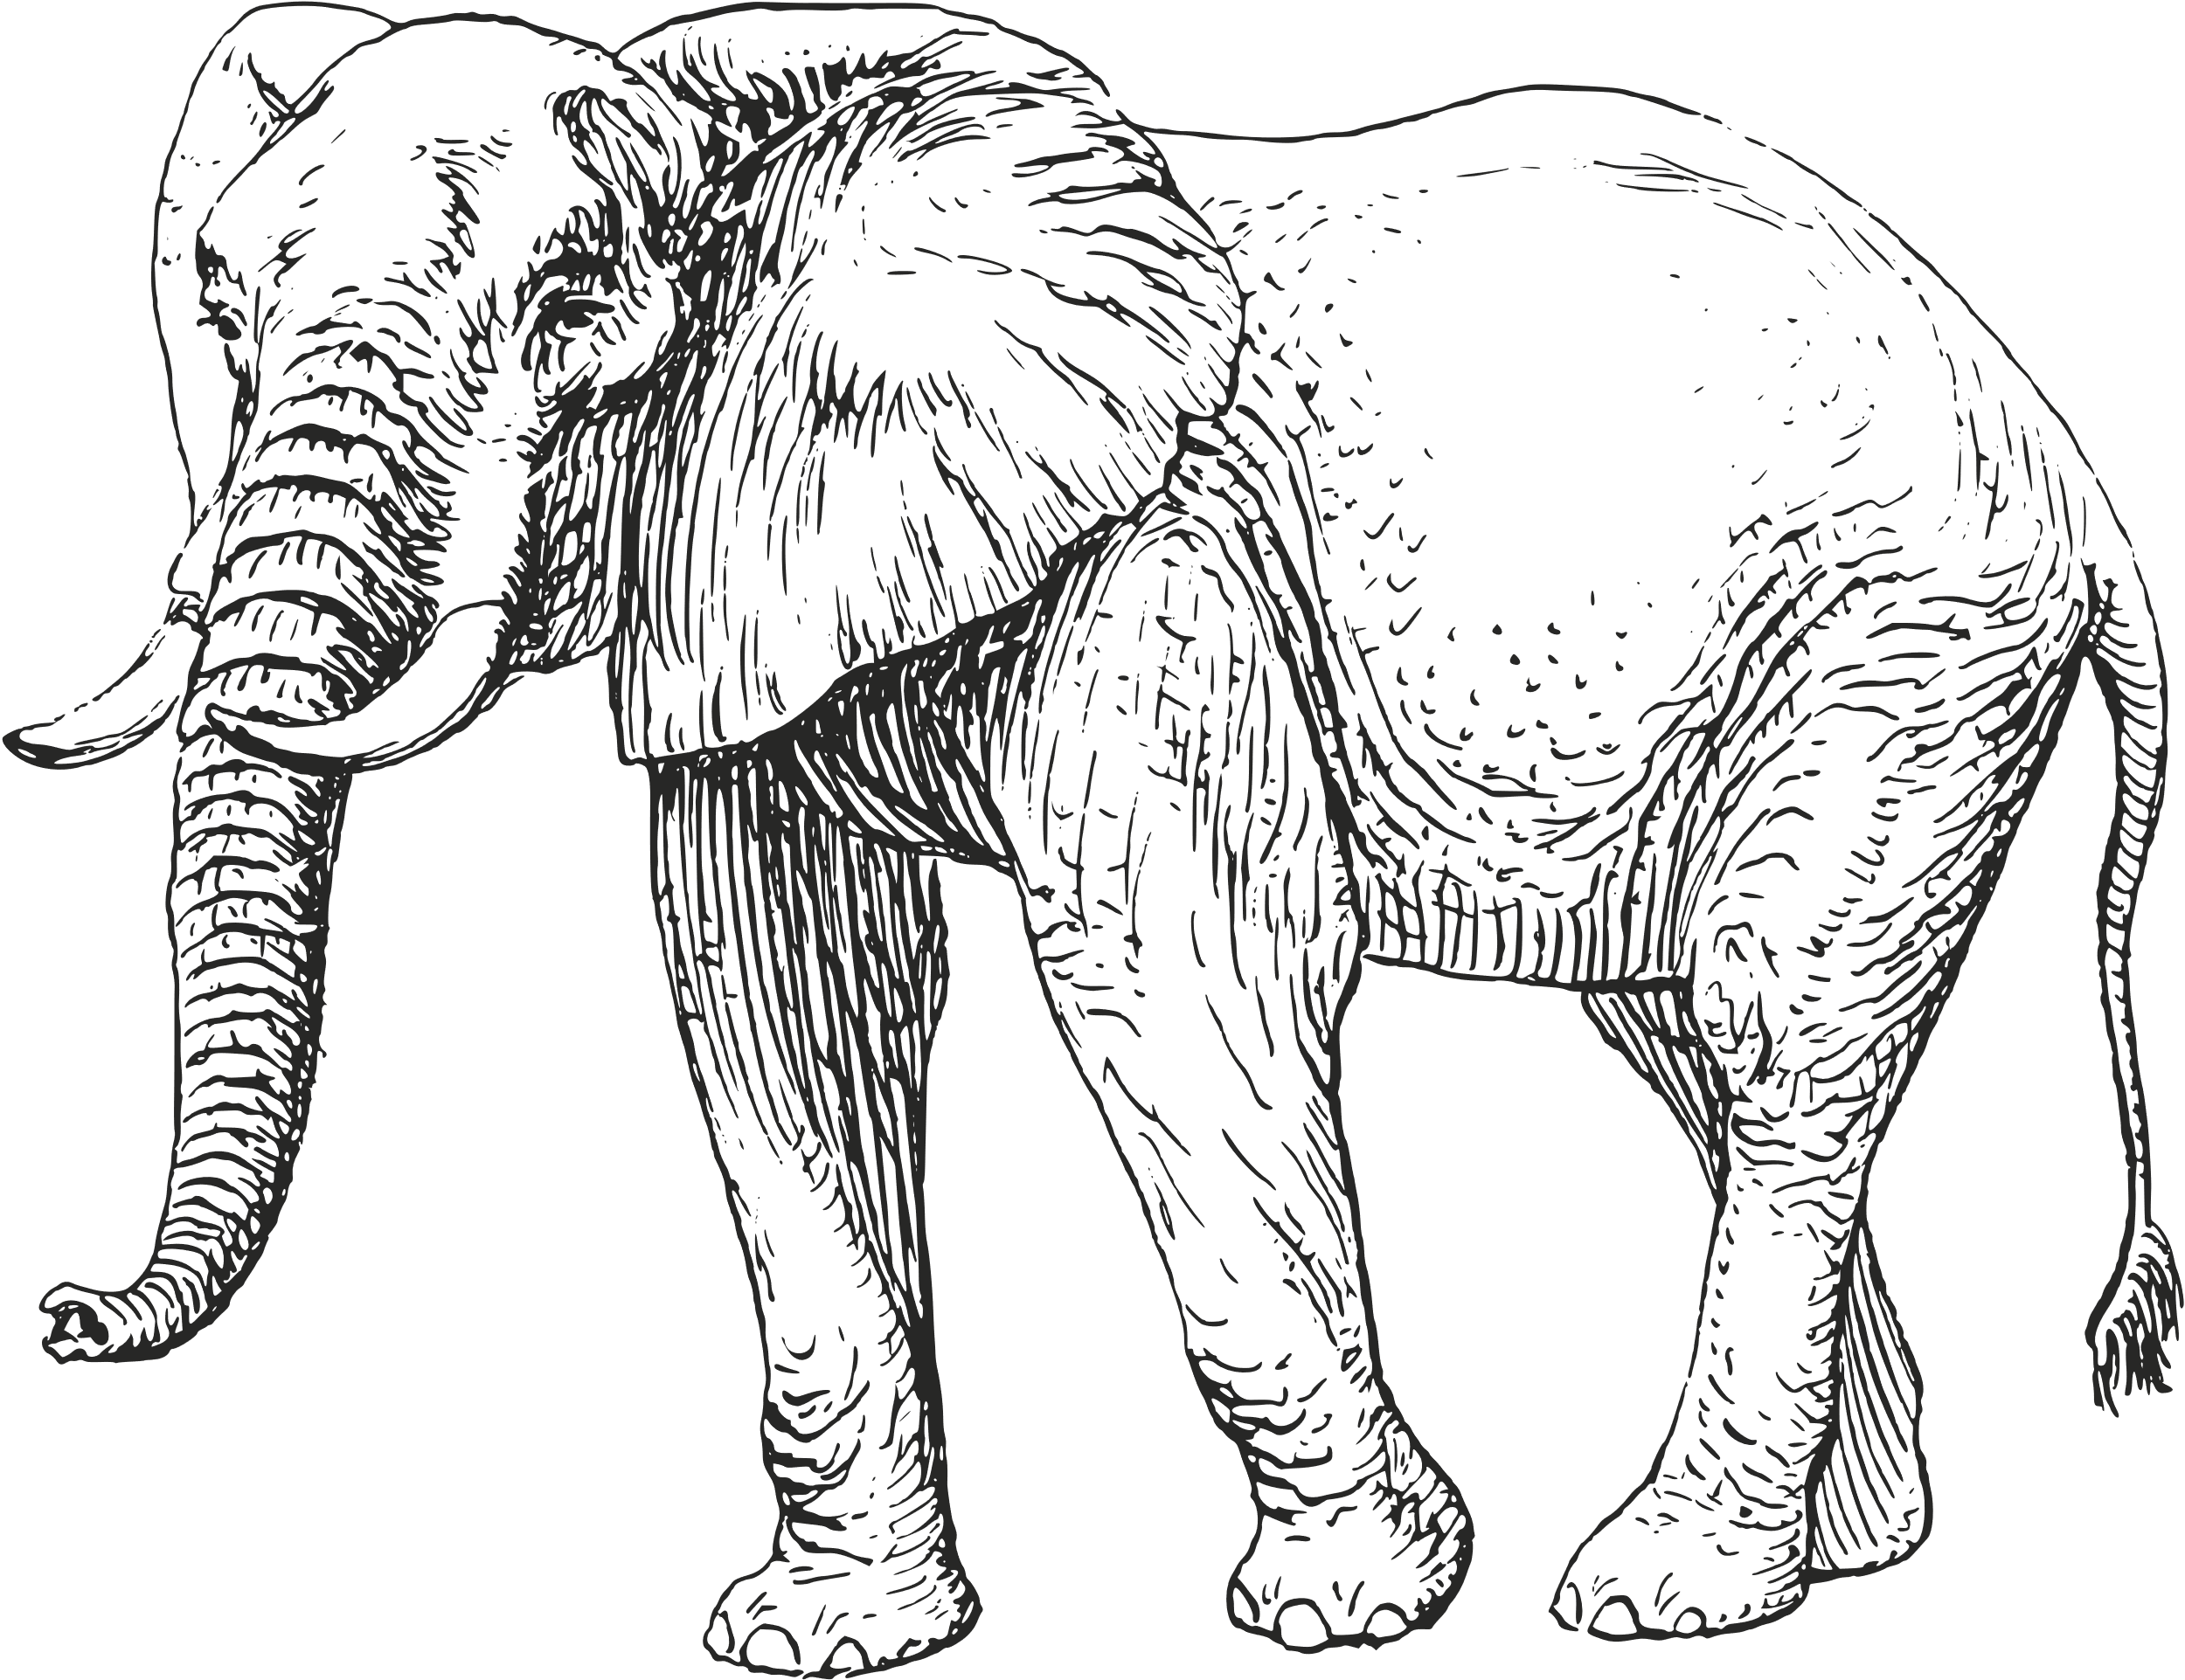

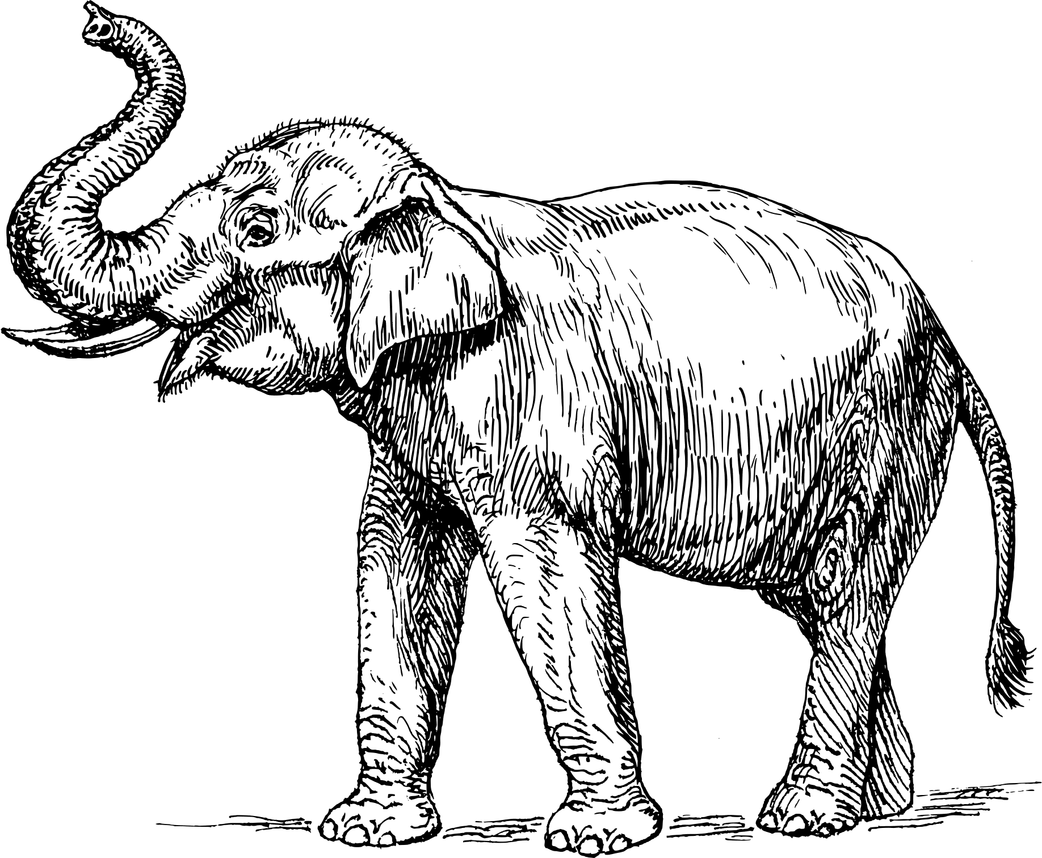
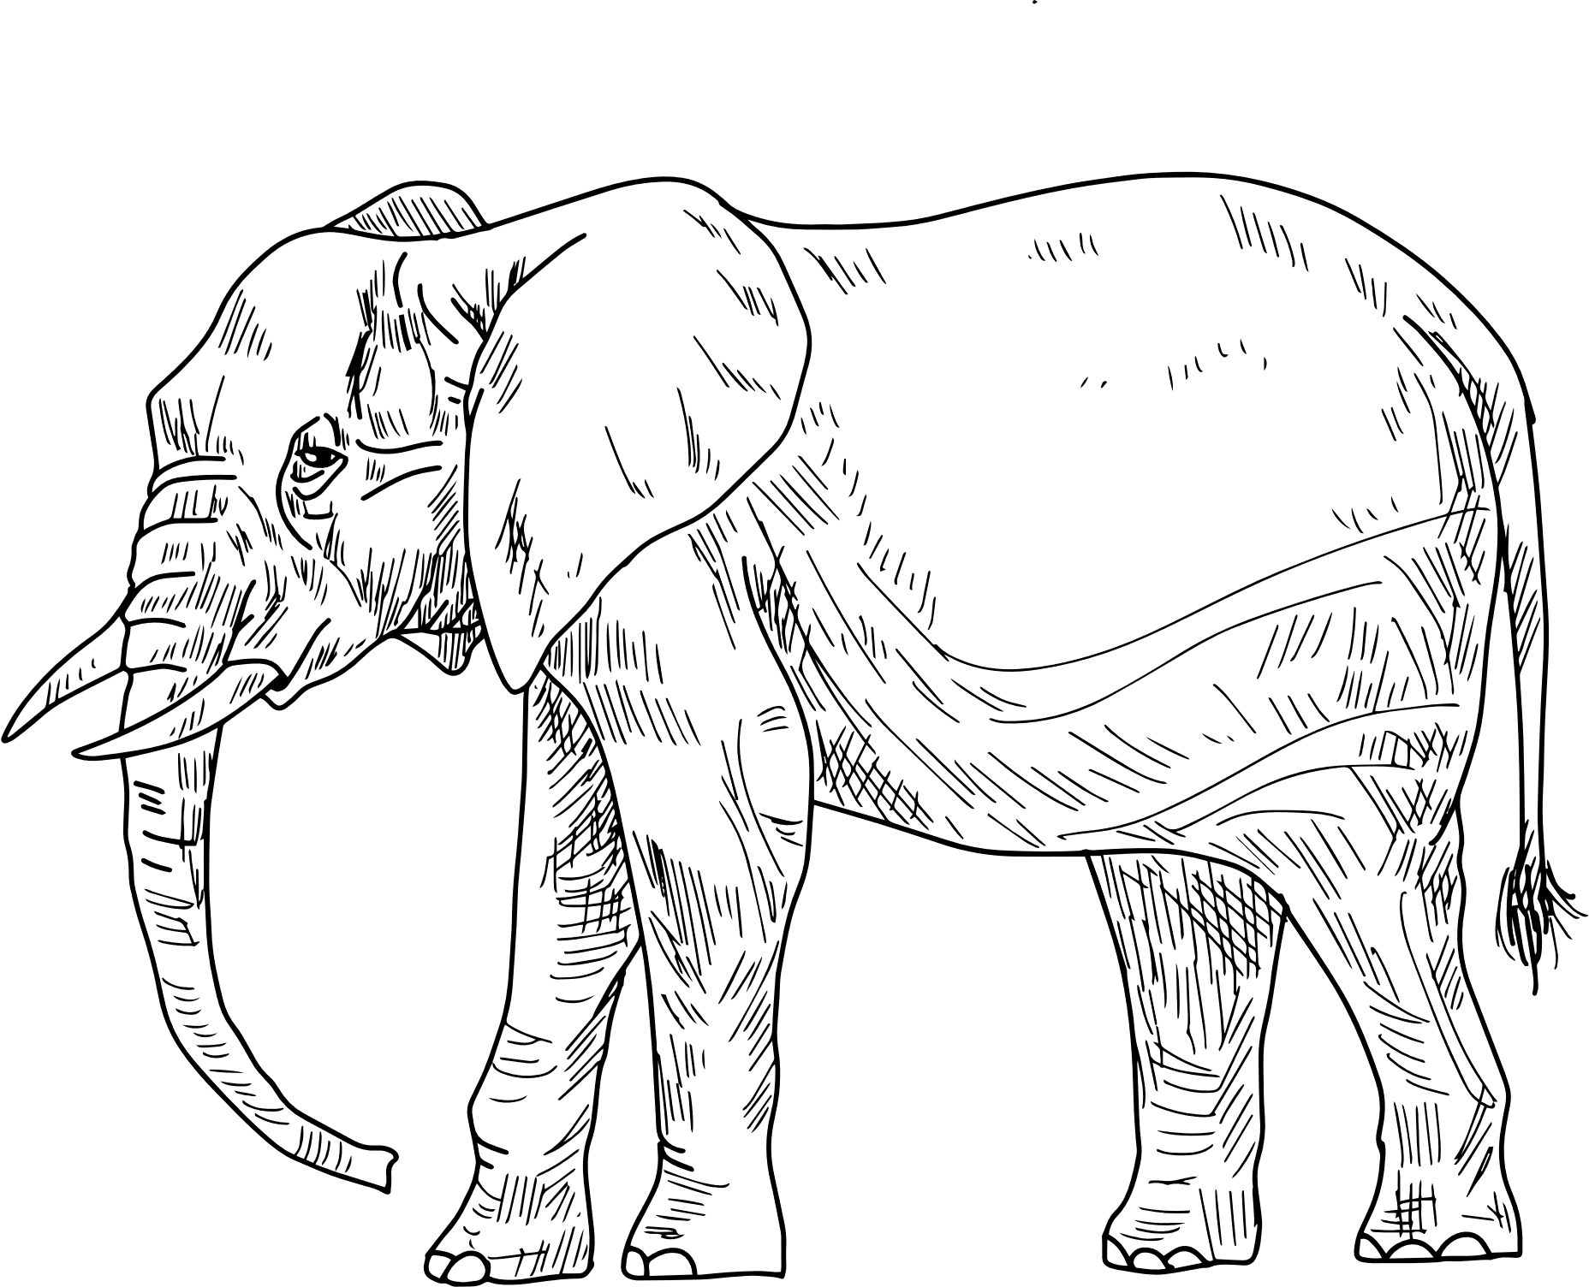

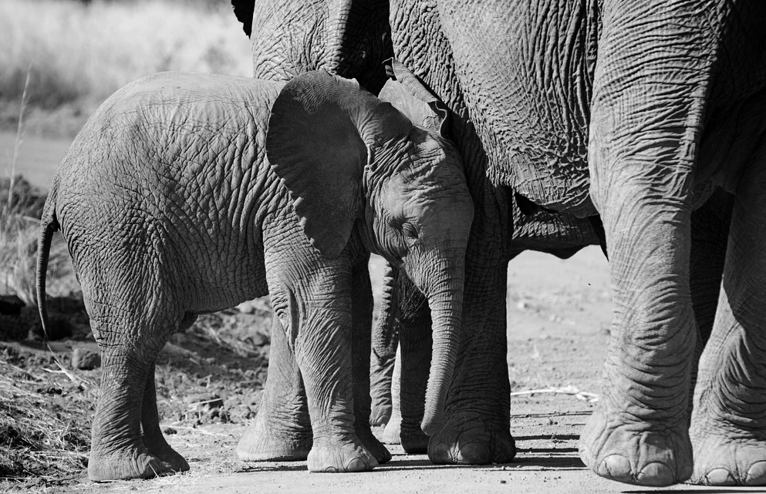


Animal Fact Sheet Template
The African Elephant Fact Sheet Template offers a concise yet thorough overview, detailing key aspects of this majestic species, making it an informative resource for education purposes
African Elephant
Species Information
Physical
Characteristics
Common Name: African Elephant
Length: Approximately 20 feet
Scientific Name: Loxodonta Africana
Height: Around 10 feet at the shoulder
Classification: Mammal
Weight: 8,000 to 12,000 pounds
Habitat: Predominantly savannas, forests, and grasslands in Africa
Color: Typically grey with variations in shades and patterns
Behavior and Social Structure
Biological Replication Process
Gestation Period
Calf Birth Weight
The gestation period for African Elephants typically spans about 22 months, marking one of the longest among land mammals
Newborn African Elephant calves typically weigh about 220 pounds, showcasing their robust nature from birth admirably
Herbivorous, grazing on grasses, leaves, and fruits
Lifespan can reach up to 70 years
Highly social,
living in groups
led by matriarch
Interesting Facts
Conservation Status
1
African Elephants are the largest land animals on Earth
IUCN Status
Vulnerable
2
They use their trunks for various tasks, including breathing, drinking, and grasping objects
3
Elephants are known for their intelligence, emotional depth, and strong social bonds
Threats
Poaching for ivory, habitat loss, human-wildlife conflict
Conservation Efforts
Protection of natural habitats
Anti-poaching initiatives
Community conservation programs

