Slide 1


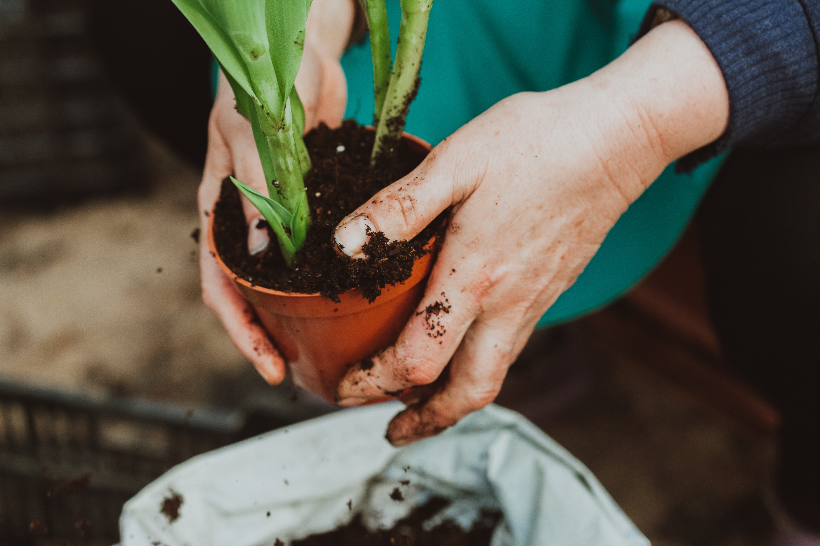
Growing Together
Green Earth Organization
greenearthorganization.com
hello@greenearthorganization.com
+123-456-789
December 15, 2025
Nora Green
Overview
Garden Coordinator
"The 'Growing Together' project aims to establish a sustainable community garden in the heart of our neighborhood, fostering environmental stewardship and community engagement. This project involves collaborating with local residents, schools, and businesses to create a green space that promotes healthy living and social interaction
Max Harves
Outreach Specialist
Lily Bloom
Education Coordinator
20
24

