Slide 1
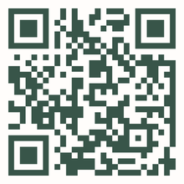
GRAND
OPENING
STORE NAME
50% OFF
We eagerly anticipate our
grand opening, celebrating
with customers, partners, and community. Your presence will make this event truly special
Scan for
more information
15 NOV 2025
123 ANYWHERE ST.,
ANY CITY
9AM
8PM

