Slide 1

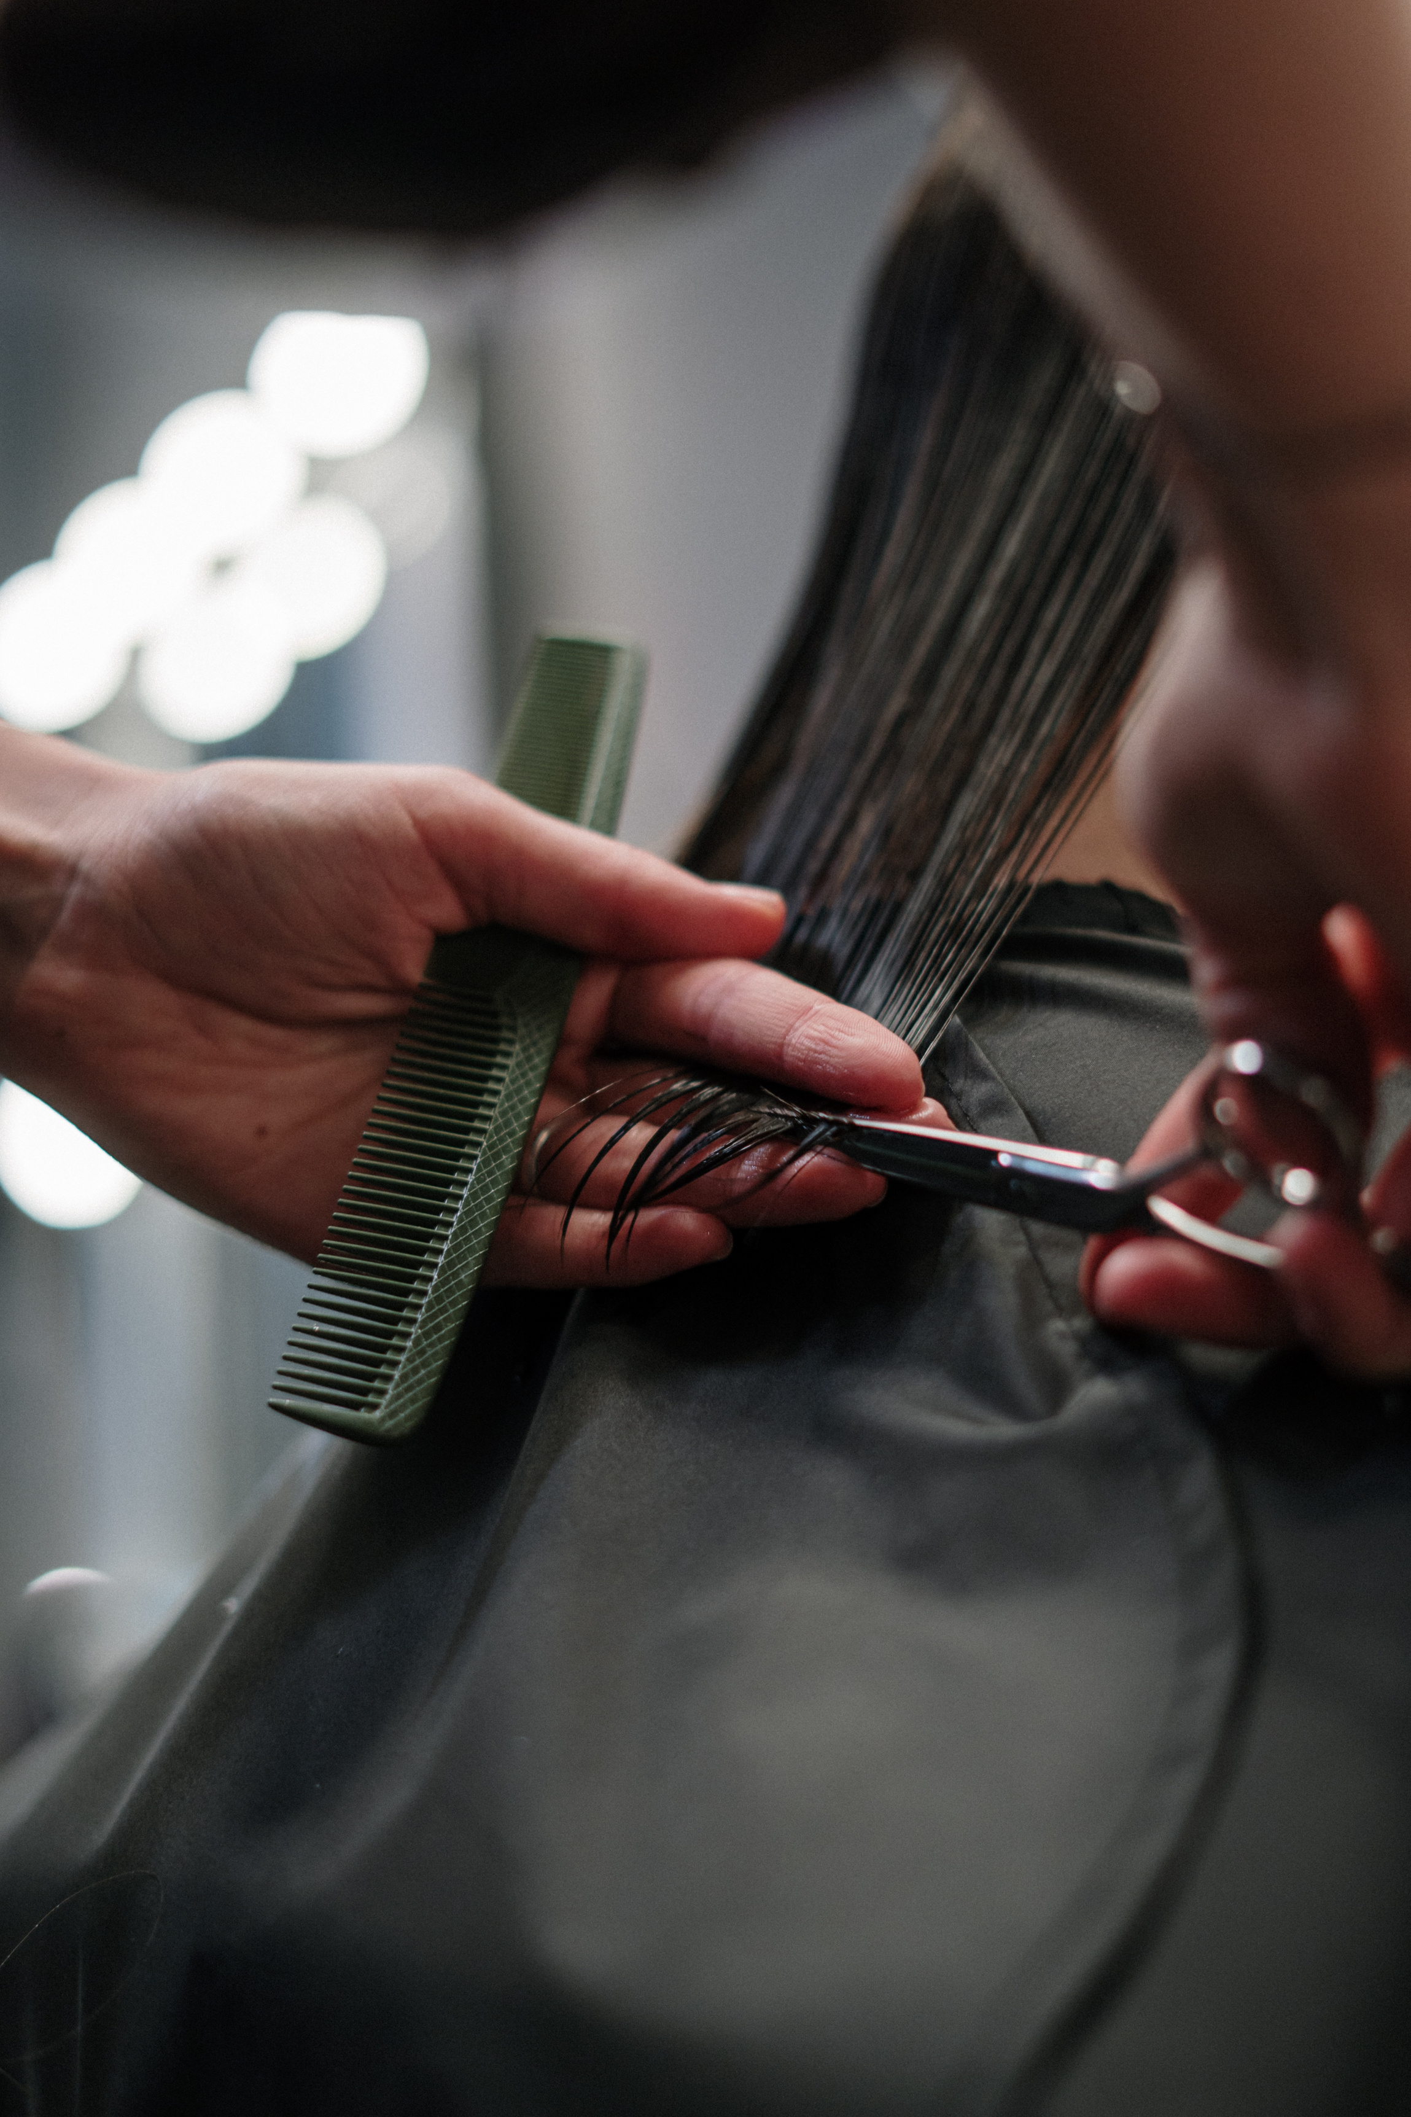


Salon
Grand
Opening
26.05.2027
Scan for more information
Start at 16:00-22:00 | 123 Anywhere St., Any City
CU Cut
$50
TR Trim
$30
Precision hair cutting for a tailored look,
includes consultation and styling
Quick touch-up for maintaining hair length
and shape, includes basic styling
CO Colo
$120
ST Style
$40
Professional hair coloring service, includes
hair treatment for vibrant results
Personalized hair styling for any occasion, includes blowout and finishing touches

