Slide 1
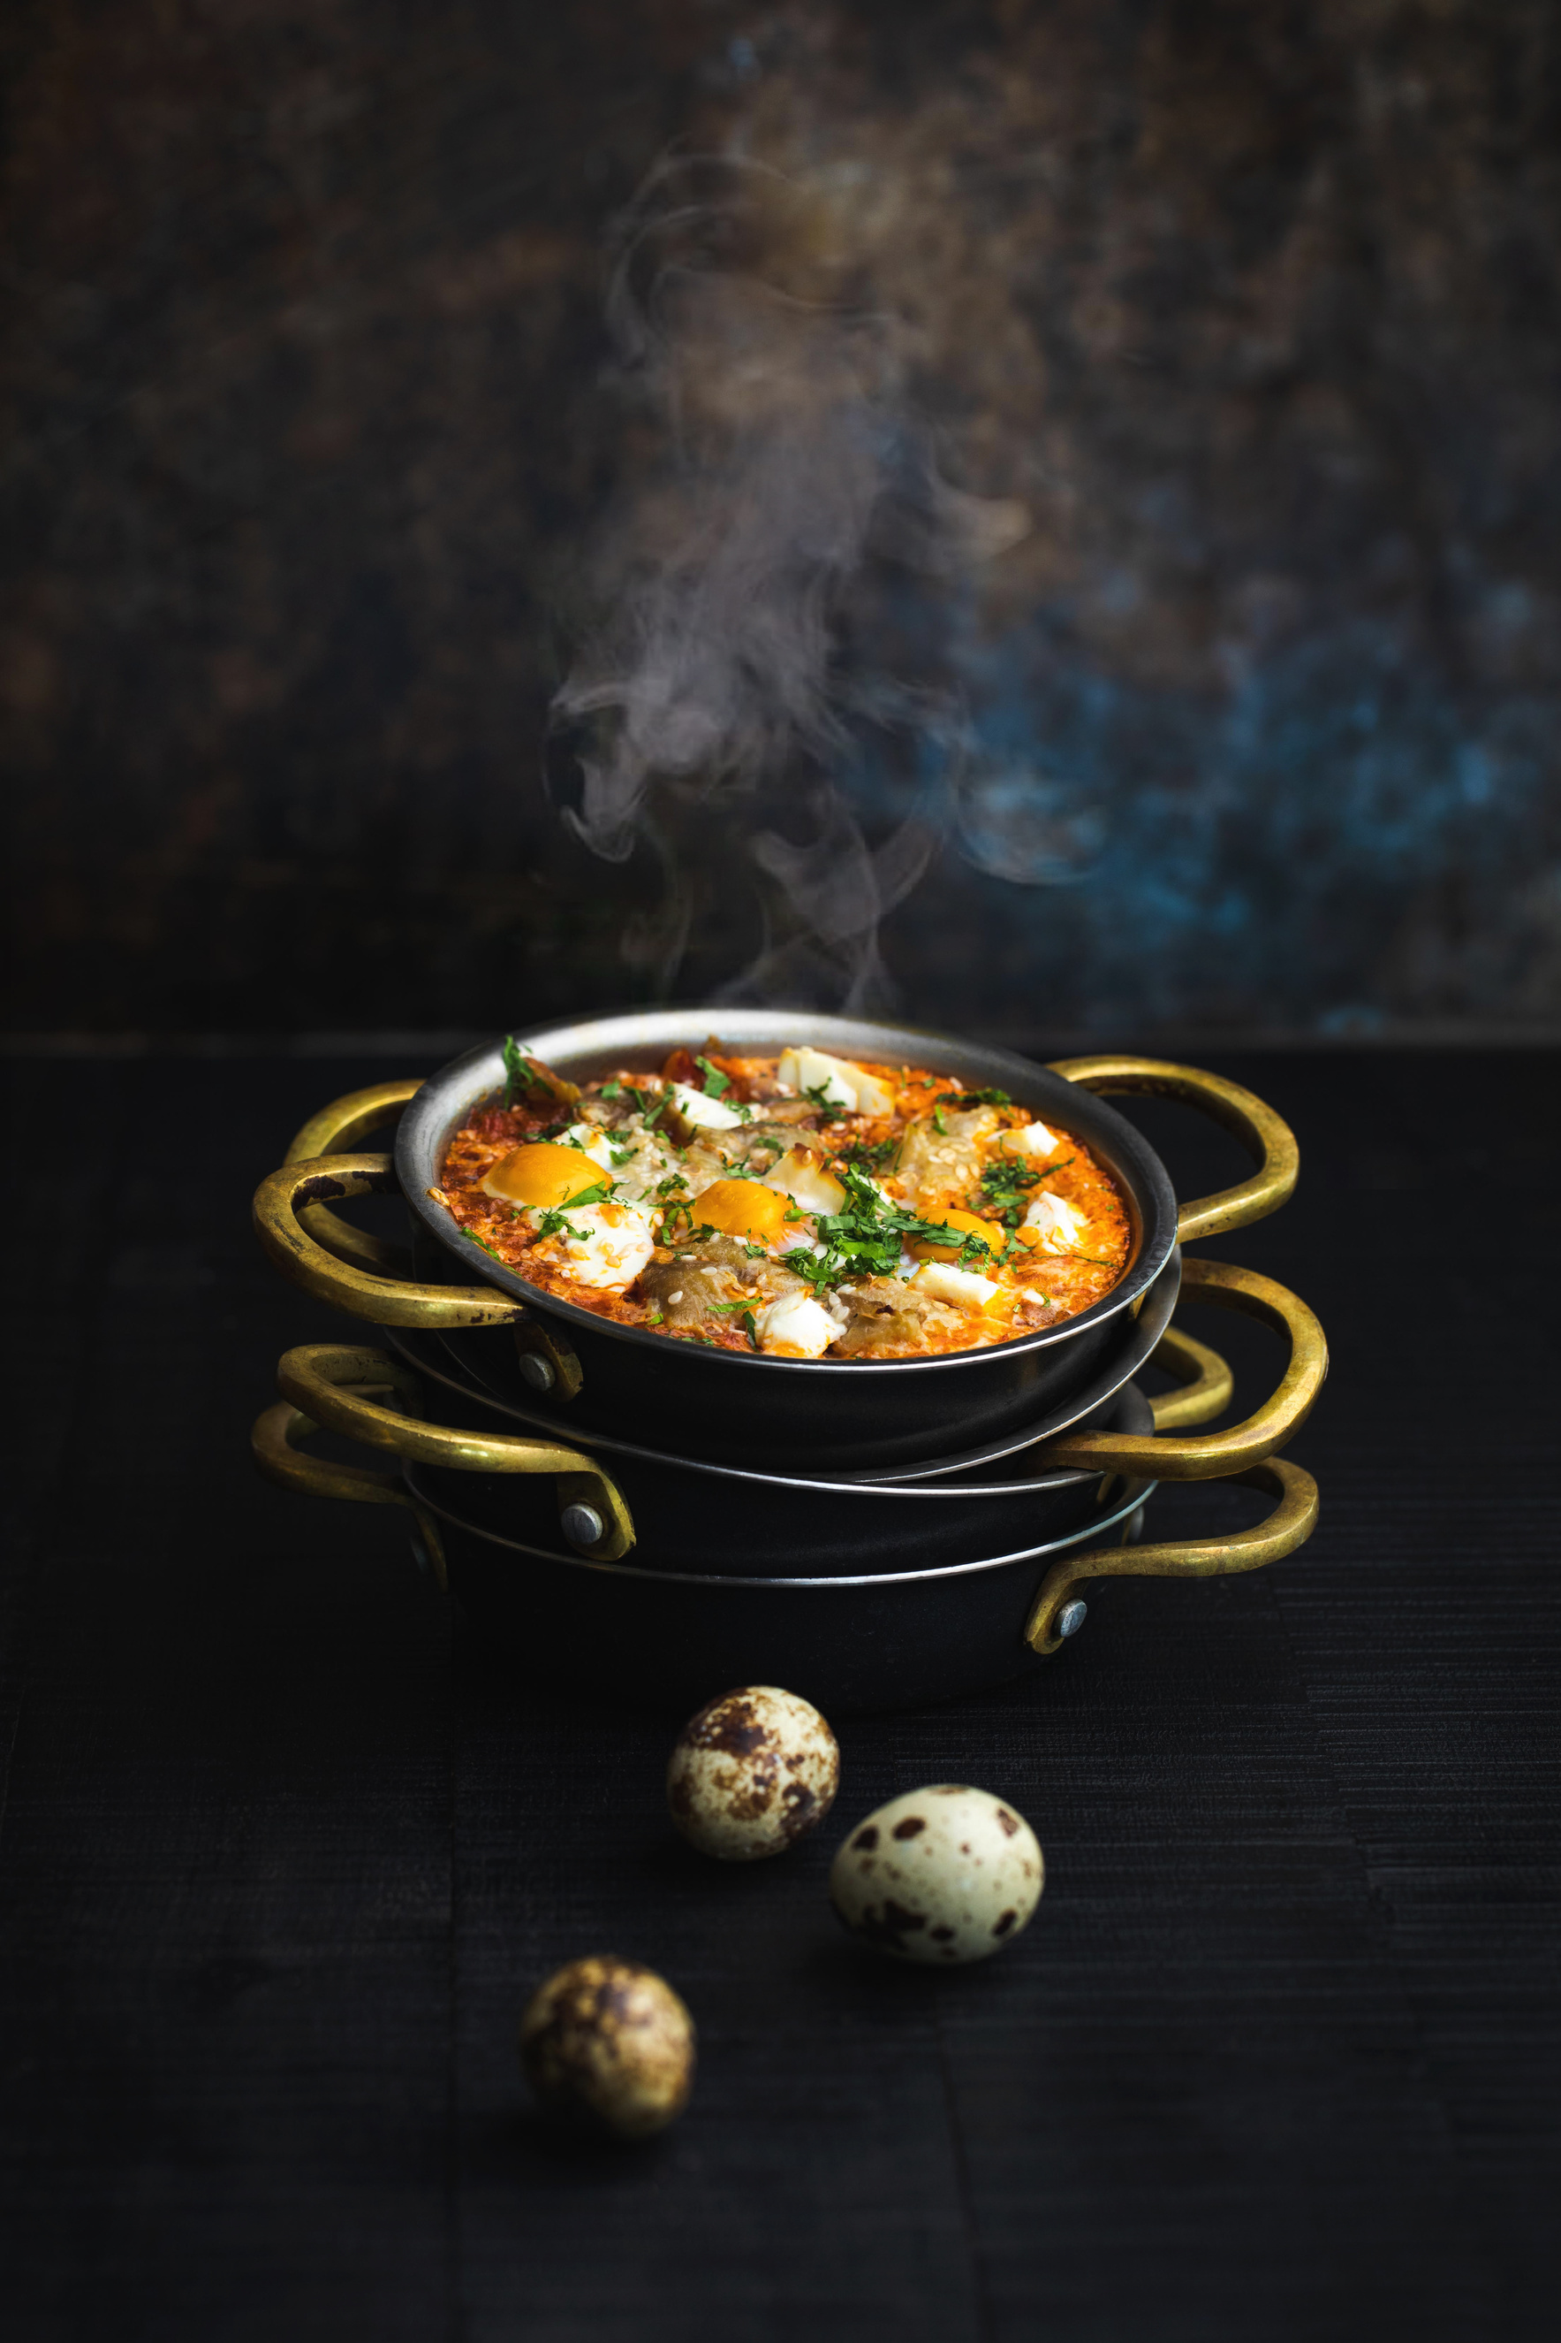


Grand
OPENING
RESTAURANT
20 MAY, 2024
start from 9am
123 ANYWHERE ST., ANY CITY, ST 12345

Slide 2
MENU
RESTAURANT NAME
01
Mediterranean Fusion Cuisine
$20-$25
A blend of Mediterranean flavors with global influences, featuring fresh seafood, aromatic herbs, and bold spices
Prices
02
Contemporary Asian Fusion
$30-$35
Innovative Asian dishes with a modern twist, combining traditional ingredients with avant-garde techniques, resulting in vibrant and flavorful creations
Prices
03
Classic French Gastronomy
$40-$45
Time-honored French culinary traditions showcasing elegant presentations,
rich sauces, delicate flavors, and meticulous attention to detail
Prices
04
Modern American Bistro
$50-$55
Creative interpretations of American comfort classics using locally sourced ingredients, presented with flair and accompanied by artisanal sides
Prices
05
Italian Trattoria Eleganza
$60-$65
Rustic Italian dishes elevated with sophistication, featuring handmade pasta, premium cheeses, and seasonal produce, inspired by regional culinary traditions
Prices
01.
Craft Cocktails /
02.
Sommelier Selections /
Handcrafted cocktails featuring premium spirits, and artisanal garnishes, expertly mixed to tantalize the taste buds
A curated collection of fine wines from renowned vineyards, offering a spectrum of flavors and varietals to complement every dish
+123-456-7890
templatelab.com

