Slide 1

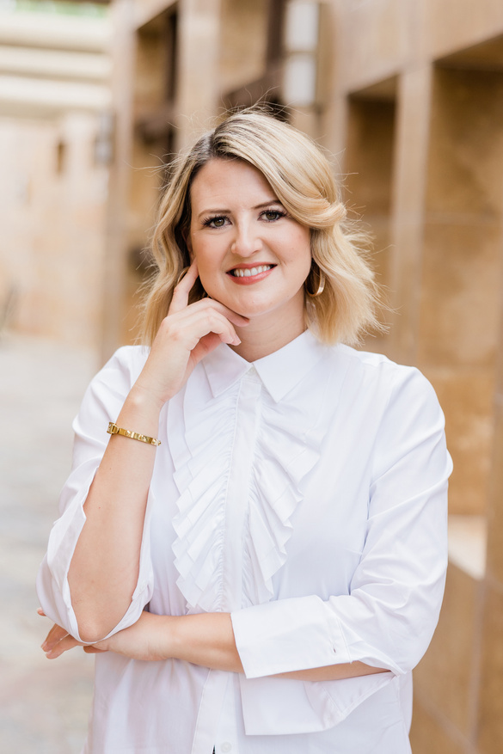
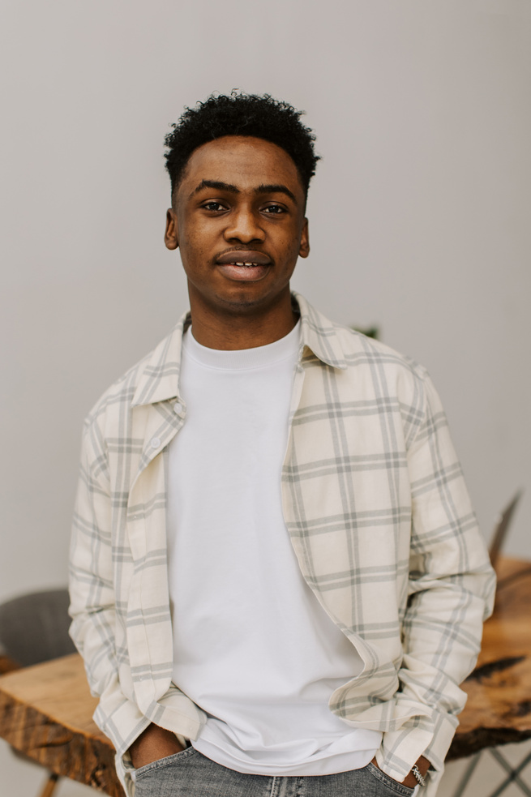



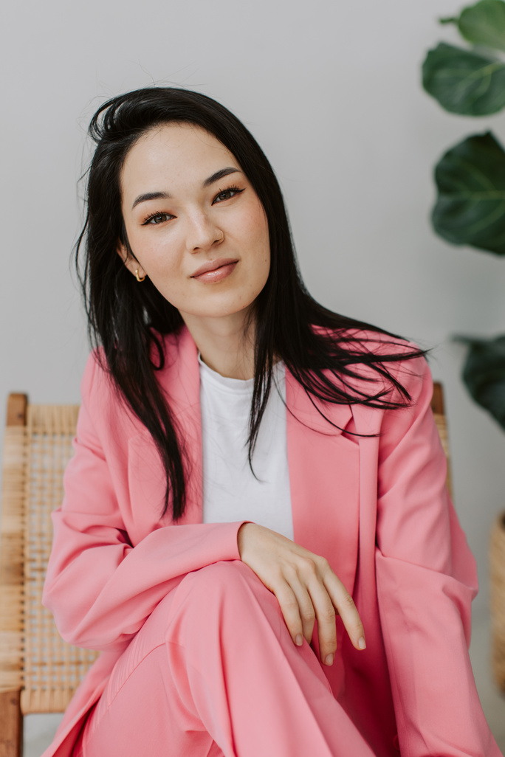


ORGANIZATIONAL CHART
for small business
EcoSpace Designs
Olivia Bennett
CEO of EcoSpace Designs
Creative Studio
Project Management
Client Relations
Ethan Turner
Sarah Mitchell
Alex Reynolds
Daniel Foster
Emily Parker
Ava Turner
Design Manager for Aesthetic Innovation
Innovation Maven
for Visionary Ideas
Project Coordinator for Seamless Execution
Operations Manager of Timely Deliveries
Client Services Manager
for Experiences
Client Comms Satisfaction Expert

