Slide 1
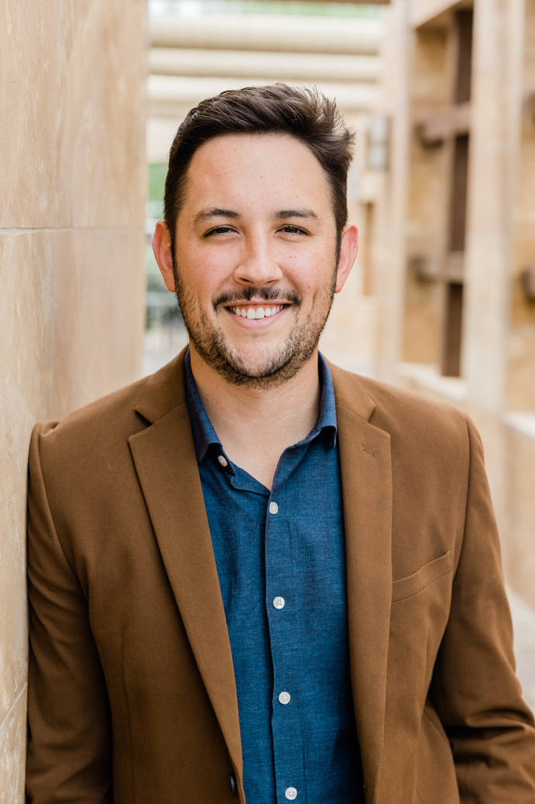
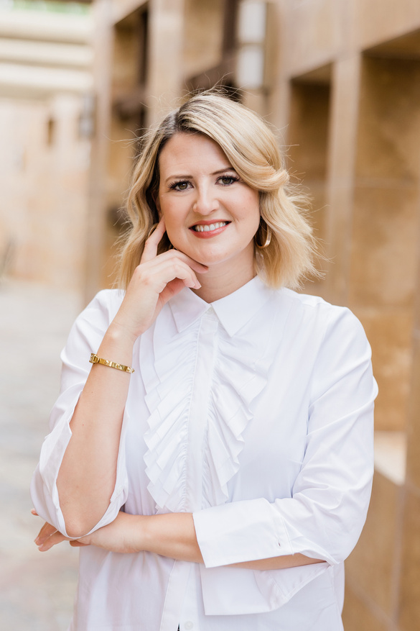
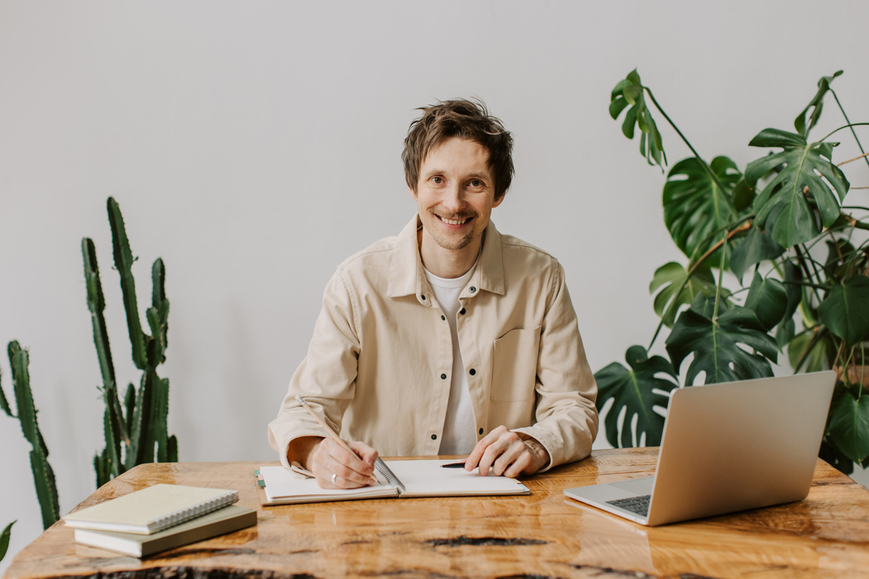
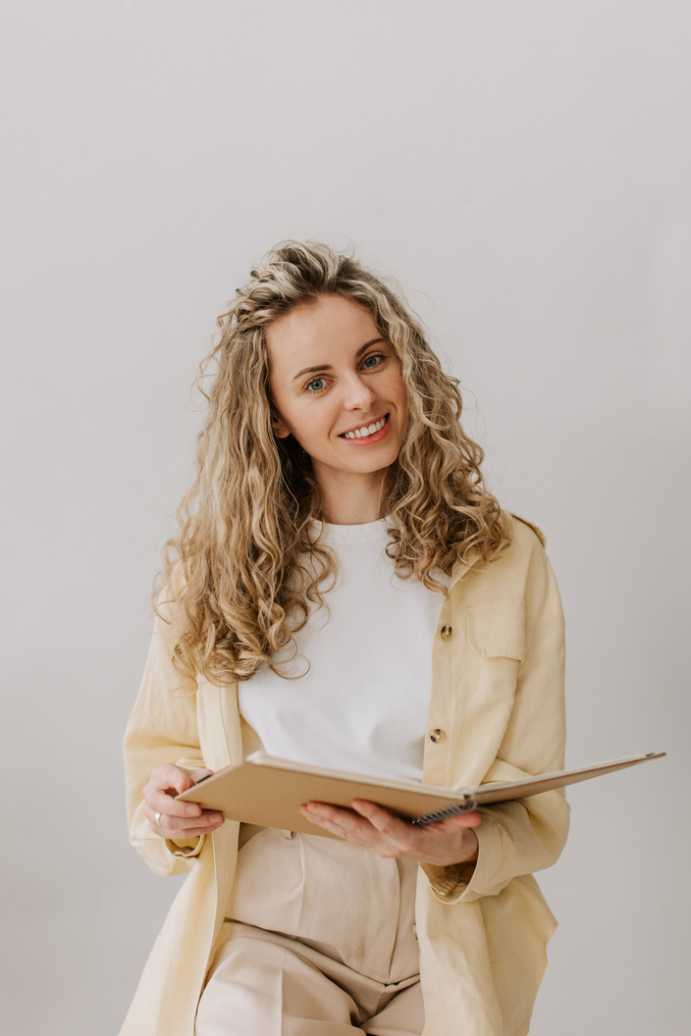
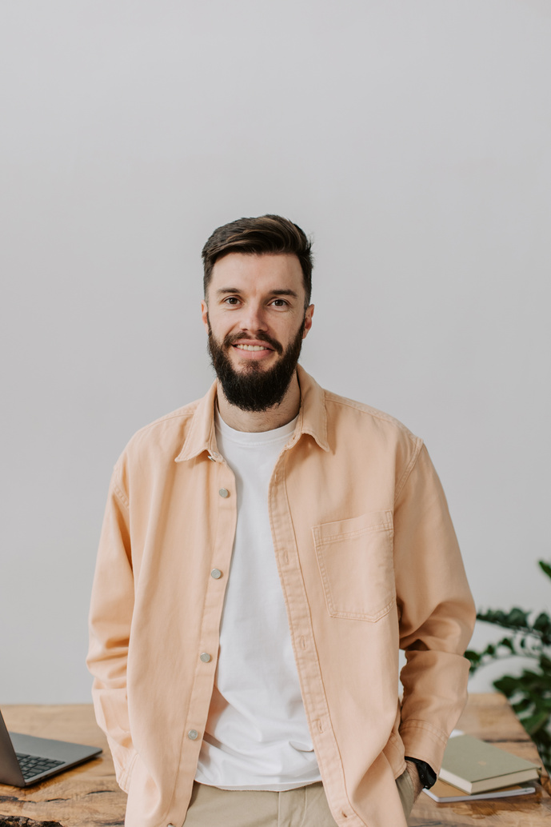
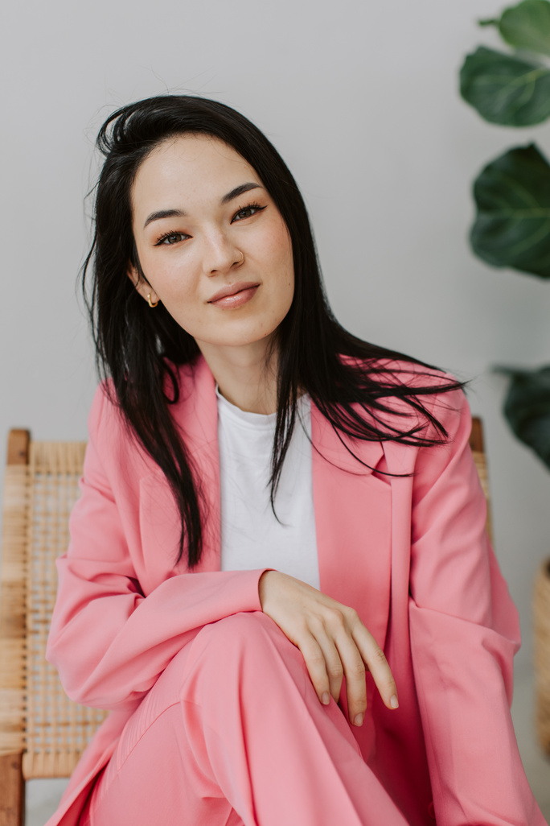
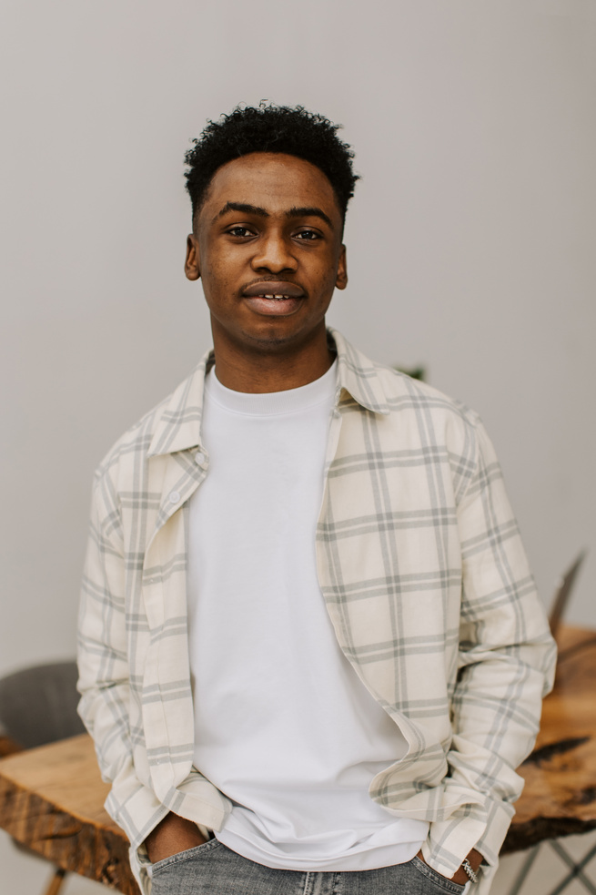

GreenSync Transit Hub
Hierarchy chart
Revolutionizing urban mobility, our project integrates sustainable transportation solutions, leveraging advanced technologies for
seamless connectivity, reduced environmental impact, and
enhanced commuter experience
Alex Turner
Olivia Bennett
General Manager
CEO
Max Swift
Jade Luna
Leo Blaze
Elle Frost
Rex Stone
Manager A
Manager B
Manager C
Manager D
Manager E
Mia Echo
Finn Storm
Ava Ember
Ty Nova
Zoe Frost
Leader A
Leader B
Leader C
Leader D
Leader E
Kai Spark
Elle Flame
Mia Zephyr
Dex Frost
Jax Frost
Employee
Employee
Employee
Employee
Employee

