Slide 1

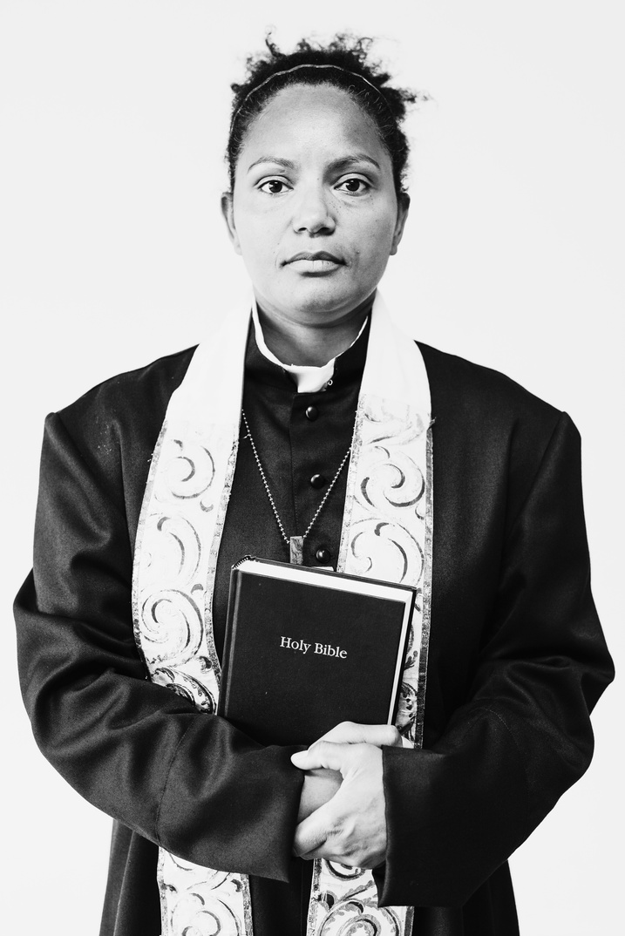

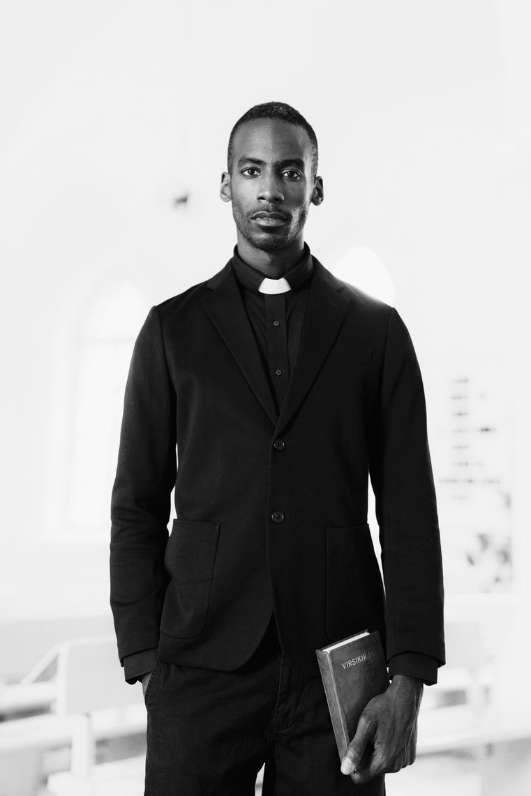
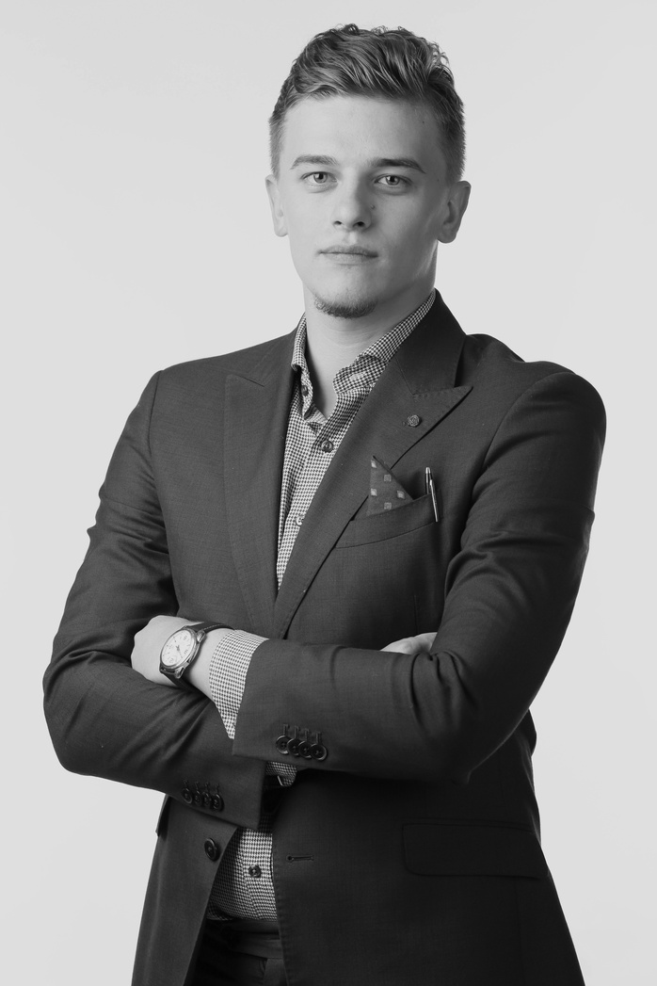

GRACEFUL HARMONY COMMUNITY CHURCH
CHURCH ORGANIZATIONAL CHART
Reverend Elizabeth Thompson
Senior Pastor
Worship and
Music Ministry
Community
Outreach
Administration
and Operations
Sarah Anderson
Michael Rodriguez
Daniel Mitchell
Worship Director
Outreach Coordinator
Church Administrator
David Carter
Rebecca Turner
Richard Brown
Music Producer
Missions Coordinator
Finance Manager
Lisa Garcia
Daniel White
Patricia Miller
Choir Coordinator
Events Coordinator
Facility Coordinator
Benjamin Foster
Karen Adams
Josephine Lewis
Tech Coordinator
Volunteer Manager
HR Coordinator
templateLAB.com
+123-456-7890

