Slide 1

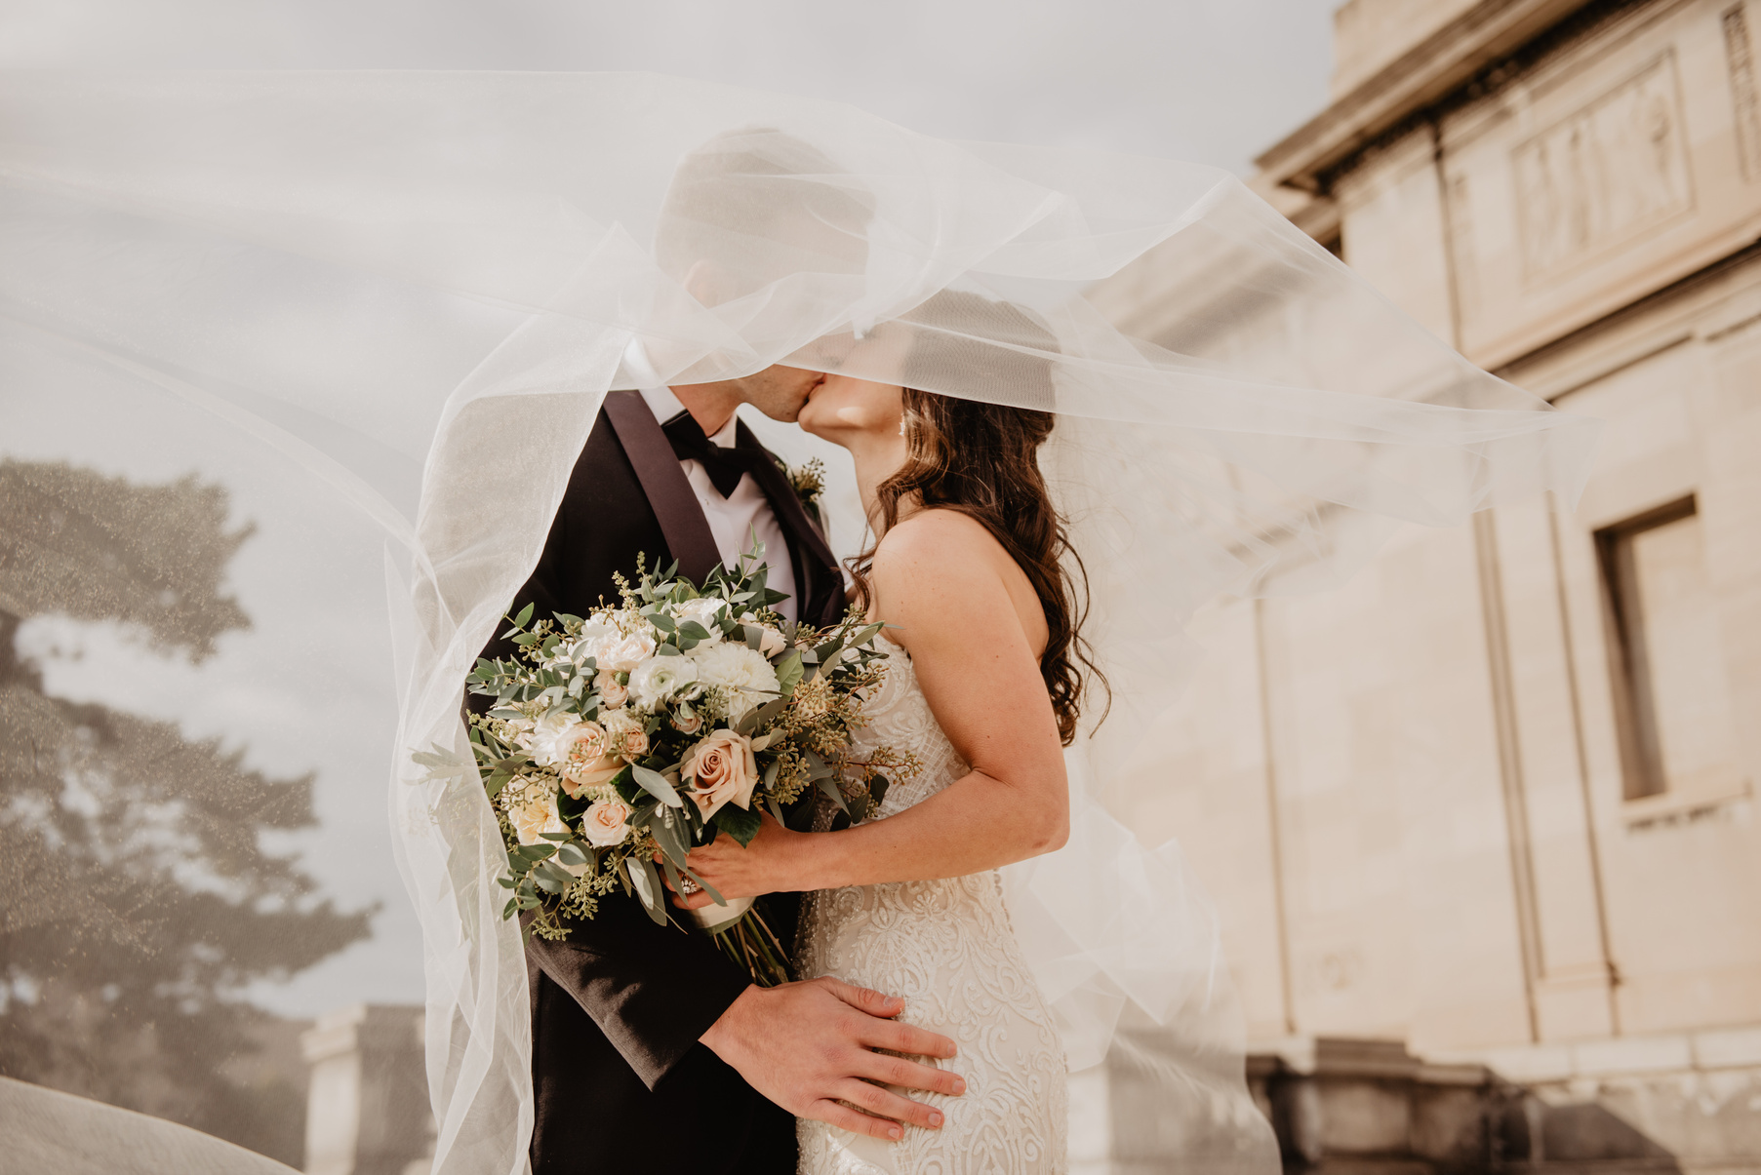



OCT 15, 2023
WEDDING BOOKLET
ANNA & THOMAS
In life's tapestry, love intertwines enchanting threads, uniting souls in
eternal joy. Today, we celebrate love's magic, transcending time, shaping
a future adorned with shared dreams and unwavering commitment

Slide 2


A JOURNEY OF LOVE.
  OCT 15, 2023
Our Serendipitous Encounter
In the bustling city where fate often intertwines lives, we encountered each other in the most serendipitous manner. A chance meeting at a local cafe sparked a conversation that resonated with laughter and shared interests. Little did we know that initial encounter would blossom into a profound connection, leading us down the path of love and companionship.
The Unforgettable Proposal
With hearts intertwined and a journey filled with cherished memories, the day of our engagement stands out as a highlight in our love story. Underneath the starlit sky, surrounded by the enchanting glow of candlelight, a heartfelt proposal unfolded, forever etching a moment of joy, commitment, and the promise of a shared future.
A Love Story Worth Celebrating
As we embark on this joyous journey together, we invite you to be a part of our love story. Join us in celebrating the union of Anna and Thomas, as we exchange vows and pledge our love in the presence of cherished friends and family. Your presence will add to the magic of this day, making it a celebration to remember and a testament to the enduring power of love. Let's create lasting memories and mark the beginning of our new chapter.
Anna & Thomas

Slide 3

THE WEDDING OF
ANNA & THOMAS
DATE & TIME
3:00 PM Saturday | 2nd of August 2023
LOCATION
Lakeside Manor Gardens
PARENTS OF THE BRIDE
Harper Quinn & Oliver Finch
PARENTS OF THE GROOM
Maya Sterling & Nolan Everest
BRIDESMAIDS
Luna Valencia, Jade Montgomery, Isla Monroe, Aurora Mitchell, Zoey Donovan
GROOMSMEN
Maxine Hartman, Dexter Blake, Asher Donovan, Celeste Ramirez, Leo Hendrix
FLOWER GIRLS
Caleb Mercer & Felix Santiago
WEDDING ORGANIZER
Celestial Nuptial Extravaganzas

Slide 4
the
WEDDING
Timeline
8:00 AM - 12:00 PM
MORNING
PREPARATIONS
12:00 PM - 2:00 PM
FIRST LOOK
AND PHOTOS
3:00 PM - 4:00 PM
WEDDING
CEREMONY
4:30 PM - 5:30 PM
COCKTAIL
HOUR
6:30 PM - 8:30 PM
BOUQUET AND
GARTER TOSS
09:00 PM - 12:00 AM
LAST DANCE
AND FAREWELL
Anna & Thomas
Thank you for joining us
in celebrating this special occasion!

