Slide 1
CIAO
ITALY!
TRAVEL BOOKLET
DISCOVER ITALY
Your Ultimate Guide to Unforgettable Adventures

Slide 2
TABLE OF
CONTENTS
01
Cover page
Unforgettable Adventures Await! Your Ultimate Travel Companion
02
Table of contents
An organized list of sections, highlighting
the diverse experiences awaiting the traveler
03
Welcome to Italy
Explore cultural wonders, from historic landmarks to vibrant traditions in Italy
04
Best Destination
Discover Italy's enchanting landscapes, from historic Rome to picturesque Venice
05
Art and Culture
Immerse yourself in Italy's rich artistic heritage, witnessing masterpieces come
06
Food and Culinary
Indulge in Italy's diverse flavors, from pasta perfection to regional delicacies
07
Budgeting
Navigate Italy economically with savvy tips for budget-conscious travelers
08
Contact Us
Plan your adventure - contact us for personalized travel tips to Italy
DISCOV﻿ER ITALY | PAGE 2

Slide 3
WELCOME TO
ITALY
Italy - a cultural gem in Southern Europe, boasts a rich history, art, and culinary delights, captivating visitors worldwide.
Italy - a country where rich history
and cultural treasures converge
to create a timeless tapestry. From the iconic Colosseum in Rome to the exquisite art of Florence, Italy boasts an unparalleled historical legacy. Dive into the enchanting world of Renaissance art and architecture, where masterpieces by Michelangelo and Leonardo da Vinci come to life, showcasing the country's enduring commitment to beauty and creativity.
Indulge your senses in Italy's culinary
haven, where each region offers a unique gastronomic experience. From the savory delights of Sicilian cuisine to the delectable pasta dishes of Bologna, Italian food is
a celebration of fresh ingredients, bold flavors, and culinary tradition. Prepare
to embark on a culinary journey that will tantalize your taste buds and leave you savoring the essence of la dolce vita.
DISCOV﻿ER ITALY | PAGE 3

Slide 4
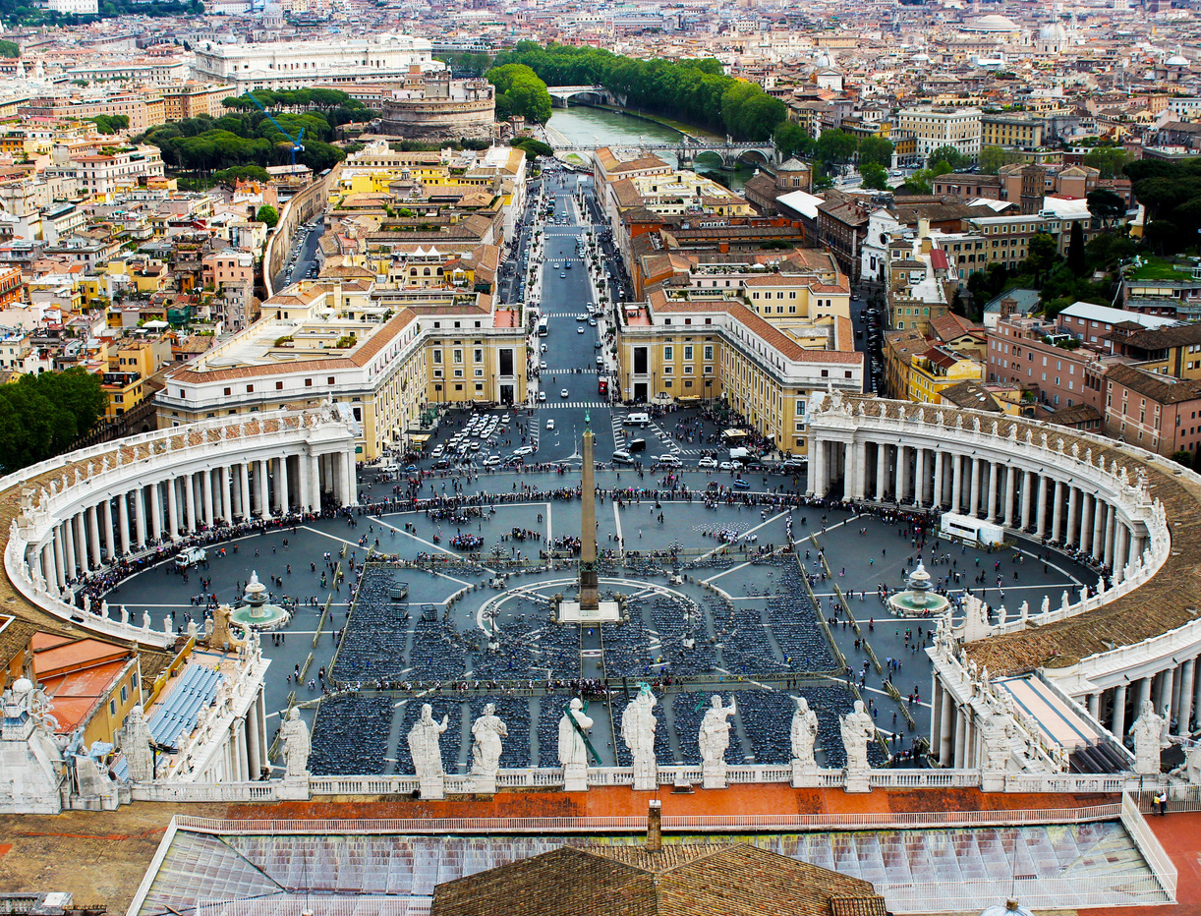
Venice, Veneto
(Northern Italy)
Venice, renowned for its scenic canals, historic architecture, and distinctive gondola transportation, features iconic landmarks like St. Mark's Basilica and the Doge's Palace. The Grand Canal, flanked by stunning buildings, is a must-visit. This romantic and enchanting destination captivates visitors with its timeless charm and allure.
Rome, Lazio
(Central Italy)
Rome, Italy's capital, is a rich repository of ancient history and architecture, boasting renowned sites like the Colosseum, Roman Forum, and Pantheon. The Vatican City, an independent enclave within Rome, hosts St. Peter's Basilica and the Sistine Chapel. Rome seamlessly blends ancient ruins, Renaissance art, and a dynamic modern culture.
Best Destination
DISCOV﻿ER ITALY | PAGE 4

Slide 5
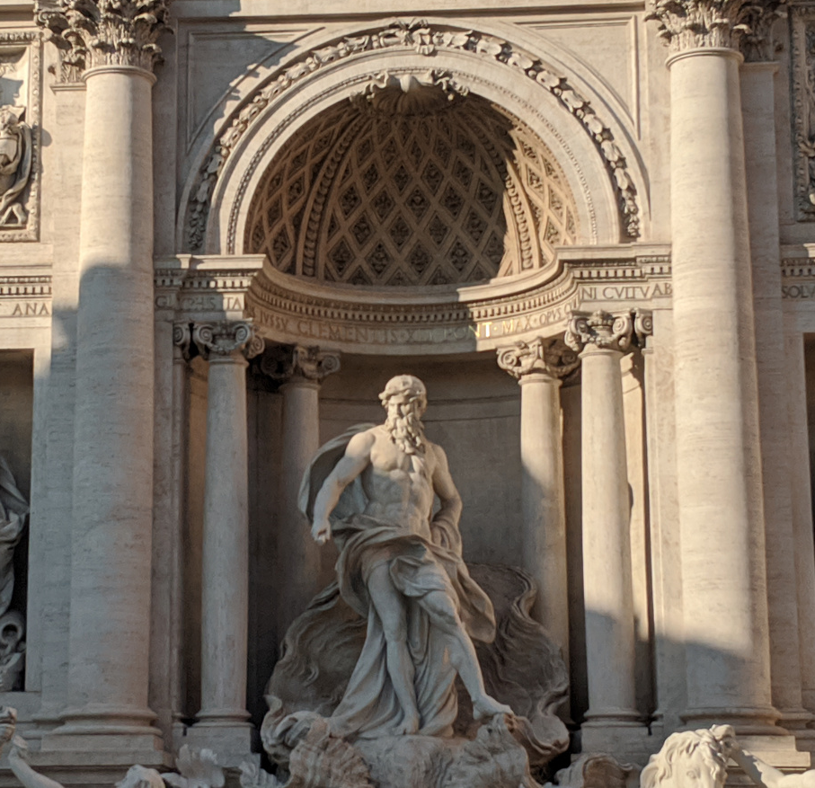
Art &
Culture
ART PLACE
Nestled in the heart of Italy, Florence stands as an unrivaled art haven and cultural gem. Renowned for its rich Renaissance history, the city boasts an impressive array of museums, including the iconic Uffizi Gallery and the Accademia Gallery, home to Michelangelo's David. Stroll through the charming streets adorned with historic architecture, where every corner seems to whisper tales of artistic brilliance. Florence
is not merely a city; it's an immersive journey through the very soul of Italian creativity, inviting visitors to revel in the timeless beauty
that permeates its every cobblestone.
CULTURAL HUB
Venture south to Rome, the eternal city and Italy's cultural nucleus. Reverberating with millennia of history, Rome is a sprawling tapestry of art, architecture, and traditions. Marvel at the grandeur of the Colosseum, lose yourself in the Vatican City's artistic treasures and wander through the enchanting streets to discover hidden fountains and piazzas. From the exquisite frescoes of the Sistine Chapel to the grandeur of the Roman Forum, Rome is
a living testament to the enduring power of human expression. Immerse yourself in the heart of Italy's cultural legacy as you traverse the vibrant streets of this extraordinary city.
DISCOV﻿ER ITALY | PAGE 5

Slide 6
Food & Culinary
1
PIZZA MARGHERITA
Classic Neapolitan pizza with a thin crust, tomato sauce, fresh mozzarella, basil, and a drizzle of olive oil
2
SPAGHETTI CARBONARA
Al dente pasta tossed with a creamy sauce made of eggs, Pecorino Romano cheese, pancetta, and black pepper
3
RISOTTO MILANESE
Creamy saffron risotto from Milan, enriched with butter and Parmesan
—a luxurious, Northern Italian delight
4
TIRAMISU
Layers of coffee-soaked ladyfingers and mascarpone cream create a luscious, iconic Italian dessert delight
DISCOV﻿ER ITALY | PAGE 6

Slide 7
Budgeting
Estimated cost
Accommodation
~$1,500
Small costs within this expense include nightly room rates, taxes, and any additional fees for amenities
Transportation
~$1,500
This covers flights, local transportation, and possibly car rentals or train tickets for exploring various destinations
Food and Dining
~$800
Sampling local cuisines, dining out, and occasional snacks contribute to the overall cost of sustenance during the trip
Sightseeing and Activities
~$500
Entrance fees to museums, attractions, guided tours, and other activities add up to the expense of exploring Italy
Miscellaneous and Souvenirs
~$300
Unexpected expenses, souvenirs, and small indulgences contribute to the miscellaneous category in the overall budget
$4600
for 1 person
DISCOV﻿ER ITALY | PAGE 7

Slide 8
DISCOVER ITALY
Contact us
Email
Website
info@templateLAB.com
www.templateLAB.com
Instagram
Facebook
templateLAB Official
templateLAB Official
Address
Hotline
+123-456-7890
12 Anywhere Street, Any City, ST, 345

