Slide 1
TRAINING BOOKLET
ENHANCING COMMUNICATION, ACHIEVING SYNERGY
QUIRKIFY
STUDIO
123 Anywhere St., Any City
+123-456-7890
www.Quirkifystudio.com

Slide 2
QUIRKIFY
STUDIO
123 Anywhere St., Any City
+123-456-7890
www.Quirkifystudio.com
03
Welcome Message
CEO welcome message extends warm greetings to new team members
04
Safety First
Prioritize and practice safety protocols to ensure a secure work environment
Table of contents
05
Team Dynamics
Foster a collaborative environment through effective communication
and teamwork strategies
06
Tech Mastery Basics
Acquire fundamental skills
for using essential workplace technologies efficiently
07
Time Management
Improve efficiency with
time skills and smart task prioritization for productivity
08
Contact Information
Reach out to us easily through our provided contact details
PAGE 2 I

Slide 3
QUIRKIFY
STUDIO
123 Anywhere St., Any City
+123-456-7890
www.Quirkifystudio.com
Welcome to Quirkify Studio!
Dear Quirkify Studio Family,
I am thrilled to extend a warm welcome
to each new member joining our vibrant community. At Quirkify, we believe in the power of creativity, collaboration, and innovation. As the CEO, I am excited
to witness the unique talents and
perspectives you bring to our studio.
Quirkify Studio transcends a mere workplace, evolving into a vibrant ecosystem where passion converges with purpose. Collaboratively, we forge extraordinary experiences, challenging the frontiers of creativity and design. Your engagement with us extends beyond a job; it's a chance to contribute to something truly exceptional.
Our commitment to fostering a positive and inclusive environment is at the core of our success. Embrace the quirkiness, embrace
the creativity, celebrate diversity, and most importantly, embrace the sense of belonging.
Welcome to Quirkify Studio – where imagination knows no bounds.
Best Regards,
Quinlan Everhart - CEO, Quirkify Studio
I PAGE 3

Slide 4
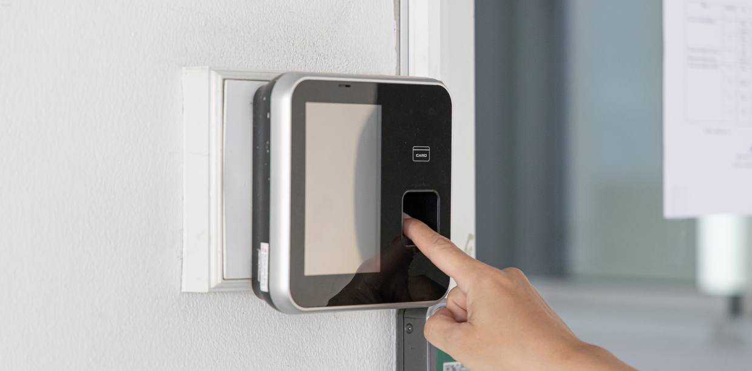
QUIRKIFY
STUDIO
123 Anywhere St., Any City
+123-456-7890
www.Quirkifystudio.com
Safety First
01
Access control systems regulate workplace entry, ensuring only authorized individuals gain access. By using key cards or biometrics, organizations enhance security against internal threats and external unauthorized entry, safeguarding personnel and assets.
ACCESS
CONTROL MEASURES
02
Emergency response planning encompasses strategies for addressing various workplace crises, considering both human and external factors.
It includes drills, communication protocols, and predefined evacuation routes, ensuring a coordinated and effective response to emergencies.
EMERGENCY
RESPONSE PLANNING
03
Conflict resolution training empowers employees with effective interpersonal skills, equipping them with communication and
problem-solving tools. This reduces the potential for workplace disruptions caused by human conflicts within organizations.
CONFLICT
RESOLUTION TRAINING
PAGE 4 I

Slide 5
QUIRKIFY
STUDIO
123 Anywhere St., Any City
+123-456-7890
www.Quirkifystudio.com
Team Dynamics
Transparent Dialogue Facilitation for Open Communication
Emphasizing open communication, 'Transparent Dialogue Facilitation for Open Communication' focuses on cultivating transparency and active information exchange within teams. It strongly encourages team members
to freely express ideas, concerns, and feedback, fostering an environment that embraces open dialogue. This approach builds trust, contributing to the development of a cohesive and innovative team dynamic, ultimately enhancing overall team effectiveness and collaboration.
Synergistic Efforts for Effective Team Collaboration
Fostering a workplace that encourages collaborative efforts among team members toward shared goals
is crucial. The concept of "Synergistic Efforts for Effective Team Collaboration" embodies collective success through coordinated actions, seamless teamwork, and united dedication. This approach underscores the interconnected nature of tasks, emphasizing the importance of creating an environment that facilitates harmonious collaboration for optimal outcomes.
I PAGE 5

Slide 6
QUIRKIFY
STUDIO
123 Anywhere St., Any City
+123-456-7890
www.Quirkifystudio.com
Tech Mastery Basics
Digital
Literacy
Cybersecurity Awareness
Cloud
Proficiency
Master digital, platforms, software for efficient information management, effective communication,
and seamless technology
use in diverse workplace
tasks-critical for modern proficiency and success
Develop a solid understanding
of cybersecurity principles
to protect sensitive data
and maintain a secure digital environment. Learn to identify and mitigate potential threats, ensuring the safety of online activities within the workplace
Excel in cloud computing
for improved collaboration, accessibility, and data storage. Develop expertise in tools like Google Workspace, Microsoft 365, or similar platforms for smooth remote work and effective data management
Data Analytics Mastery
Efficient Project Management
Video Conferencing Mastery
Develop essential data analytics skills for interpreting insights from datasets. Grasp core concepts, utilize tools such as Microsoft Excel or Google Sheets for analysis,
and make informed decisions based on data-driven insights
Master project management tools such as Asana, Trello, or Microsoft Project. Hone skills
in task organization, team collaboration, and project deadline management for successful assignment completion proficiency
Acquire virtual meeting proficiency on platforms
like Zoom, Microsoft Teams,
or Google Meet. Hone skills
in effective communication, screen sharing, and virtual collaboration, optimizing capabilities for remote work
PAGE 6 I

Slide 7
QUIRKIFY
STUDIO
123 Anywhere St., Any City
+123-456-7890
www.Quirkifystudio.com
Time Management
These are things you need to keep in mind while working
to make time management more effective
Start
Work
End
01
03
05
Set Clear Intentions
Prioritize Essential Tasks
Review achievements
Begin with a purpose.
Define your goals succinctly. What do you
aim to achieve? Clarity at the outset sharpens focus and propels you into
a productive mindset,
ready to conquer tasks
Recognize crucial tasks, prioritize them, and
invest time and energy wisely. Addressing key responsibilities early boosts productivity and establishes a positive tone for the rest of your work
Recognize finishing,
cheer goals. Think
about successes for higher spirits and increased productivity. Use this good energy
as motivation for what comes next
02
04
06
Eliminate Distractions
Embrace Time Blocking
Prepare for Tomorrow
Make a good space. Remove disruptions.
Quiet notifications,
close extra tabs. Unplug from distractions. Start work with full focus
and efficiency in your undistracted environment
Embracing time blocking involves scheduling specific blocks of time for focused tasks, optimizing productivity by allocating dedicated periods for targeted activities and minimizing distractions
Wrap up work by planning tomorrow's tasks. List priorities for a head
start. This proactive
step ensures a smooth transition, setting the stage for ongoing efficiency the next day
I PAGE 7

Slide 8
Location
Website
123 Anywhere St., Any City
www.Quirkifystudio.com
Hotline
Facebook
+123-456-7890
Quirkifystudio Official
Quirkify
studio

