Slide 1
Program
booklet
ECOFORGE
Celebrates
10
th
anniversary of the association's founding
Takes place over 2 days
25 - 26/05/2023
Time: 02:00p.m - 06 p.m
Location: 123 Anywhere St., Any City
Email
Website
Hotline
Address
info@templateLAB.com
www.templateLAB.com
+123-456-7890
12 Anywhere Street, Any City, ST, 345

Slide 2
Table of
contents
ECOFORGE
Table of contents
Page 2
Welcome messages
Page 3
Timeline day 1 - 25.05
Page 4
Timeline day 2 - 26.05
Page 5
Speakers
Page 6
Q&A
Page 7
Sponsors
Page 8
PAGE 2 -

Slide 3
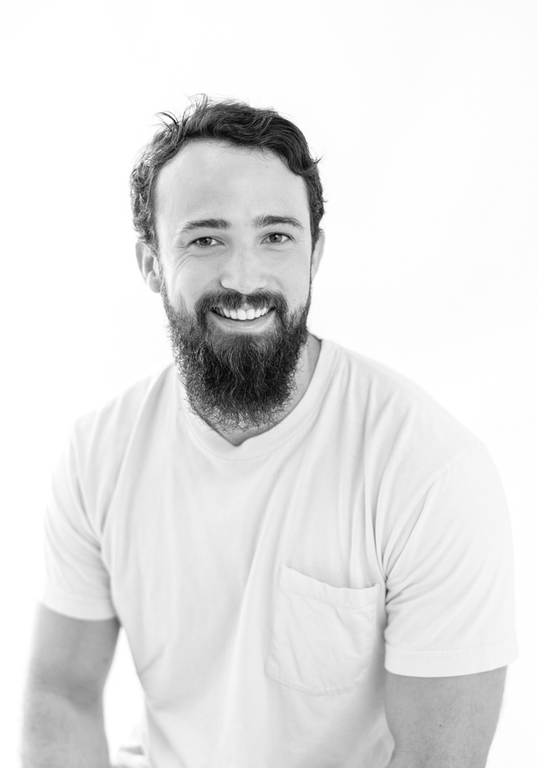
Welcome
messages
ECOFORGE
Dear Esteemed Guests,
Join us in the monumental celebration hosted by EcoForge - an embodiment of shared dedication and a passion for sustainable progress. As the founder, I am thrilled to witness the realization
of our collective efforts, marking yet another milestone in our transformative journey.
EcoForge epitomizes our dedication to crafting
a sustainable future. From modest origins to a thriving community, each stride is propelled by the conviction that purposeful actions are the catalysts for positive change.
Thank you for gracing this special occasion. Your presence enriches the tapestry of EcoForge, and together, we embark on a future where sustainable practices and innovative thinking mold the world for generations to come.
Leo Williams
Welcome to EcoForge, where passion converges with purpose.
Founder, EcoForge
Warm regards,
Leo Williams - Founder, EcoForge
- PAGE 3

Slide 4
25.05
ECOFORGE
1
2
Inception Unveiled
Growth
Spurt
Focused
Sustainability
30 min
Community
Flourish
1 hour
Initiating environmentally conscious practices for
a foundation rooted in sustainable growth
Strengthening the
association's roots as
a community blossoms
with shared values and environmental stewardship
Collaborative
Vision
1 hour
Project
Expansion
1 hour
Promote group creativity
for unity, building a lasting
and strong alliance among members effortlessly
Initiating diverse projects signifies the association's growth, branching out into impactful avenues for sustainable development
Vision
Expansion
30 min
Broadening the vision
towards a green horizon, encompassing expansive projects and a flourishing sustainable ecosystem
PAGE 4 -

Slide 5
26.05
ECOFORGE
3
4
EcoForge Flourishes
Anniversary
Apex
Environmental
Balance
30 min
Sustainable
Impact
1 hour
Balancing progress and
eco-care for sustainable development, establishing harmony as a model for progress unfolds
Building a strong legacy
with impactful efforts,
making a lasting mark
on sustainability and
innovation practices
Continuous
Improvement
45 min
Unity
Celebrated
1 hour
Elevating the commitment
to innovation, ensuring
ongoing progress and excellence in sustainable initiatives within EcoForge
Members celebrate unity, marking the association's anniversary, cheering EcoForge's collective
success together
Shared
Prosperity
40 min
The community thrives as sustainable practices and
a collective vision lead
to shared prosperity and environmental well-being
- PAGE 5

Slide 6
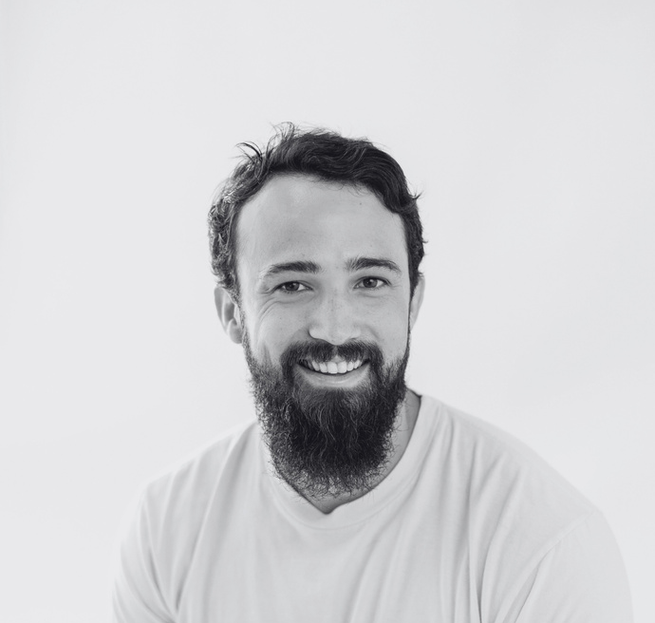
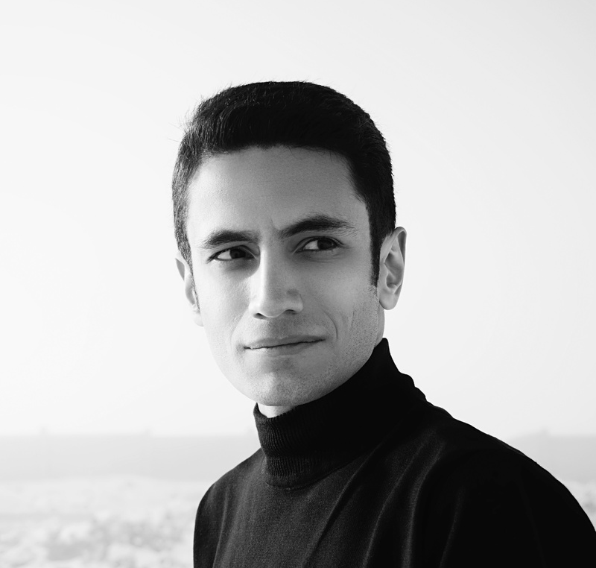
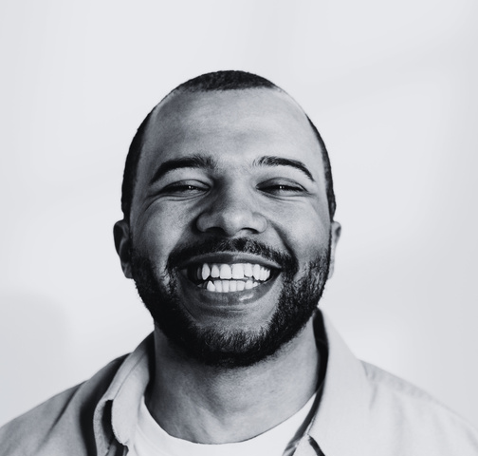
Speakers
ECOFORGE
Leo Williams
Olivia Hayes
Caleb Johnson
Founder, EcoForge
Climate Change Researcher
Tech Innovation
Lead
Ethan Mitchell
Oscar Reynolds
Sophia Parker
Environmental
Policy Analyst
Marketing
Strategy Manager
Sustainable
Design Specialist
PAGE 6 -
Emma Bennett
Miles Anderson
Nathan Carter
Youth Engagement Coordinator
Community Outreach Coordinator
Financial Sustainability Consultant

Slide 7
Q&A
ECOFORGE
Q1
A1
Where can attendees find information about conference schedules and venues?
Detailed schedules and venue information are available on the conference website and mobile app
Q2
A2
Will there be opportunities
to interact with and
question speakers?
Yes, Q&A sessions and networking breaks provide opportunities to engage with conference speakers
Q3
A3
How can attendees access presentation materials and conference resources?
All materials, including presentations and resources, will be accessible through the conference platform
Q4
A4
Are there designated networking sessions for attendees to
connect with others?
Yes, networking sessions and virtual lounges are scheduled to facilitate attendee connections
PAGE 7 -
Q5
A5
What support is available for technical issues during the
virtual conference?
A dedicated technical support
team will assist with any issues during the conference

Slide 8
ECOFORGE
Our sponsors
ECOTECH
SOLUTIONS
EcoTech Solutions proudly supports the virtual event's digital infrastructure and sustainable technology initiatives
GREENHARBOR INVESTMENTS
GreenHarbor Investments is a key sponsor, supporting innovation awards and sustainable project development
GREENHUB VENTURES
EcoTech Solutions proudly supports the virtual event's digital infrastructure and sustainable technology initiatives
Scan this QR code for more detailed information

