Slide 1
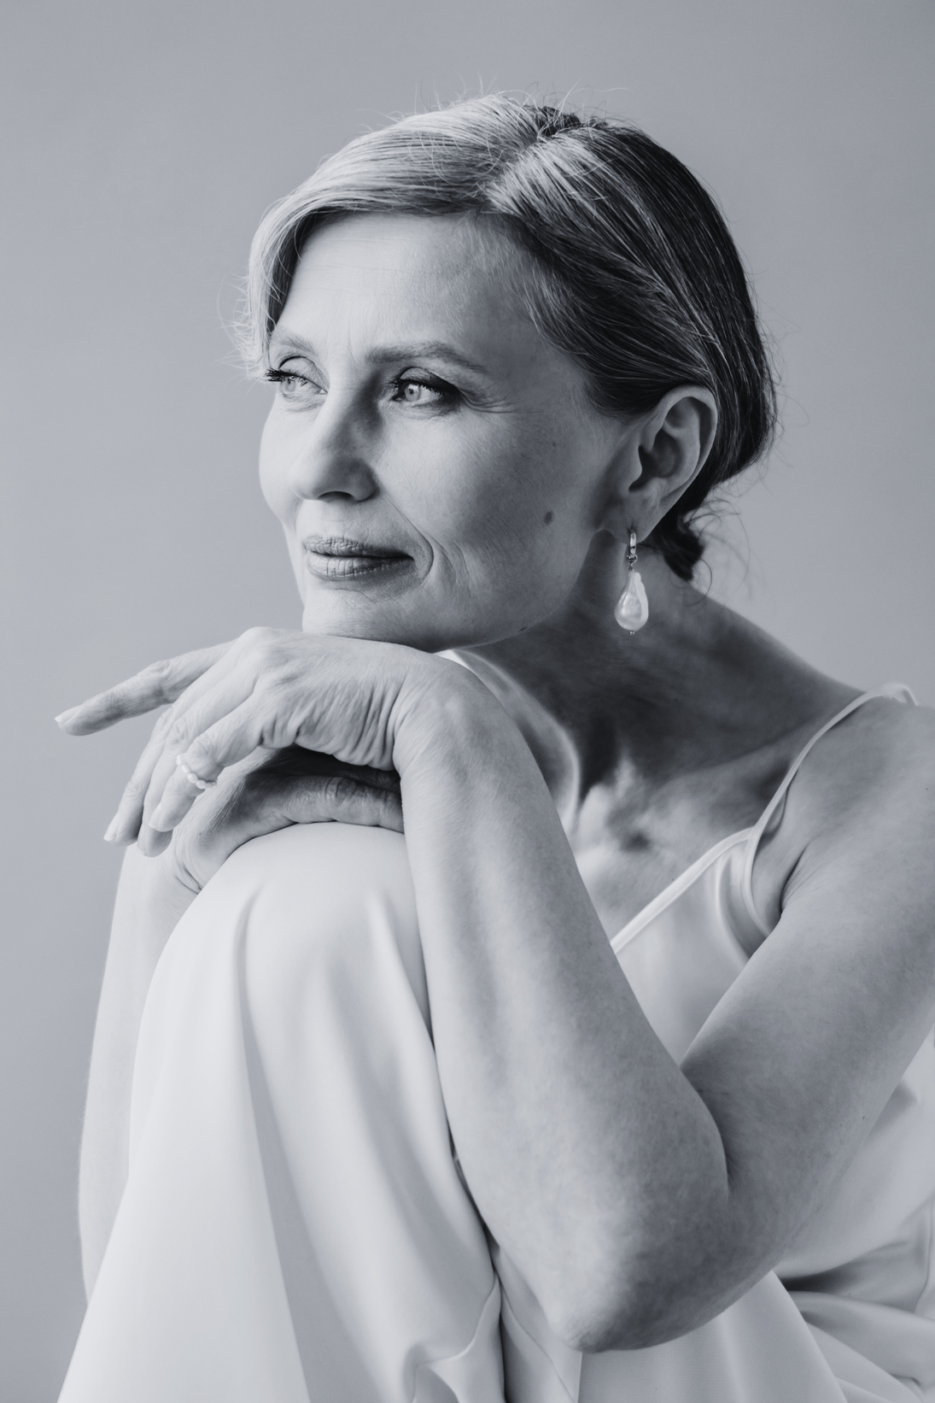


FUNERAL BOOKLET
Elena Nightshade
12.12.1940 - 04.03.2022
  Sunday, the 4th of February 2024 | 11:00 AM | Bennington Memorial Gardens

Slide 2


In Loving Memory of Elena Nightshade (12.12.1940 - 04.03.2022)
Early Life
Elena Nightshade, known affectionately as "Ella" to friends and family, was born on December 12, 1940, in the vibrant city of New York. From an early age, her lively spirit and compassionate nature endeared her to those around her.
Family Life
A devoted wife to Elias Hawthorne, Elena was the heart of her family. Together, they built a home filled with love, laughter, and cherished memories.
Memorable Quotes
Elena's wisdom and warmth were encapsulated in her insightful words. One of her favorite expressions was, 'Embrace each day with gratitude, for life's true beauty lies in its fleeting moments.'"
Closing Remarks
In celebrating Elena Nightshade's life, we honor a remarkable individual who touched the hearts of all who knew her. Her legacy of love, resilience, and compassion will forever live on in the lives she touched.
Acknowledgments
The Nightshade family extends heartfelt gratitude for the outpouring of support during this difficult time. Details about memorial services and opportunities to share memories can be found when you scan this QR code

Slide 3


  FUNERAL SERVICE DETAILS
  HOST
  The Nightshade family
  DATE & TIME
  LOCATION
11:00 AM Sunday
  4th of February 2024
  Bennington Memorial
  Gardens
  OPENING PRAYER
  CLOSING PRAYER
  Alexander Hawthorne
  Alexander Hawthorne
  CEREMONY COORDINATOR
FLORAL AND
  DECOR UNIT
  Event Elegance Enforcers
  Floral Harmony Bureau
  ARRANGING A RECEPTION
  Department of Extravagant Gatherings
  ARRANGING THE FUNERAL SERVICE
  Eternal Event Orchestrators

Slide 4

Thank you!
  "In loving memory, we bid farewell to Elena Nightshade. Her light lives on in our hearts, a cherished legacy of love and laughter. May the warmth of shared memories bring comfort in this time of sorrow."

