Slide 1
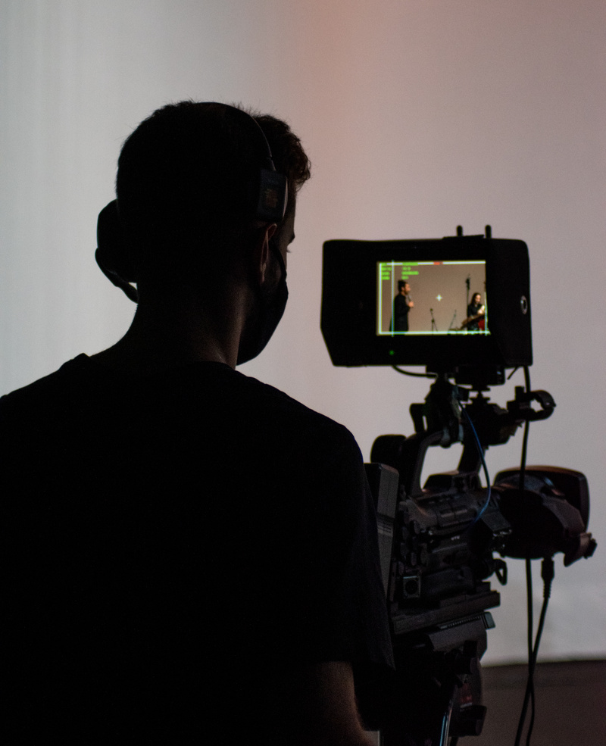
CINEFEST
01
CINEFEST
EVENT
BOOKLET
SHORT HISTORY OF FILMMAKING
Time
Saturday,
June 17, 2024
Venue
2:00 PM to 7:00 PM
Silver Screen Studios

Slide 2
CINEFEST
02
CINEFEST
Dear
Welcome to CineFest, an ode to the magic of filmmaking! Your presence amplifies the thrill of this cinematic exploration. As we embark on this journey of storytelling through film, your passion enriches our shared experience. Thank you for being part of this extraordinary gathering, your enthusiasm elevates the event.
Get ready to immerse yourself in the captivating world of filmmaking where every frame tells a story and
every story sparks imagination. Let the cinematic adventure begin!
2:00 PM to
7:00 PM
Welcome & Introduction
15 MINS
Time
Get acquainted, overview of the
workshop, and set the creative tone
2:00 PM
- 2:15 PM
OPEN
Icebreaker: Filmmaking Bingo
20 MINS
Saturday,
June 17, 2024
Break the ice and ignite creativity with
a fun filmmaking-themed bingo game
2:15 PM
- 2:35 PM
Date
Basics of Storyboarding
60 MINS
Silver Screen Studios
Learn the art of visual storytelling by translating a script into storyboards
2:35 PM
- 3:35 PM
Venue
MAIN CONTENT
Lights, Camera, Action!
90 MINS
Hands-on session covering camera usage, framing, and capturing dynamic scenes
3:35 PM
- 5:05 PM
Editing Essentials
75 MINS
Dive into the world of editing, mastering
the basics to enhance your films
5:05 PM
- 6:20 PM
Schedule
END
Showcase & Closing Remarks
40 MINS
Screen participants' work, discuss learnings, and wrap up the filmmaking workshop
6:20 PM
- 7:00 PM

Slide 3
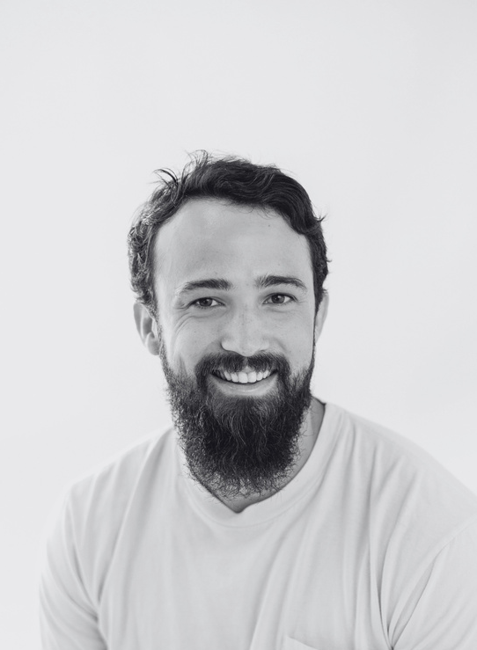
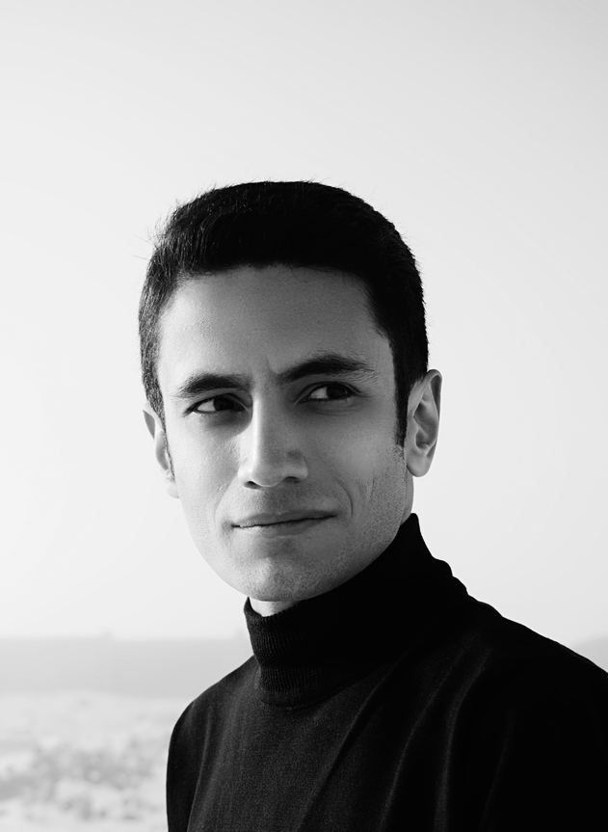
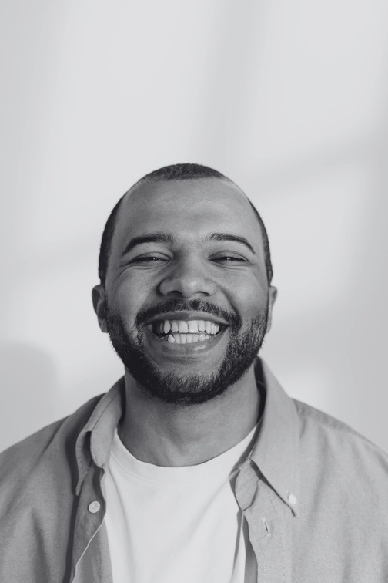
CINEFEST
03
CINEFEST
MEET OUR
SPEAKERS
Alex Turner
Emily Thompson
Ryan Mitchell
Director of Cinematography (Cinematographer)
Artistic Production Coordinator
(Production Designer)
Audio Post
Production Engineer (Sound Mixer)
Lucas Chang
Jordan Williams
Olivia Bennett
Script Continuity Supervisor
(Script Supervisor)
Motion Picture
Editing Specialist
(Film Editor)
Costume and
Apparel Stylist
(Costume Designer)

Slide 4
CINEFEST
04
CINEFEST
SPONSORS
SHORT HISTORY OF FILMMAKING
THANK YOU TO OUR VALUED SPONSORS AND PARTNERS
Your support ignited creativity at Cinefest, shaping cinematic dreams. With gratitude, we celebrate the sponsors who made our filmmaking workshop a vibrant tapestry of inspiration
CINECRAFT SOLUTIONS
SCRIPTSYNC STUDIOS
Equipment Rental
Screenwriting Masterclass
High-end cameras, lighting, and sound gear for an immersive and professional filmmaking experience
Industry experts guide aspiring filmmakers in crafting compelling narratives and engaging screenplays
CINESOUND SOLUTIONS
POSTPRO INSIGHT
Audio Mastery
Post-Production Lab
CineSound provides top-notch audio support, ensuring immersive experiences in filmmaking workshops
Editing software, color grading, and sound design tools for a polished cinematic masterpiece
ACTORS AVENUE AGENCY
SPOTLIGHT STRATEGIES
Acting Workshop
Marketing Mastery
Professional actors share insights and techniques, helping participants bring characters to life on screen
Spotlight Strategies brings creations to the forefront with expert marketing support for workshops

