Slide 1


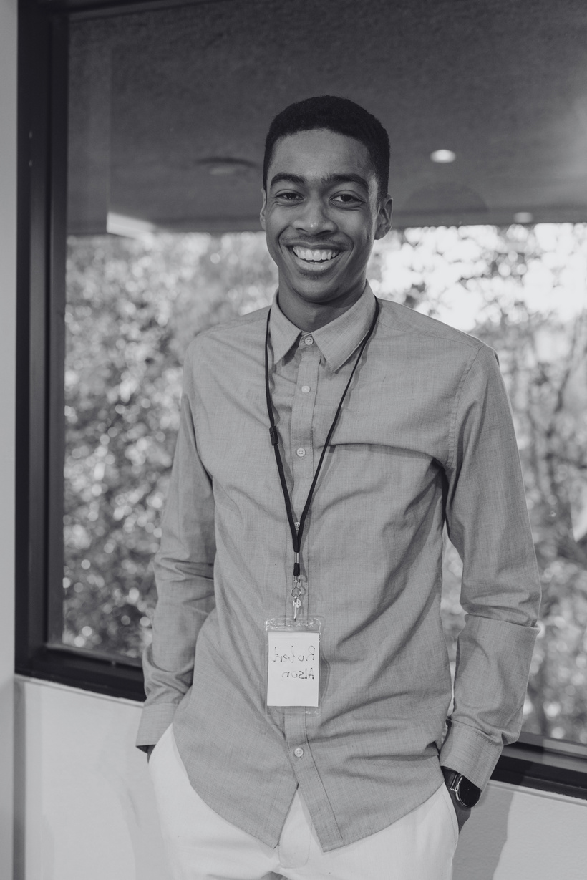
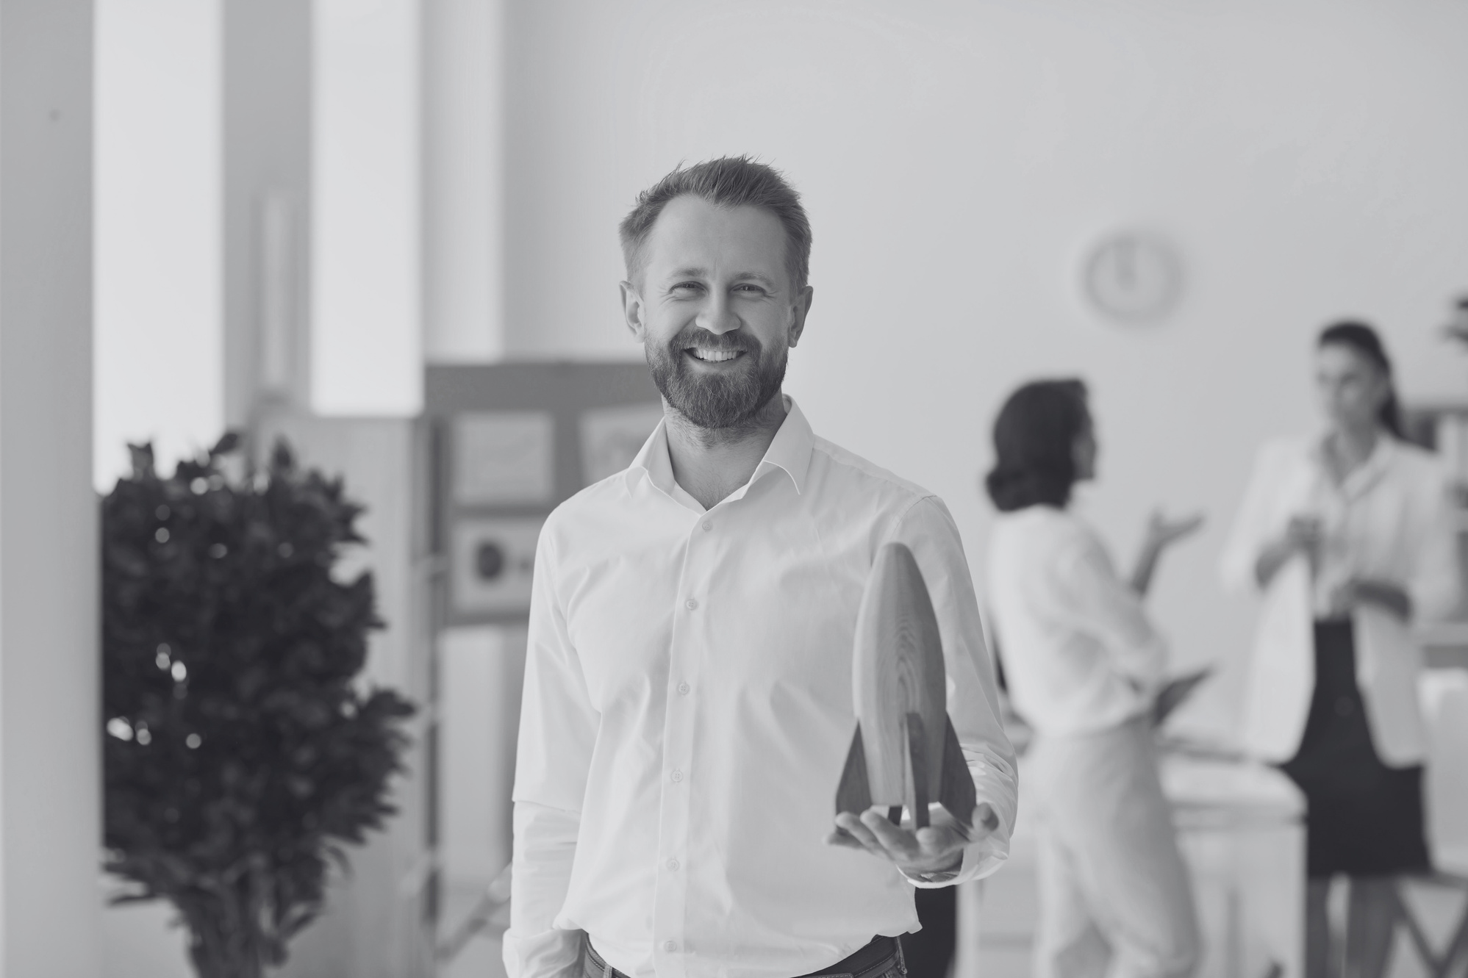

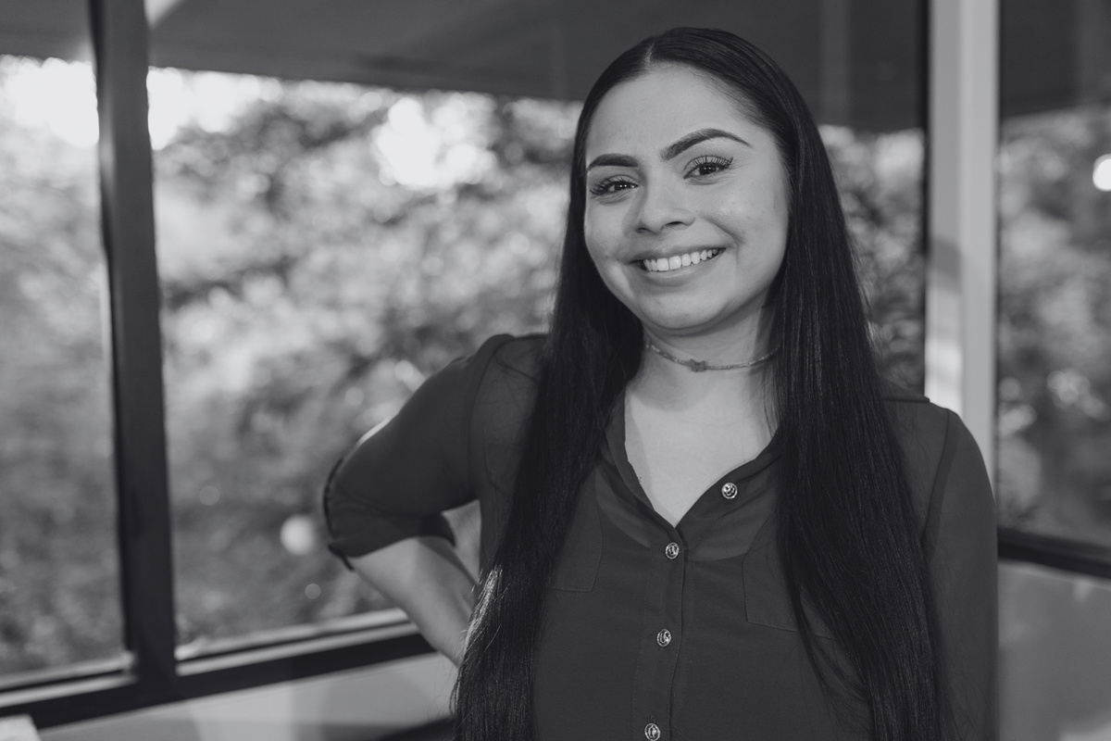


SPEAKERS
DREAMSPHERE CONVENTION
Free Entry |
OLIVIA STERLING
CONFERENCE BOOKLET
Chief Technology Officer, Innovate Solutions
ADRIAN KNIGHT
Founder and CEO,
Insights Labs
Gift for participating in the conference
XAVIER REYES
Head of Research
and Development,
SolarTech Solutions
AMELIA BENNETT
Director of Sustainability,
EcoTech Innovations
25-26
JULY 2024
Scan this QR code for more detailed information
2:30 p.m - 5:30 p.m |
Same schedule for 2 days
Grand Horizon Convention Center
123 Anywhere St., Any City, ST 12345

Slide 2


AGENDA
DREAMSPHERE CONVENTION
TIME + MAIN KEYS
MAIN CONTENTS
01
Emerging Technologies Overview
Discover the forefront of technology with innovations
and breakthroughs. Dive into industry-shaping trends
and advancements, uncovering the transformative landscape that defines the future of various sectors.
2:30 P.M - 3:00 P.M 25 July 2024
02
Artificial Intelligence Revelation
Uncover the power and potential of Artificial Intelligence. Learn how AI is revolutionizing processes, enhancing efficiency, and driving transformative changes across diverse sectors.
3:00 P.M - 4:00 P.M 25 July 2024
03
Blockchain's Transformative Influence
Explore the decentralized realm of blockchain,
uncovering its secure and transparent nature. Witness
its transformative influence on finance, supply chain, and more, as it reshapes industries with unparalleled innovation.
4:30 P.M - 5:00 P.M 25 July 2024
04
IoT: Unveiling
Intelligent Connectivity
Delve into the interconnected realm of IoT, where smart devices, sensors, and data analytics propel intelligent connectivity. Witness how these innovations enhance
daily experiences, defining a new era of technological.
2:30 P.M - 3:00 P.M 26 July 2024
05
Cybersecurity Mastery Essentials
Navigate the dynamic cybersecurity terrain, comprehending the latest threats, strategies, and vital innovations. Learn the essentials for securing digital assets and privacy in this ever-evolving landscape of online security.
3:00 P.M - 4:00 P.M 26 July 2024
06
Eco-Friendly
Technology Odyssey
Dive into the realm of eco-friendly technology. Explore innovations promoting sustainability, renewable energy, and environmentally conscious practices for a greener
and more resilient future.
4:30 P.M - 5:00 P.M 26 July 2024

Slide 3
DREAMSPHERE CONVENTION
Speakers
OLIVIA STERLING
Chief Technology Officer, Innovate Solutions
As the Chief Technology Officer at Innovate Solutions, my fervent wish during this conference is to foster a collaborative environment where ideas seamlessly converge. I aspire to witness a dynamic exchange of insights, sparking innovation that propels our technological landscape to unprecedented heights.
ADRIAN KNIGHT
Founder and CEO, Insights Labs
At the technology conference, Insights Labs' Founder and CEO passionately expressed a fervent wish for collaborative innovation. Envisioning a future where technology transcends boundaries, the speaker urged attendees to unite in advancing solutions that positively impact society and reshape the technological landscape.
XAVIER REYES
Head of Research and Development, SolarTech Solutions
As the Head of Research and Development at SolarTech Solutions,
my fervent wish is to see our innovative solar technologies catalyze
a sustainable energy revolution. I envision a future where our advancements empower communities globally, driving a paradigm shift towards cleaner and more accessible energy sources.
Amelia Bennett
Director of Sustainability, EcoTech Innovations
In the realm of technology, our fervent desire at EcoTech Innovations is to catalyze a paradigm shift towards sustainable solutions. As the Director of Sustainability, my wish is to inspire collaboration and innovation that transcends conventional boundaries, propelling
us towards a greener and more resilient future.

Slide 4








CONTACT INFORMATION
  Website
  Facebook
www.templateLAB.com
templateLAB Official
  Email
  Address
info@templateLAB.com
12 Anywhere street, Any City, ST, 345
THANKS TO
OUR SPONSORS
Preemptive gratitude to sponsors backing conference

