Slide 1
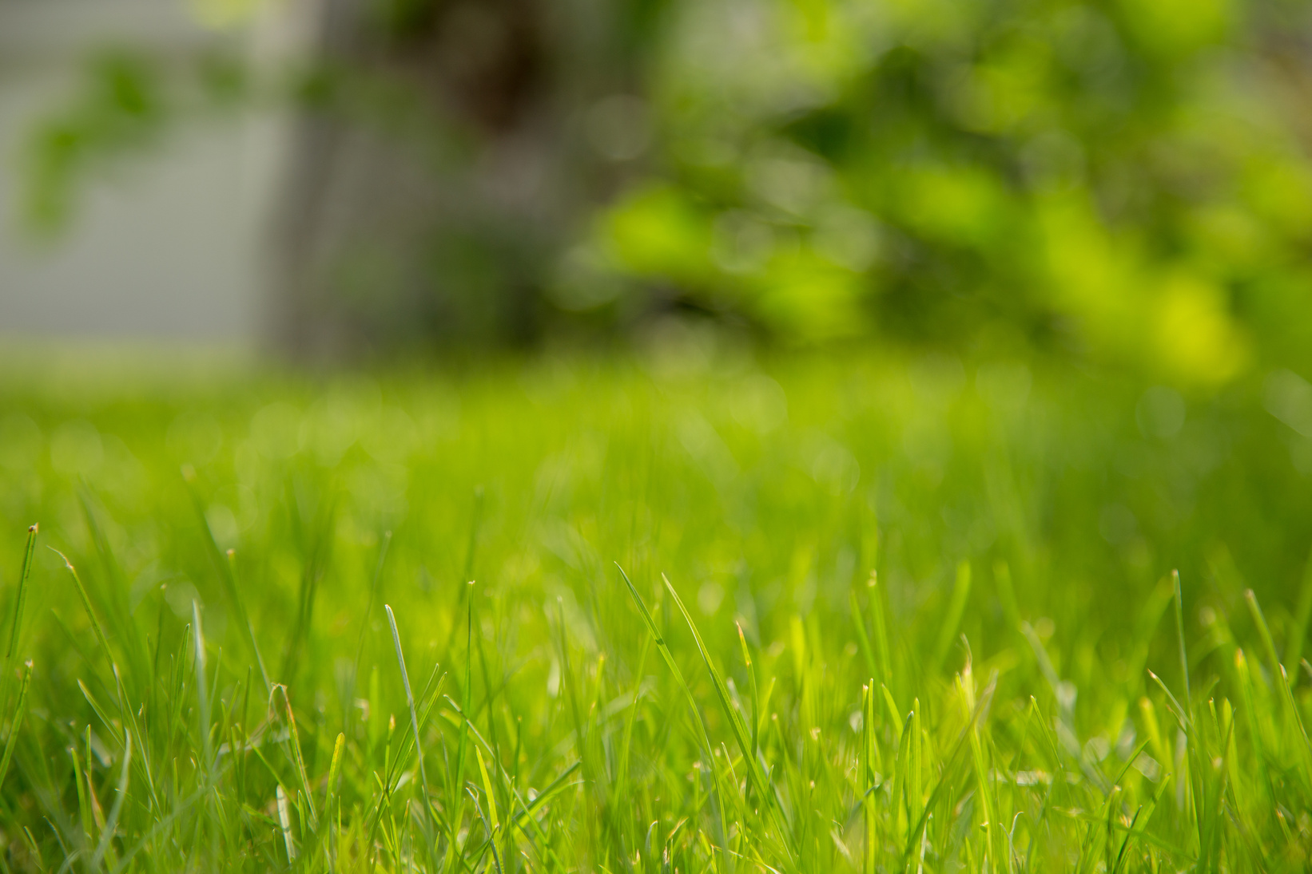









GREENDREAMSCAPE
LAWN CARE SERVICE
YARD
WORK FLYER
Transform your outdoor space with our expert yard
work services! From lawn mowing and tree trimming to garden maintenance, we've got your landscaping needs covered. Our skilled team is dedicated to creating a lush and inviting environment for you to enjoy. Contact us for reliable and affordable yard care today!
UP TO
30%
OFF
OUR AWESOME SERVICES
Green
Oasis
Precision Pruning
Autumn Cleanup
Instantly transform your yard into a green oasis with our professional lawn care services for a vibrant, healthy outdoor space
Achieve manicured perfection with our precision pruning service, ensuring your landscape radiates elegance and curb appeal effortlessly
Revitalize your yard with our fall cleanup, ensuring a clutter-free space, refreshed for the season, free from fallen leaves
Contact for more information
+123-456-7890
@TemplateLAB | TemplateLAB.com
123 Anywhere St., Any City, ST 12345

