Slide 1
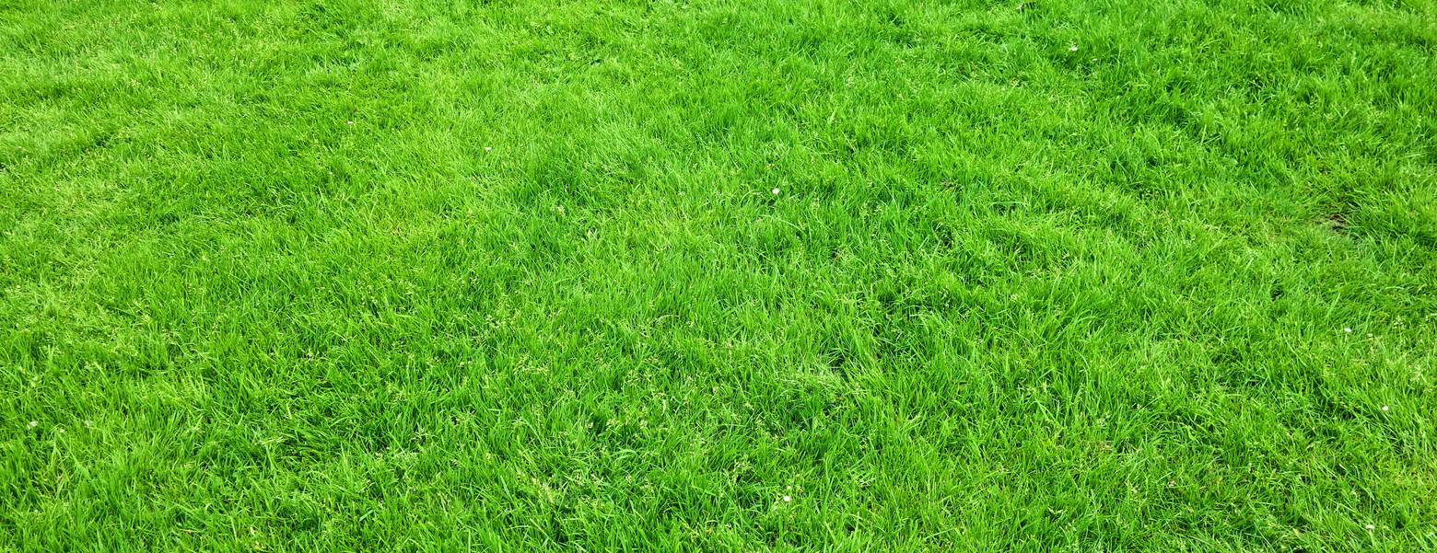
FAUXFOLIAGE FINERY
Lawn care business flyer
Transform your lawn into a lush paradise! Our expert team offers top-notch
lawn care services for a greener, healthier, and more beautiful outdoor space
Our awesome services
METICULOUS
TURF TENDING
FLORAL
OASIS DESIGN
TREE SCULPTURE SHAPING
Enhance your lawn's charm
with Precision Greencare's
expert services, ensuring meticulous turf care
through precise mowing,
fertilization, and aeration
Revamp your outdoors
with Precision Greencare's
experts in landscape design,
lively flowerbeds, and
efficient irrigation, creating
a blooming floral oasis
Precision Greencare's reveals tree beauty through artful pruning, precise shaping,
and effective disease management, fostering
a flourishing landscape
Contact for more information
+123-456-7890
www.templateLAB.com
123 Anywhere St., Any City, ST 12345

