Slide 1


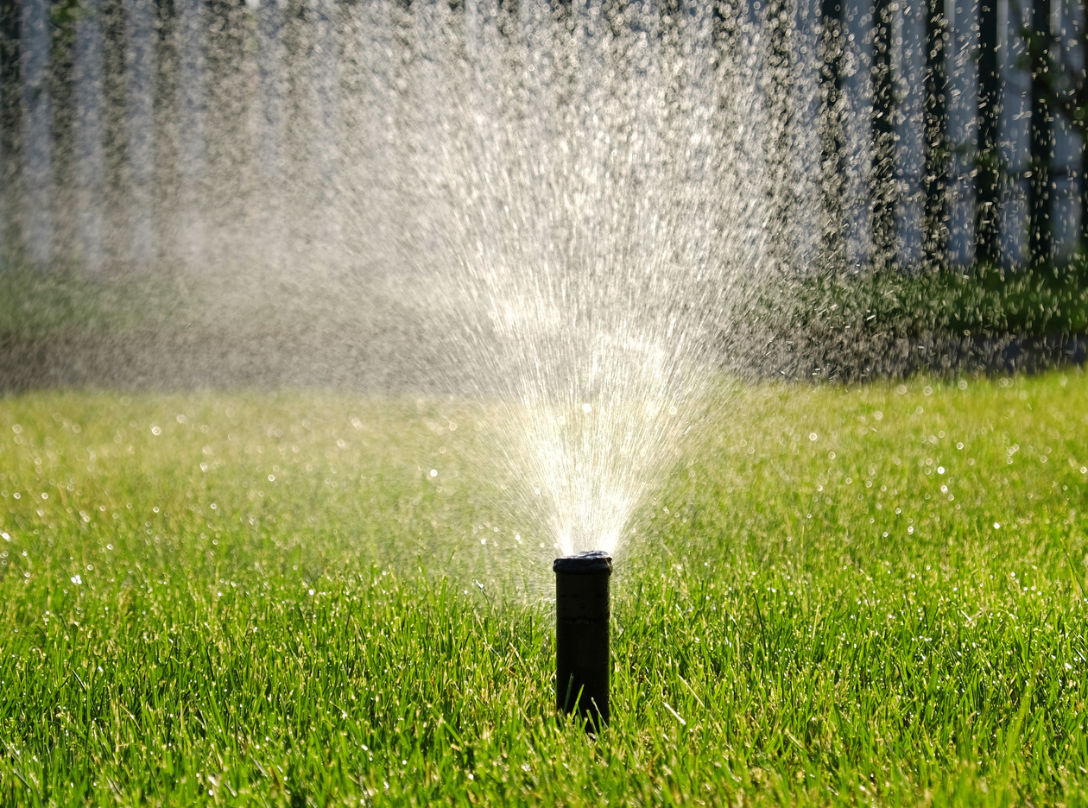




COMPANY
LANDSCAPING SERVICES
LANDSCAPING FLYER
Transform your outdoor space
into a breathtaking oasis with our expert landscaping services. From lush gardens to pristine lawns, we bring beauty to your doorstep
WE OFFER
Mow the Garden with Precision
Fertilize, control weeds expertly
Maintain and repair irrigation systems
30%
Tree care, hedge pruning, flower elegance
OFF
BOOK NOW
Contact Us
Visit Our Website
123-456-7890
www.templateLAB.com

