Slide 1

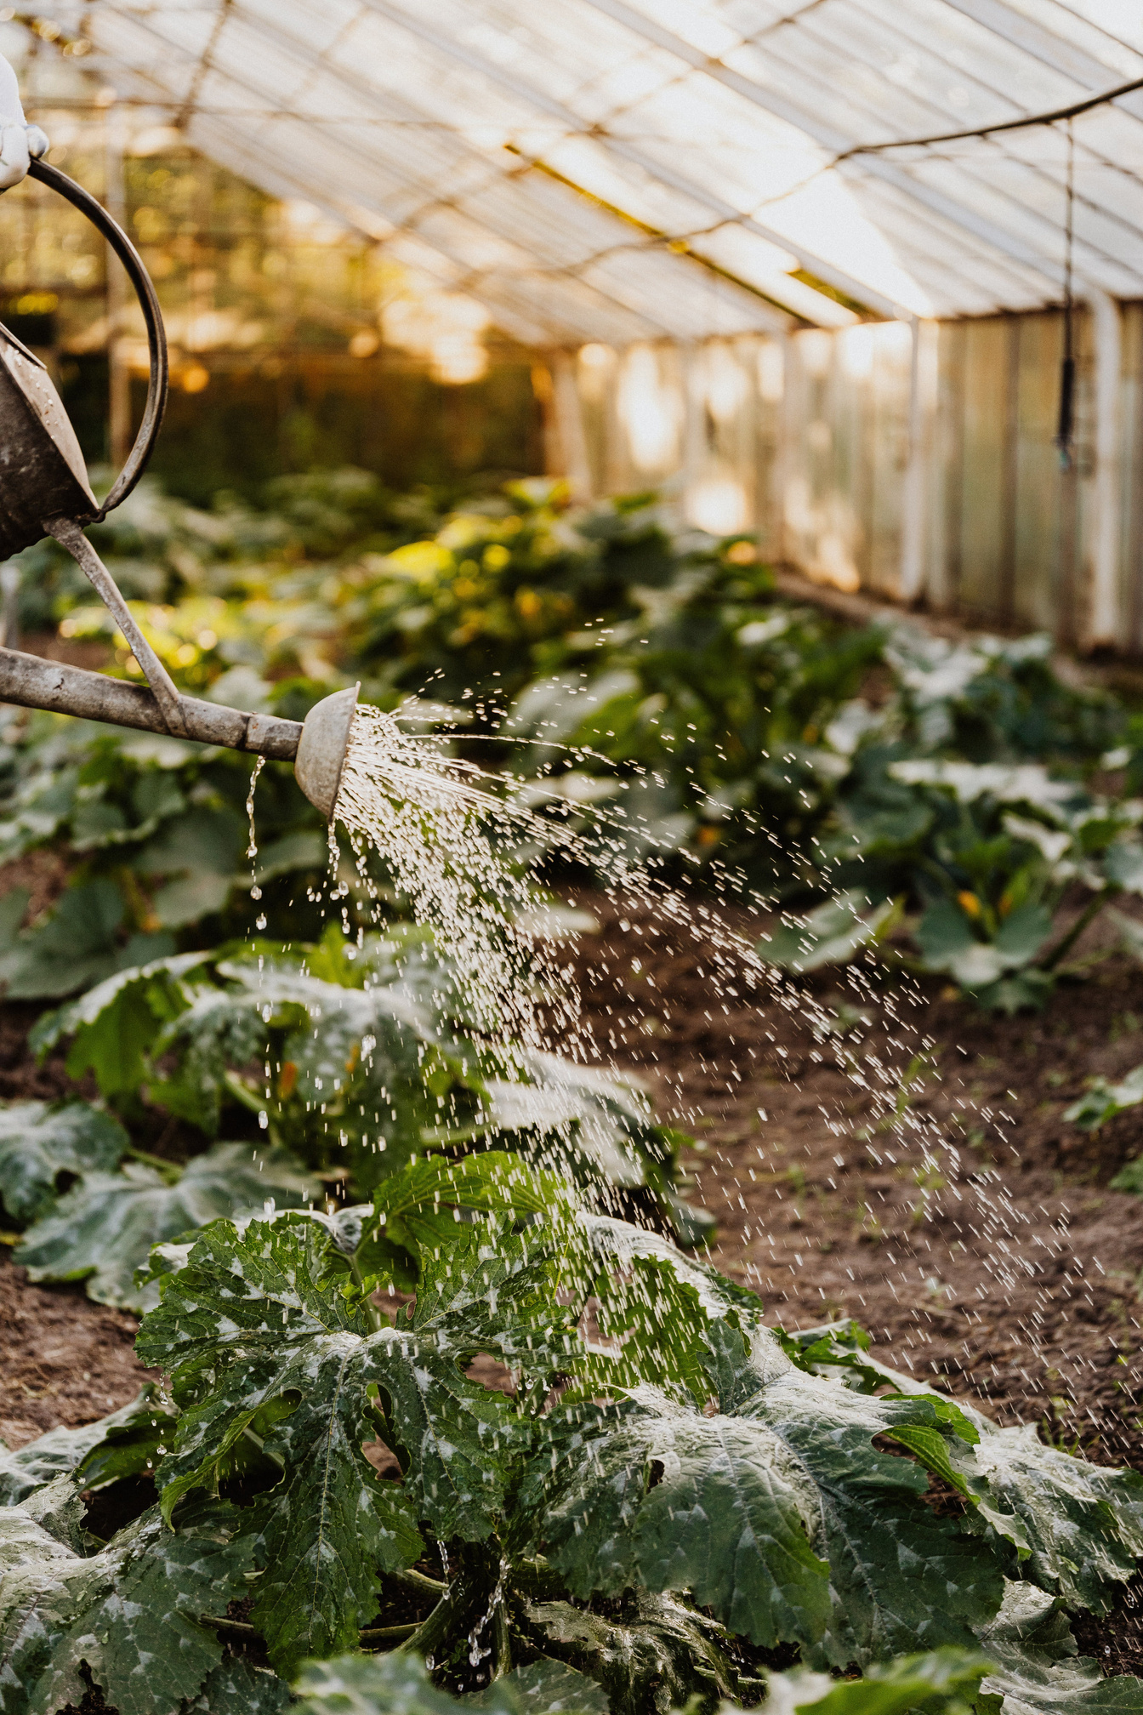






FloraFolly Gardenscapes Co.
GARDENING FLYER
UP TO
40%
Transform your outdoor space into a blooming paradise with our gardening essentials! Discover a wide range of
vibrant plants, quality tools, and expert
advice to nurture your garden. Elevate
your green haven with us today!
OFF
OUR SERVICES
INNOVATIVE LANDSCAPE DESIGN
Transform your outdoor space with visionary landscaping ideas, creating a picturesque haven with timeless and innovative design concepts
ECO-FRIENDLY GARDEN MAINTENANCE
Ensure the long-lasting beauty of your garden
with expert care and sustainable practices, promoting vibrant and healthy landscapes
through EcoGro Maintenance services
TRANQUIL GARDEN INSTALLATIONS
Immerse yourself in serenity with FloralZen,
where garden installations blend nature's
beauty into your surroundings, creating a
peaceful and inviting atmosphere
CONTACT FOR MORE INFORMATION
HANDS-ON GARDENING WORKSHOPS
Cultivate your green thumb with TerraTend Workshops, offering hands-on learning
experiences that deepen your connection
with the earth and the art of gardening
Hotline
123-456-7890

