Slide 1
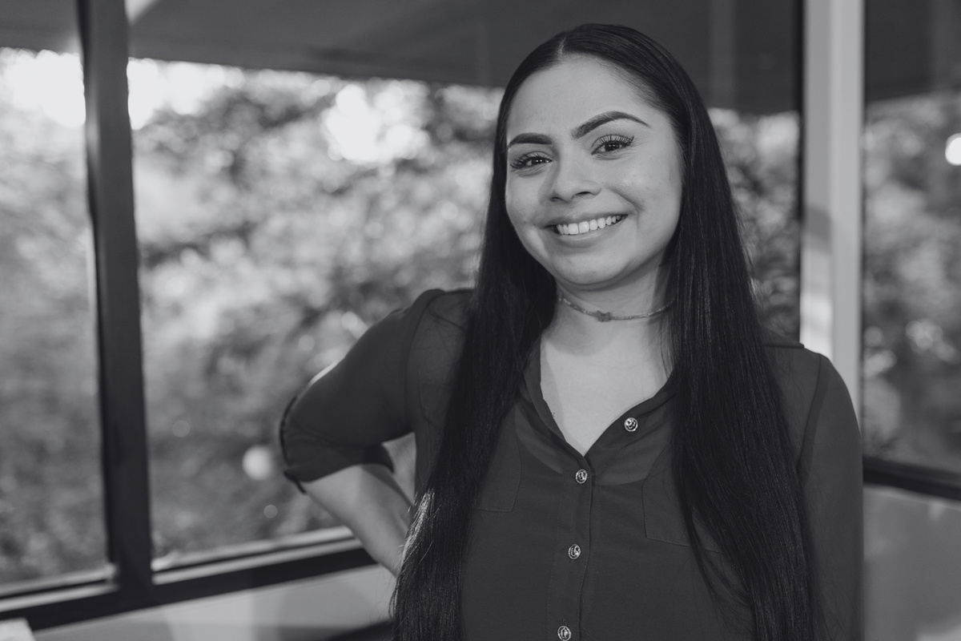
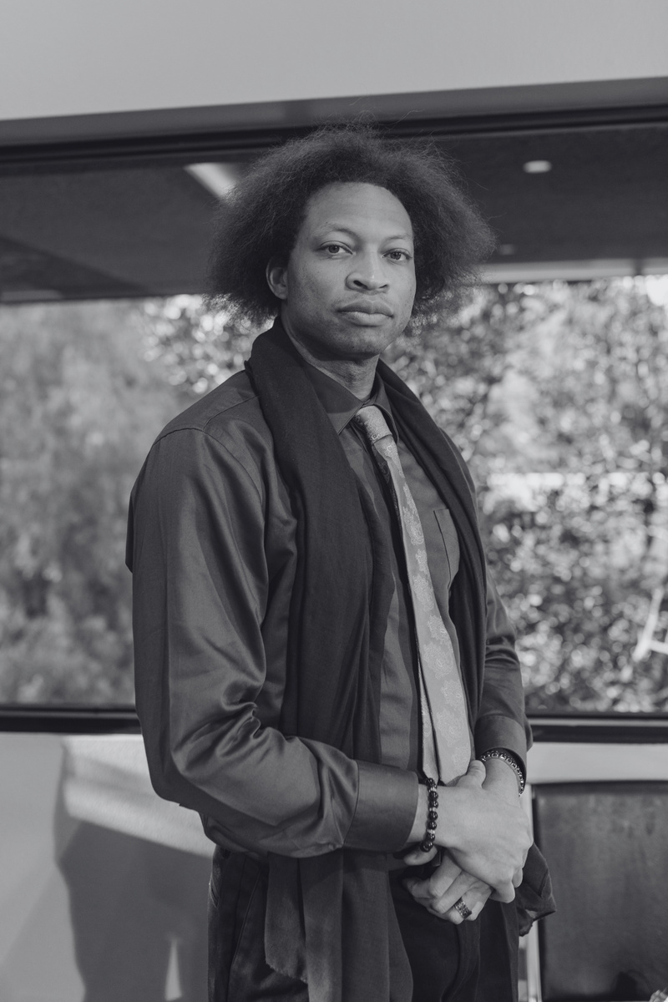
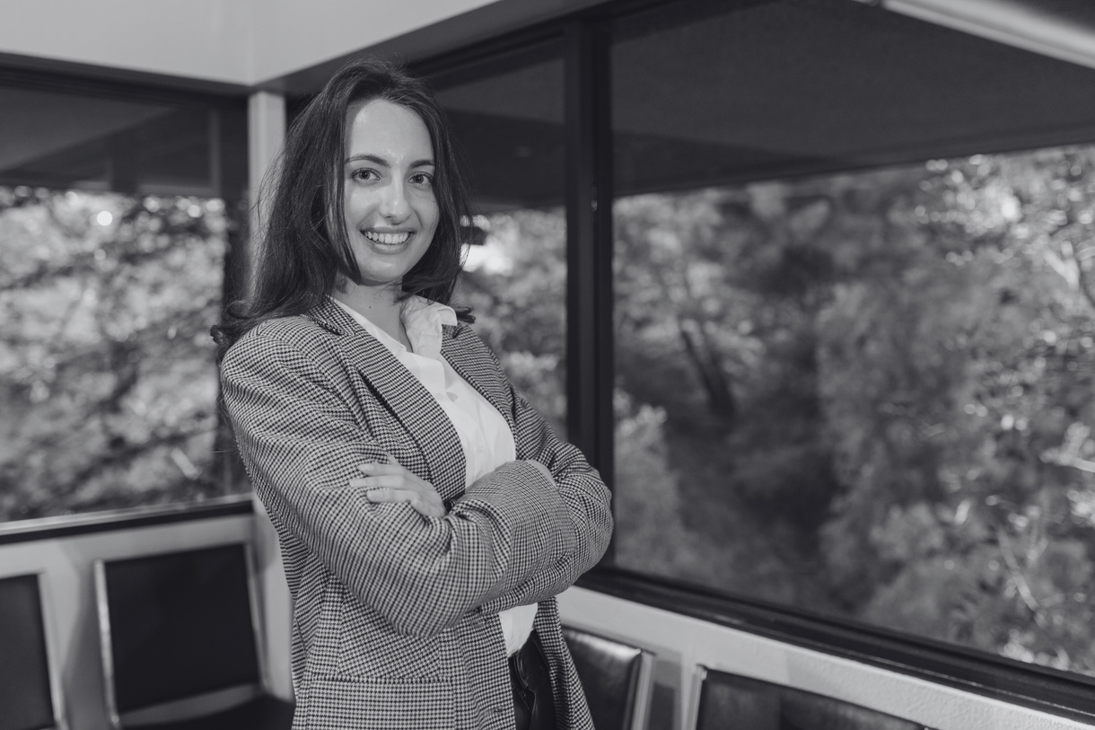



INNOVATEX IMPROVEMENT TEAM
PERFORMANCE IMPROVEMENT TEAM CHARTER
2023
TEAM MEMBER
Leader
Sarah Anderson
John Smith
Sarah Brown
Emily Johnson
TEAM PURPOSE
TEAM VALUES
01
02
03
Our team is dedicated to identifying and implementing process improvements within our organization to enhance efficiency, reduce waste, and achieve higher quality results
Excellence
Collaboration
Data-Driven
Striving for continuous improvement and
high standards
Valuing open communication
and teamwork
Making decisions
based on data
and evidence
IMPROVEMENT PROCESS
1
2
3
4
Problem Identification
Data Analysis
Solution Development
Monitoring
Identifying areas in
need of improvement
Accumulating and scrutinizing data for fundamental origins
Creating and implementing improvement plans
Consistently assessing results and adapting as needed
COMMUNICATION
Open and transparent communication is vital. We'll hold regular meetings and provide updates to stakeholders
www.templateLAB.com
INNOVATEX IMPROVEMENT TEAM

