Slide 1
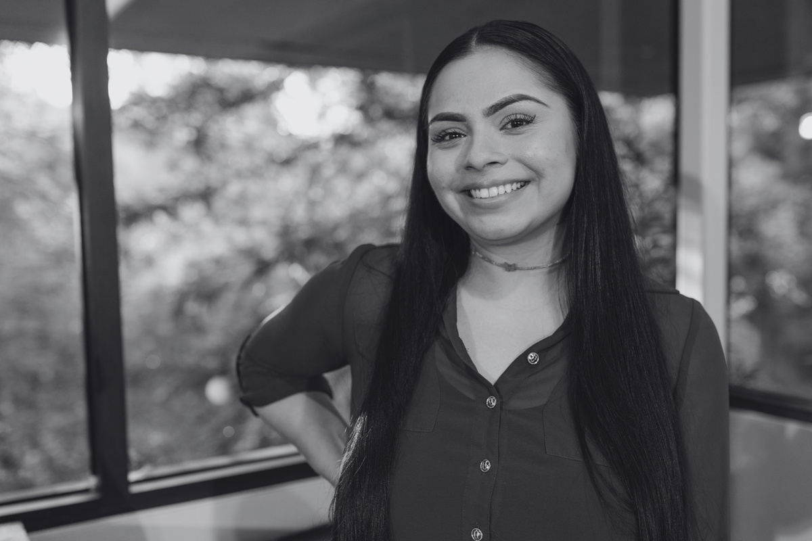
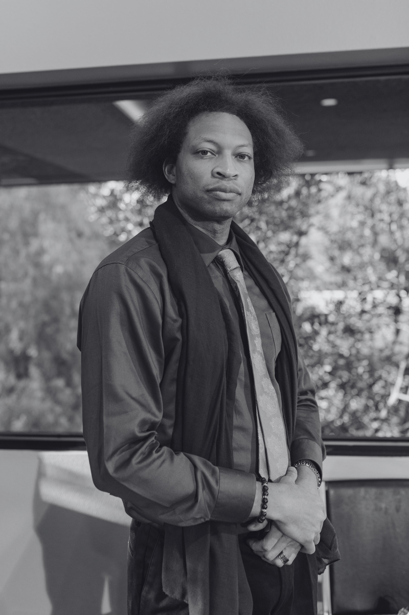
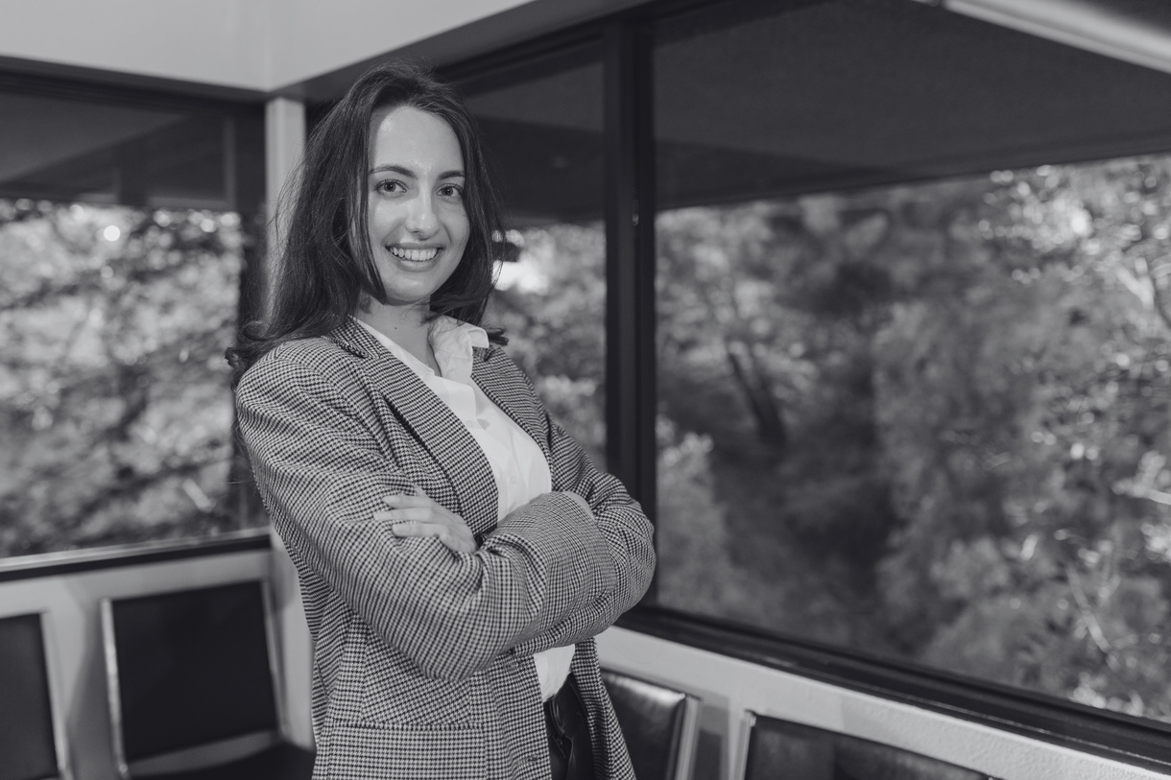

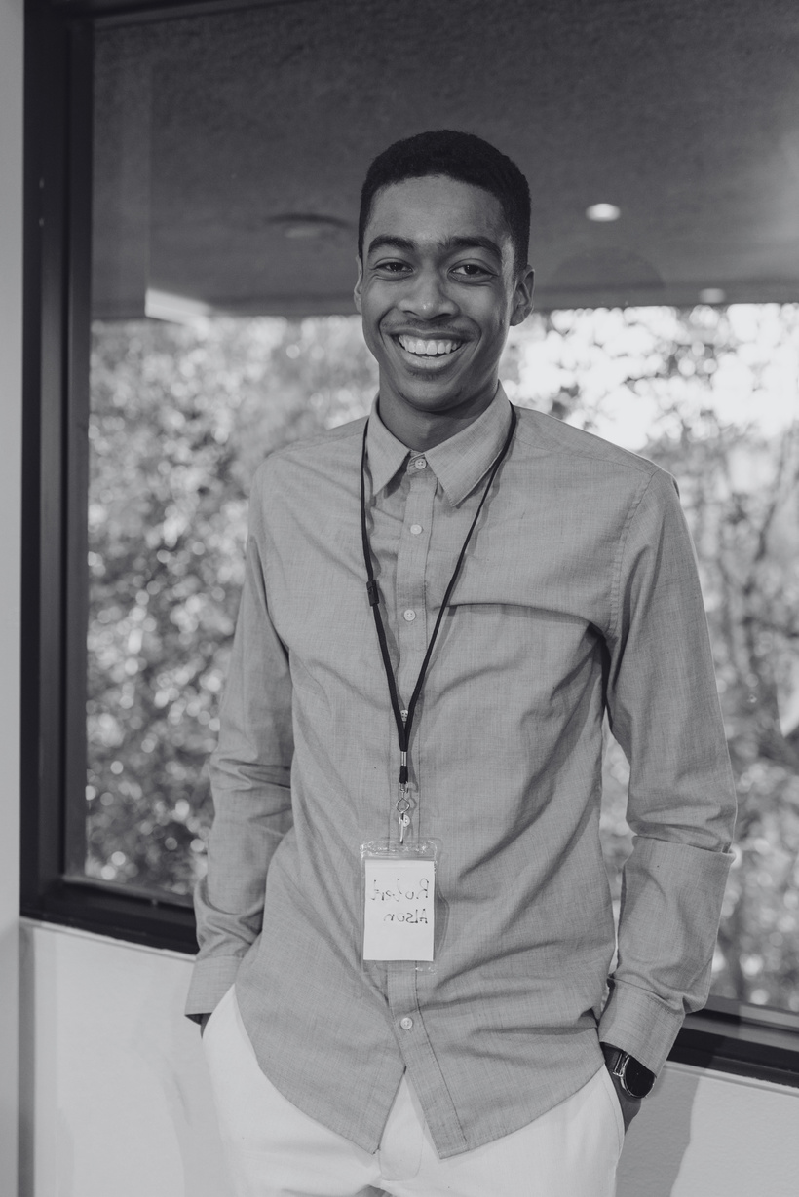

AGILE TEAM CHARTER
SWIFTDEV TEAM
PURPOSE
Our team, led by Alice Smith (Product Owner), is committed to delivering valuable software by adhering to Agile principles. We prioritize collaboration, adaptability, and continuous improvement.
ROLES
We value teamwork and open communication
Open communication fosters trust and progress
AGILE PRACTICES
Collaboration
Transparency
We follow key Agile practice
1
2
Daily Stand-up Meetings
Alice Smith
John Davis
VALUES
Sprint Planning
Product Owner
Scrum Master
3
4
Sprint Review
Adaptability
Quality
Sprint Retrospectives
Sarah Brown
Emily Johnson
Mark Wilson
We embrace change and respond effectively
We commit to delivering high-quality work
Backlog Refinement
Developer
Developer
Developer
4 NORMS
Open
Communication
Continuous Improvement
Individual
Accountability
Prioritizing
Customer Needs
Foster transparent, honest dialogues for informed decisions and efficient collaboration
Commit to regular retrospectives, adapting processes to optimize team performance
Each member takes ownership
of their tasks and progress, promoting responsibility
Prioritize customer needs and feedback to guide product development and iterations

