Slide 1
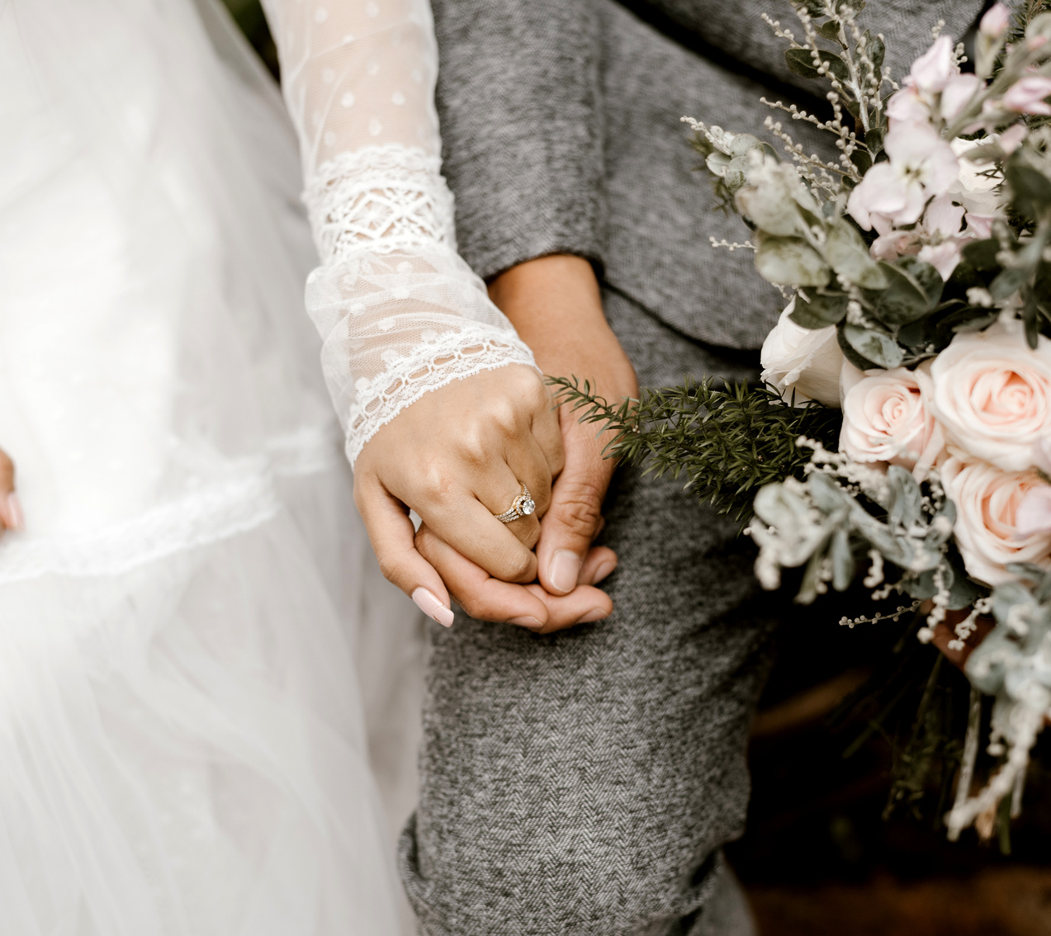
WEDDING
The Daily Chronicle Editorial
NEWSPAPER
Wednesday 15 November 2023
JAYDEN & SARAH ARE GETTING MARRIED
"True love is a journey that never ends, where every step taken together only strengthens the bond"
SUNDAY 26 NOV 2023
LOCATION
Graceful Haven Church
1 Anywhere ST., Any City 123
THE
WEDDING
TIMELINE
05 P.M
Wedding Begins
06 P.M
DEAR OUR CHERISHED FAMILY & FRIENDS,
Your unwavering support and friendship have been a constant source of strength, and as we stand on the brink of this new adventure as a married couple, we are eager to create countless more cherished memories together. We are profoundly grateful for your willingness to join us in this celebration and for the blessings you've brought into our lives. We can't wait to see you there and to share this joyous occasion with all of you.
Wedding Ends
Tea and cake are served
We are thrilled to invite you to our upcoming wedding celebration, and we cannot contain our excitement as we look forward to sharing this remarkable day with every one of you. Your presence will mark the beginning of an extraordinary new chapter in our lives, and we want you to know how deeply appreciative we are of the joy and love you have brought into our journey thus far.
07 P.M
Dinner is served
07:30 P.M
Toasts and Speeches
With all our love and anticipation,
08:30 P.M
JAYDEN & SARAH
Wedding Party

