Slide 1
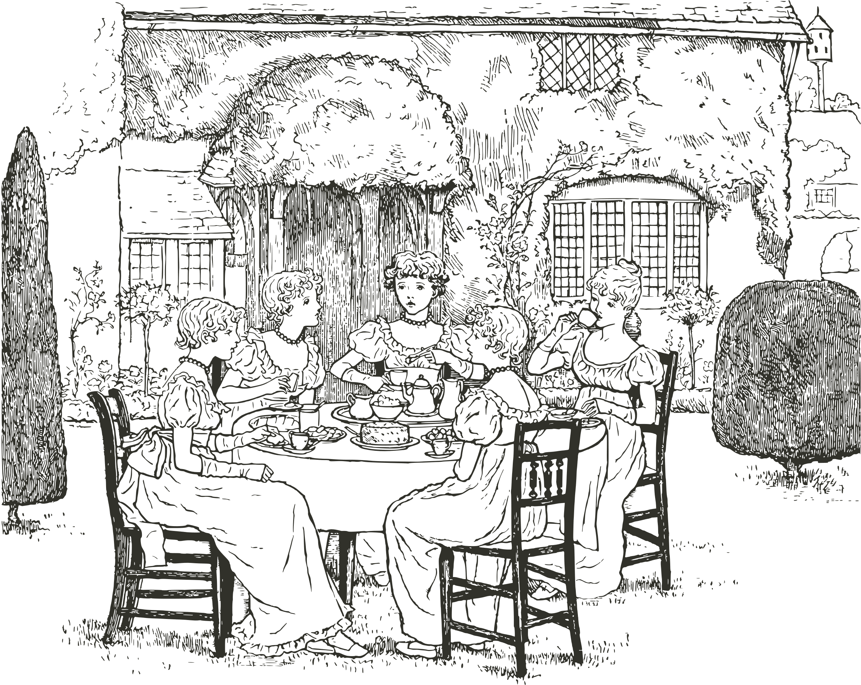
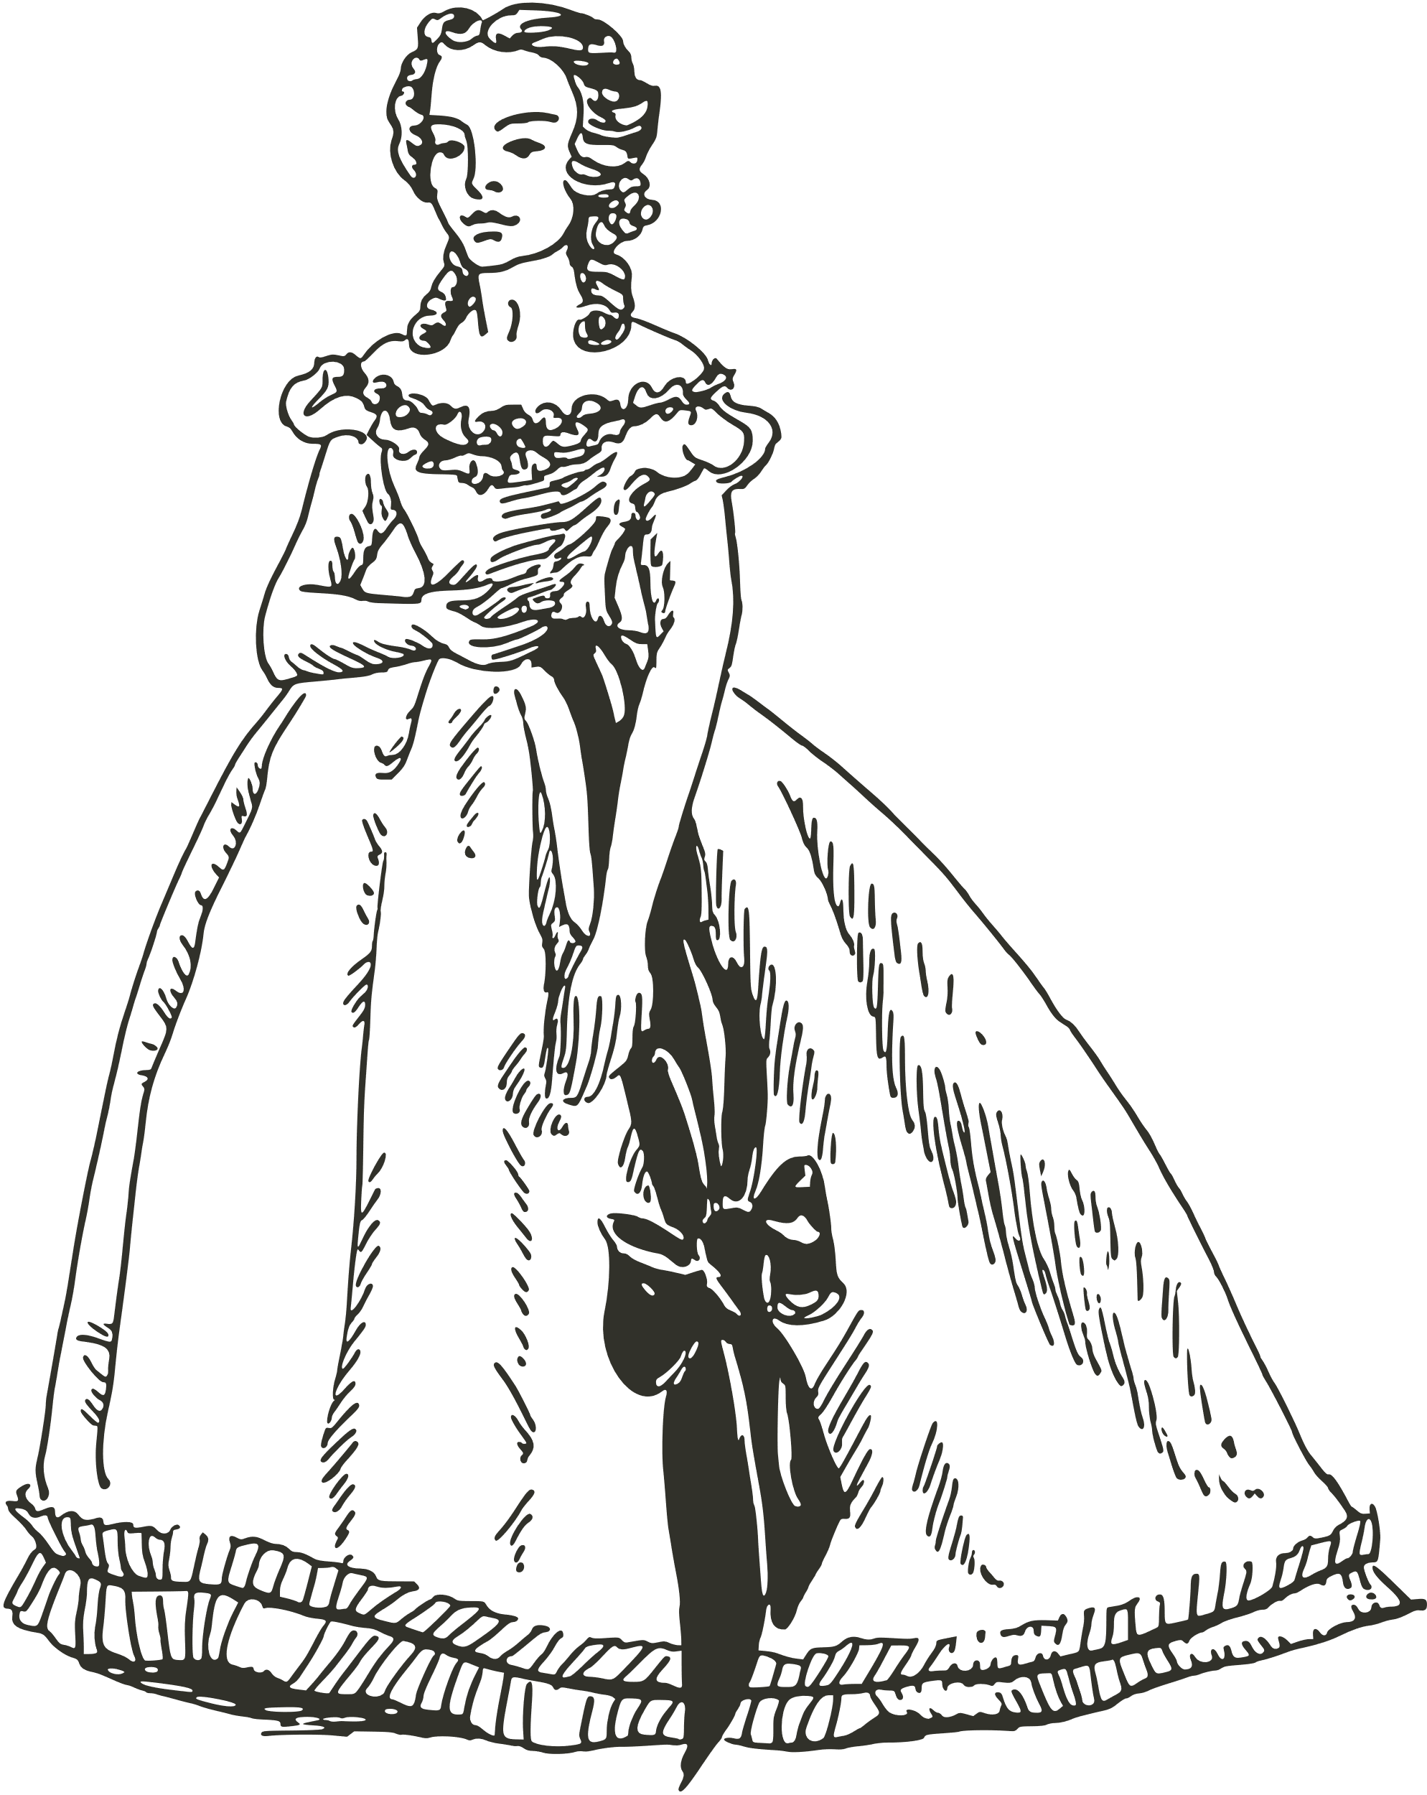



The Sunday sentinel news
EST. 1919
Vintage newspaper
Vol. 201
SEPTEMBER 7 1978
The Grace and Elegance of
Princess
Arabella
A Noble Gem of Yesteryears
TEA PARTY
20/6 - 22/6
Don't miss out – Join us for a delightful afternoon of tea, conversation, and community! Let's celebrate the simple joys of life over a cup of your favourite tea.
Delicious
In the bygone era of grandeur and opulence, a singular princess graced the annals of history with her resplendent presence. She was none other than the enchanting Lady Arabella of House Whitestone, a beacon of elegance in the hallowed circles of nobility.
QUALITY PASTA
Pasta lovers, get ready to embark on a culinary journey that will tantalize your taste buds and leave you craving for more. The "Super Delicious Pasta Shop," is making waves in the city cuisine with its mouthwatering dishes and an unwavering commitment to delivering an unparalleled dining experience.
Her radiant countenance, adorned with delicate lace and satin, was a testament to the meticulous artistry of her time. Lady Arabella's gentle demeanor and unwavering dedication to her people earned her the adoration of all who crossed her path. With her innate sense of grace and compassion, she proved that true nobility was not merely a birthright but a calling. In her enchanting presence, the world beheld a princess who personified the very essence of a bygone era's elegance and nobility.
Bella Pasta Cucina
LOCATION
123 Anywhere ST., Any City 12345

