Slide 1
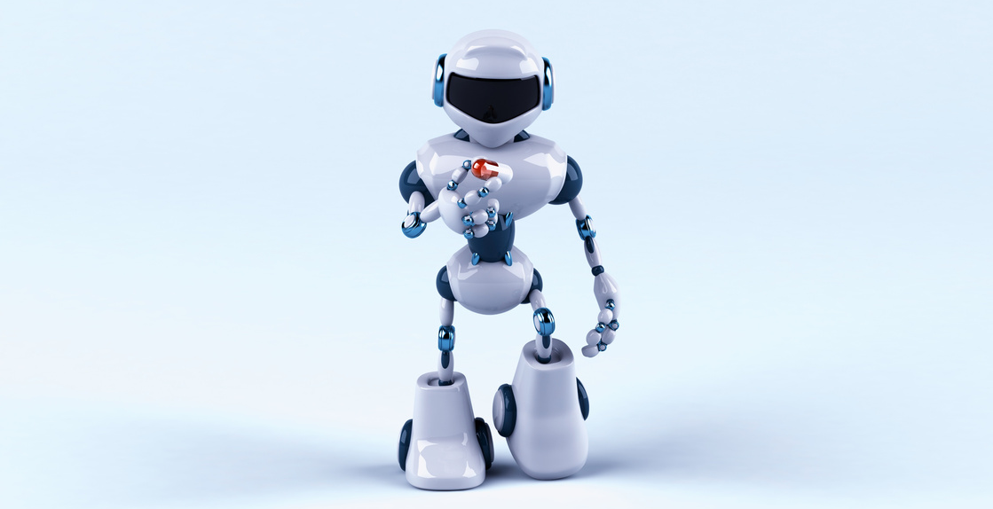
ABC Newspaper
July 17, 2025
WELCOME TO OUR
Fake newspaper
Utopia Unveiled: A Glimpse into a Workless Future
In a groundbreaking interview, Sarah Johnson, a content resident of the year 2045, expressed sheer happiness and contentment in a world where artificial intelligence has relieved humanity from the shackles of work. She declared,
With AI's widespread adoption, mundane jobs have become obsolete. From healthcare to manufacturing, robots and AI systems have taken over, ensuring efficiency and accuracy. People now dedicate their time to creative pursuits, personal development, and spending quality moments with loved ones. The future is bright, as humanity thrives in this AI-enabled utopia.
In this workless world, the concept of the 9-to-5 grind has vanished into the annals of history. With AI-powered systems managing production and logistics effortlessly, individuals have reclaimed their work-life balance. The economy has shifted to value social and environmental progress over profit, and the newfound freedom has allowed for an unprecedented focus on tackling global challenges, fostering innovation, and nurturing the human spirit. This harmonious coexistence between humanity and AI promises a future where the pursuit of dreams and passions takes precedence over the need to earn a livelihood, creating a society where fulfillment and happiness are the currency of choice.
"We're truly living our
best lives"
www.templateLAB.com
01

