Slide 1

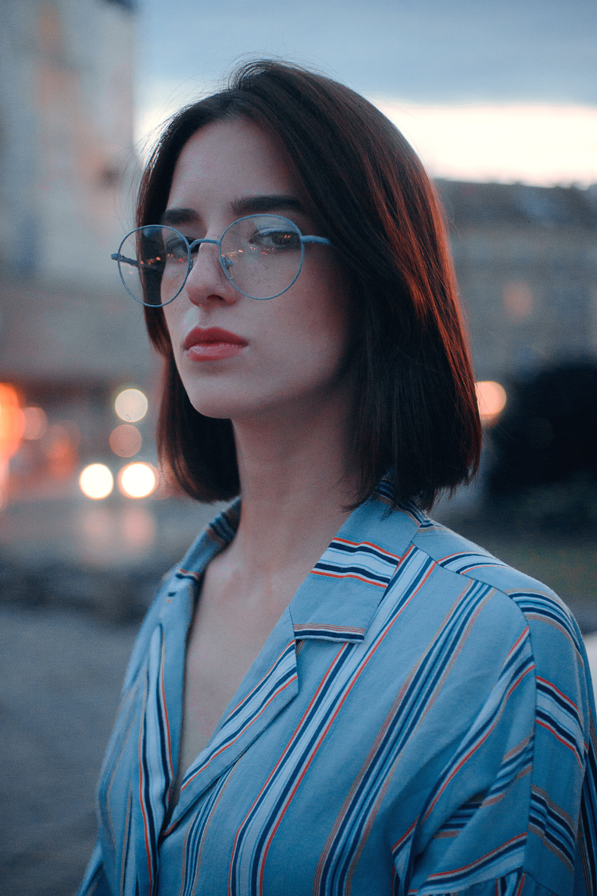


All about me adults
I’M ELENA
ABOUT ME
Hi there! It's great to meet you!
My name is Elena, and I'm a graphic designer who thrives on transforming concepts into captivating visuals, merging my professional expertise with a profound passion for creativity. Beyond my design world,
I embark on thrilling adventures, relishing the chance to connect with diverse individuals and absorb their inspiring stories and perspectives, enriching my creative reservoir.
My favorite Colors
THIS OR THAT
Coffee
Tea
Mac
PC
07.07.1997
Introvert
Extrovert
Age: 26 years old
Cats
Dogs
Height: 167 Cm
Sneakers
Sandals
Know more about my work at
www.imelena.com

