Slide 1






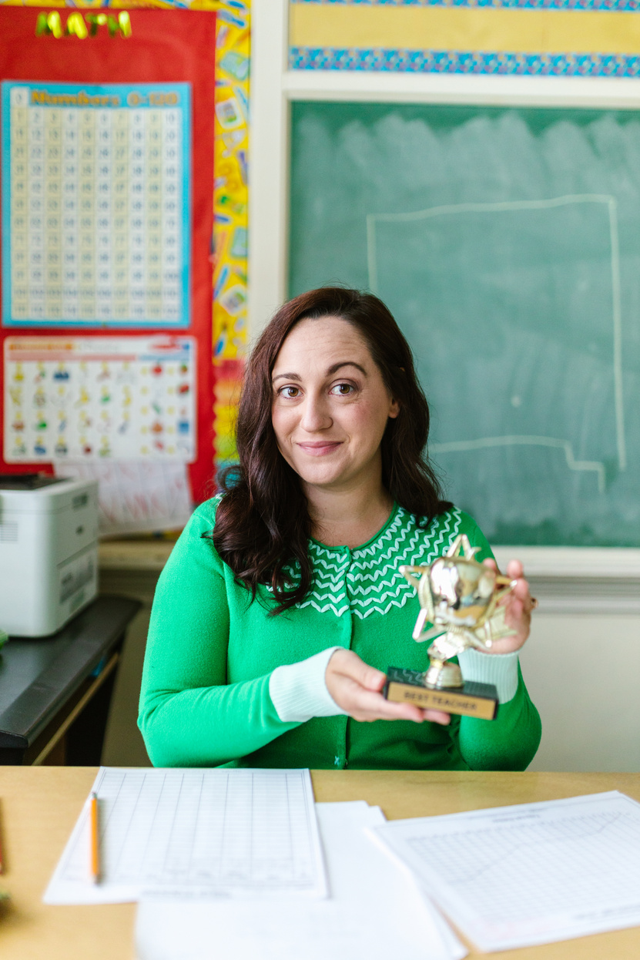







All about me teacher
Mrs. Carter
Introduction
Hi, I'm Mrs. Carter! I've been teaching for 20 years, 10 of
those as a second-grade teacher. I absolutely love science and
enjoy inspiring young minds to discover the wonders of nature. Learning is an adventure in my classroom, where we explore
and grow every day!
My Favorites
Contact
I adore cooking and
experimenting with recipes
hello@mrscarter.com
(123) 456-7890
Music and dance captivate me
AVAILABLE TIME
I'm passionate about photography
and capturing moments
9am - 5pm daily
I have a deep interest in
gardening and nurturing plants

