Slide 1
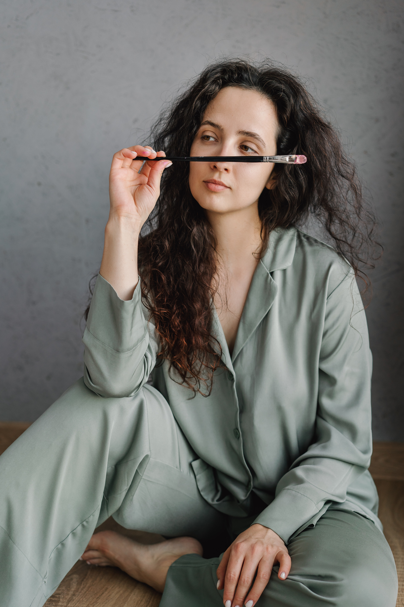
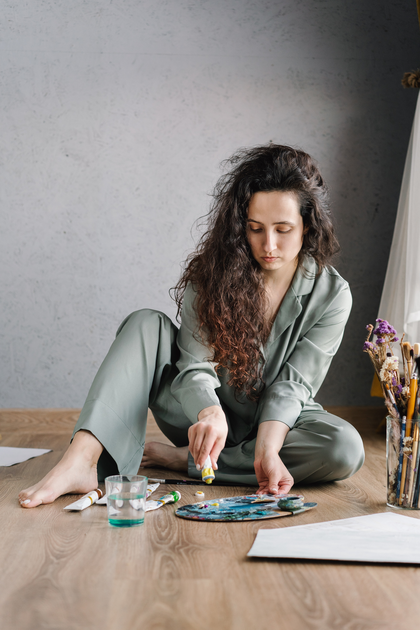

D.O.B
04/04/1994
Zodiac
Aries
Hometown
USA
Favorite Food
Tacos
Favorite Colors
Blue, Green
Favorite Animal
Cat
Favorite Scent
Freshly cut grass
ALL ABOUT ME POSTER
Hobbies
Ava Montgomery
Painting, Gardening
At the age of 29, I find myself deeply immersed in the world of artistry, a journey that has been both exhilarating and transformative. By day,
I embrace the vibrant realm of colors, textures, and boundless creativity that beckon to me.
As the sun gradually dips below the horizon,
my artistic exploration takes on a new dimension. I dive deep into the recesses of
my creative soul, daring to experiment with
a diverse array of mediums and techniques. The stillness of the night envelops me like a comforting shroud, allowing my thoughts to roam freely and inspiring me to push the boundaries of my artistic capabilities.
GET IN TOUCH WITH ME
hello@avamontgomery.com

