Slide 1
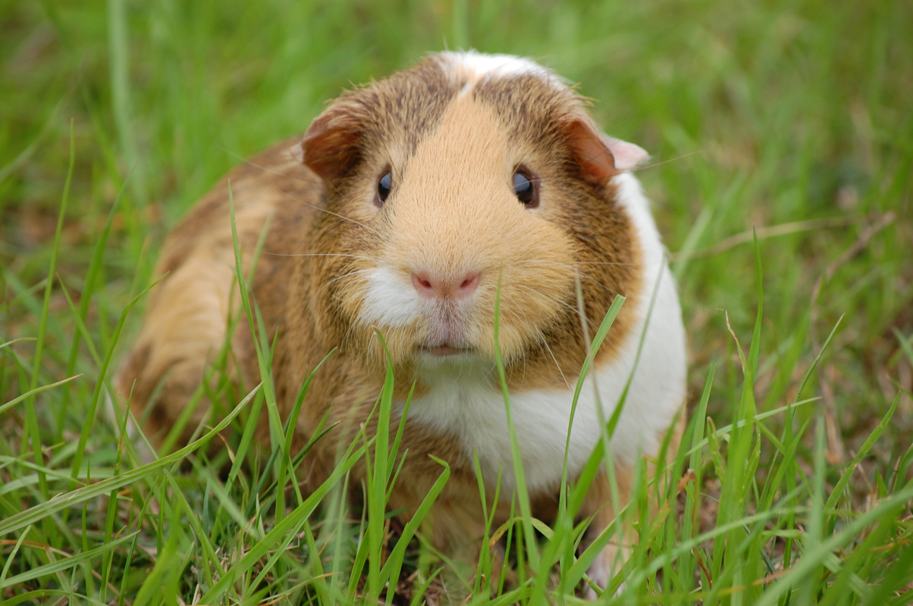

PLEASE HELP US FIND
OUR BELOVED COCOA
REWARD
$300
MISSING PET
Cocoa - The Guinea Pig
DISTINCTIVE FEATURES
Light brown fur, right cheek has a tear
LAST SEEN
456 Serene Avenue, Tranquil Town
IF YOU HAVE INFORMATION PLEASE CONTACT
+123-456-7890

