Slide 1
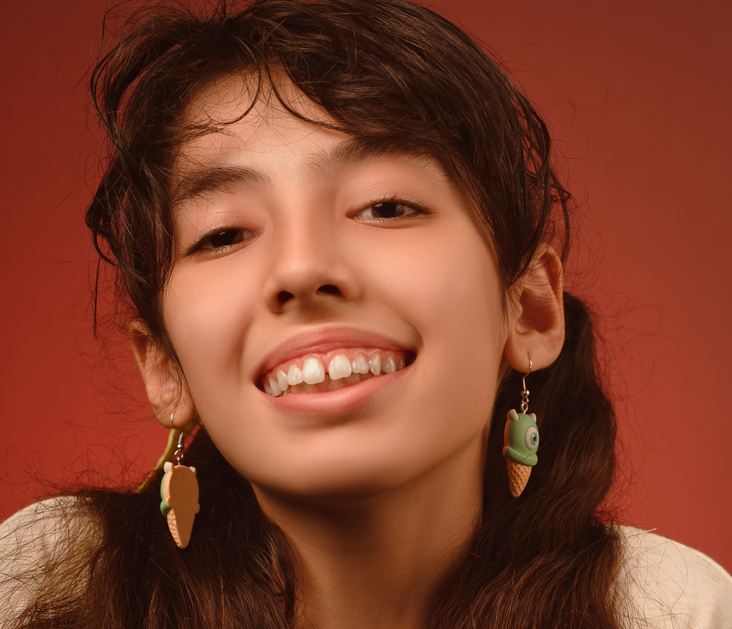
MISSING PERSON
ISABELLA GRACE
15 YEARS OLD
She was last seen at 11 p.m., 26 September
2023 at our house and then left home at
1 a.m. Our family did not know what she was wearing, only knowing that when she left, she was carrying a purple backpack and a golden phone.
150 LBS
5.6 FEET
BROWN EYES, BROWN HAIR
SPACED FRONT TEETH
For any information that can help us to find her, Please call her family at:
123-456-7890

