Slide 1
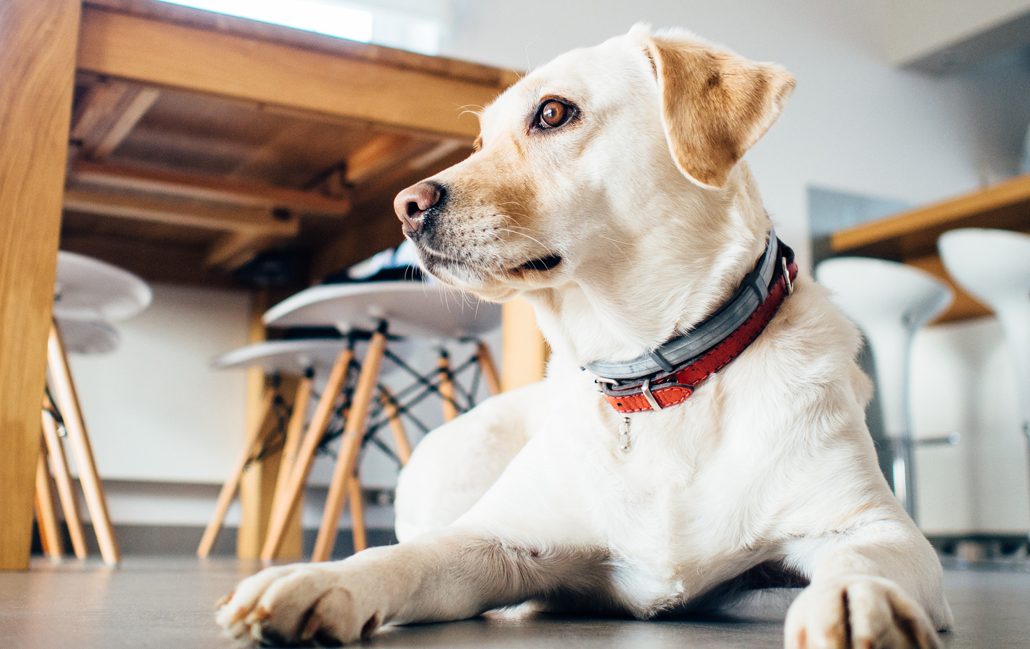
WE NEED YOUR HELP
MISSING DOG
REWARD
$400
MOLLY
LABRADOR RETRIEVER
FEMALE
4 YEARS OLD
She wears a red-gray necklace with a bell
Her right ear is missing a small piece
Her fur is yellow-white, slightly curly on the back
Please call us if you see her anywhere
so we can pick her up. We miss her a lot!
123-456-7890

