Slide 1
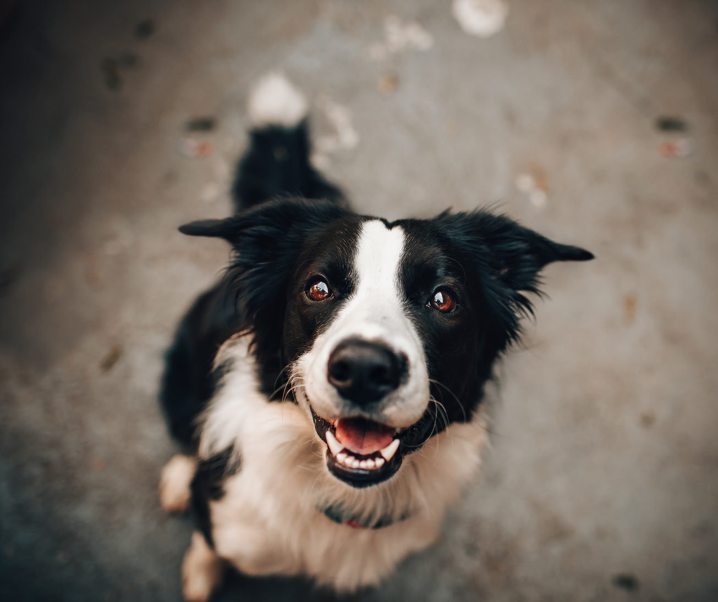
TOMMY
REWARD
$500
MISSING DOG
IF YOU HAVE ANY INFORMATION
PLEASE CALL - AUTHUR
LAST SEEN AT
Whispering Willow Park
+123-456-7890

